Slide 1
2019-2020 OAAP Training
Oklahoma Alternate Assessment Program

Slide 2
Today’s Agenda
Overview of the Oklahoma Alternate Assessment Program (OAAP)
OAAP Participation Requirements
Characteristics of students participating in an alternate assessment
Participation Cap and Waiver
OAAP Support and Resources
Implementing DLM Instructionally Embedded Assessments and Year-End Assessments

Slide 3
OAAP Overview
The Oklahoma Alternate Assessment Program (OAAP) is a component of the Oklahoma School Testing Program (OSTP) and is designed for students with the most significant cognitive disabilities.
These students generally represent 1% of the total tested population of students.

Slide 4
OAAP Participation
1. The IEP team must determine annually that the alternate assessment is most appropriate for the student; and
2. The student must meet the state-established criteria identified in The Criteria Checklist for Assessing Students with Disabilities on Alternate Assessments.

Slide 5
OAAP Participation Cont.

Slide 6
OAAP Participation - 1
Question 1: Adaptive Behavior Deficits
Does the student have significant intellectual disabilities AND significant adaptive behavior deficits?
This is a two part question and both parts must be answered “yes” in order for a student to meet the participation criteria.
Current and comprehensive adaptive behavior data should be used when making the assessment decision.
Adaptive behavior data should be available for all domains of the Adaptive Behavior Scale in order to be considered comprehensive.

Slide 7
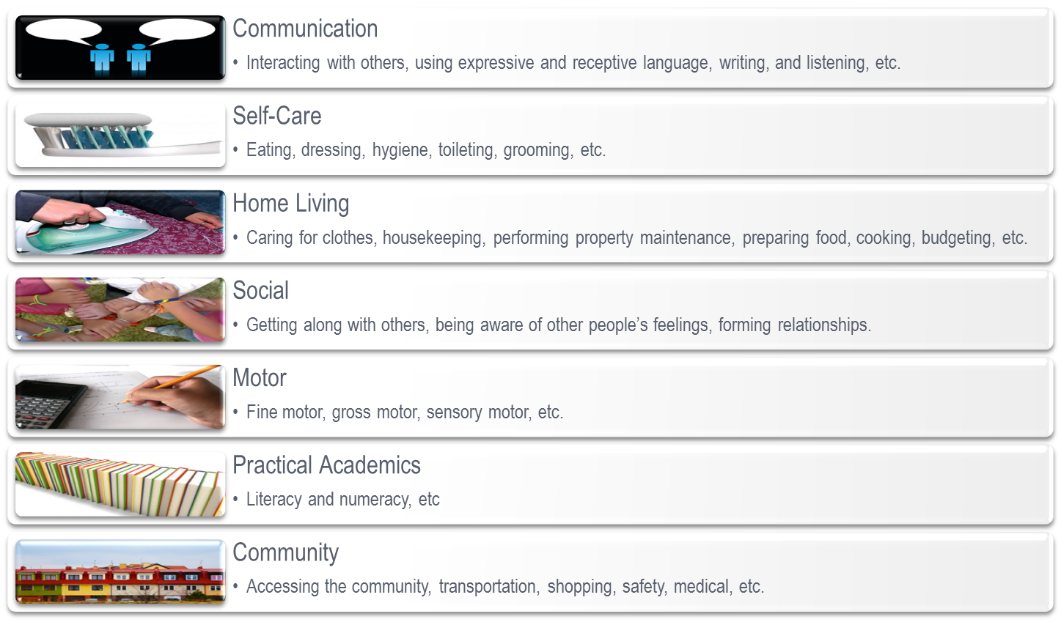
OAAP Participation - 2
Adaptive Behavior Domains
Communication
Daily Living Skills
Socialization
Motor Skills
Fine and Gross

Slide 8
OAAP Participation - 3
Question 2: The IEP
Does every section of the student’s IEP reflect the severity of the students’ disability?
Need for alternate achievement standards in ALL content areas is indicated.
Present Levels of Performance (PLOP) indicate severe/profound disability.
Annual goals and short-term objectives/benchmarks are present in IEP.
Accommodations/Modifications and Related/Supplementary Services indicate severe disability and the need for intensive supports.

Slide 9
OAAP Participation - 4
Question 3: Lifelong Supports
Does the IEP team feel extensive family/community supports (e.g. lifelong supported employment if student is capable of working, continuous caretaker required….) will be a requirement, regardless of modifications, accommodations or adaptations implemented in the student’s program?
Related to significant adaptive behavior deficits.
Students will need various supports throughout their lives.

Slide 10
OAAP Participation - 5
Question 4: Multiple Settings
Does the student require intensive and extensive direct instruction in multiple settings to acquire, maintain, generalize and demonstrate knowledge of skills?
Relates to intellectual functioning and the ability to generalize knowledge.
Frequent repetition and practice in multiple settings is required.

Slide 11
OAAP Participation - 6
Question 5: Based on student’s disability
The decision to place a student on the alternate assessment must be based on severe discrepancies in cognition and adaptive behavior. Students CAN NOT be placed on an alternate assessment because of poor reading skills, excessive absences, language, disruptive behaviors, emotional distress, OR poor performance on the regular assessment.

Slide 12
OAAP Participation - 7
Parents of OAAP Students
ESSA requires districts to inform parents when their child will participate in the OAAP.
Located in EdPlan and on the OAAP Website
Contact OSDE-SES for print requests: Abby.Johnson@sde.ok.gov

Slide 13
Definition of MSCD
State Definition of “students with the most significant cognitive disabilities” 34 CFR § 200.6(d)(1)
Students with the most significant cognitive disabilities have limited conceptual skills, written language skills, and understanding of numerical concepts such as quantity, time, and money. Vocabulary and grammar are quite limited and augmentative communication devices are often necessary to communicate with others. They tend to focus on present, everyday events and rarely attempt to analyze or expand on new ideas and concepts through spoken language. Skill acquisition and measurable gains on grade-level alternate academic achievements and require extensive, direct individualized instruction. These students require substantial supports for all activities of daily living including meal preparation, dressing, grooming, and personal hygiene. Their personal safety is dependent upon constant supervision and will be a concern throughout their lifetime.

Slide 14
Characteristics of OAAP Students
Available nationwide data reflects most students with significant cognitive disabilities are in the categories of intellectual disabilities, autism, and multiple disabilities.
These are not the only disability categories, but the most prevalent.

Slide 15
Characteristics of OAAP Students’ Communication Skills
Pre-symbolic: 10%
Symbolic (e.g., gestures, pictures, use of objects): 17%
Expressive (verbal or written words, signs, braille, and augmentative and alternative communication): 72%

Slide 16
Characteristics of OAAP Students’ Receptive Communication Skills
No evident response to stimuli: 3%
Show an alert response, but do not follow simple directions without support: 9%
Able to follow one- to two-step directions when provided cues (e.g., pictures, objects): 40%
Able to follow one- to two-step directions without cues: 48%

Slide 17
Participation Cap
The Every Student Succeeds Act (ESSA) places a cap on statewide participation in the alternate assessment at 1.0%
Participation is based off of each subject area: Math, English Language Arts, and Science and is based off the testing population for those subjects
Oklahoma’s participation percentage for the 2017-2018 school year was 1.48% in Math and Reading

Slide 18
Participation Cap - 1
Oklahoma State Department of Education was granted a waiver by USED for SY 2017-2018
OSDE must:
Demonstrate growth towards 1.0%
Provide appropriate oversight
Professional Development
Onsite Training
Justification Statements
Targeted Desktop Monitoring

Slide 19
Participation Cap - 2
Moving Forward 2019-2020
Consider the most appropriate assessment for each student
Principles of Universal Design for Learning are incorporated into the OSTP
Provide appropriate accommodations in the classroom
Curriculum must align to alternate academic achievement standards with short term goals
OSDE-SES will request a waiver for the 2018-2019 SY in the fall of 2019

Slide 20
Participation Cap - 3
Moving Forward 2019-2020 (cont.)
Ensure your staff understands who are the students with the most significant cognitive disabilities
Pepper Training available in EdPlan
IEP team members should understand the purpose of the alternate assessment
Analyze Data: Unique Reasons
Contextual, Population size
Unusual spikes

Slide 21
Dynamic Learning Maps (DLM)
The Oklahoma Alternate Assessment Program (OAAP) is delivered through the Dynamic Learning Maps (DLM) Alternate Assessment, which is an online platform.
Oklahoma is in its 5th year of implementing the OAAP through DLM

Slide 22
DLM Offers Two Types of Testing
Year End Model – Required
Used for federal and State accountability
Testing Window: 3/9/2020-5/1/2020
Instructionally Embedded – Optional
Highly Recommended
Designed to integrate classroom instruction and assessment throughout the year
Testing Window: 9/9/2019-02/26/2020

Slide 23
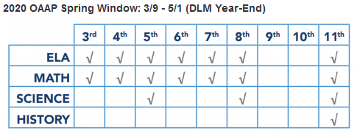
DLM Testing Schedule
The OAAP mirrors the Oklahoma State Testing Program (OSTP) in regards to grade levels and subjects assessed.

Slide 24
OAAP Resources
District-Level Resources for District Test Coordinators/Directors/Teachers
ELA/Math/Science resource pages
Educator Resource videos
DLM professional development
ELA familiar texts
Requirements for Test Administrators
Must be completed annually, prior to administering the OAAP

Slide 25
Special Education Homepage

Slide 26
Alternate Assessment Homepage

Slide 27
DLM Resources
DLM Resources
Educator Portal Link
Blueprints/Manuals/Guides and Trainings

Slide 28
OAAP Homepage
OAAP Updates & Memos
Add yourself to the mailing list for updates

Slide 29
OAAP Support
OSDE Special Education Services
Kurt (OAAP specialist): (405)521-2081 or Kurt.Johnson@sde.ok.gov
Kristen (Specialist): (405)522-1463 or Kristen.Coleman@sde.ok.gov
Jenae (behavior specialist): (405)522-3255 or Jenae.Tindell@sde.ok.gov
DLM Assistance and Support
Assistance with student rosters/enrollment
(844) 261-6481 or DLM-support@ku.edu

Slide 30
I-SMART Pilot Test
Assessment grant through the U.S. Department of Education
November 5th to December 20th
Extending the Science Learning Map
Developing new testlests with engagement features
Interested in participating? Email Kurt.Johnson@sde.ok.gov

Slide 31
OK Alternate Assessment Program
Oklahoma State Department of Education
© 2019 Center for Accessible Teaching, Learning, and Assessment Systems (ATLAS)
Notes:
Welcome! This presentation is entitled, “Essential Elements and Mini Maps,” which are two of the most important components of the DLM alternate assessment because of the instructional value they bring to teachers and students.

Slide 32
Objectives
Student Upload & Tasks in Educator Portal
Benefits of using instructionally embedded assessments
Overview of the new Instruction and Assessment Planner
Released testlet examples
Review of Spring Assessment window
Review the instructional materials provided
Notes:
There are two main purposes of this training: the first is to understand why a teacher would want to use instructionally embedded assessments, and then the second is to learn the steps involved in the process.

Slide 33
Verify Student Data and Create Rosters
District data managers
Upload enrollment files for test administrators (Completed 8/27)
Test administrators
Check rosters and student information
Notify the data manager if student information is inaccurate
Notes:
Before there is any student information in Educator Portal, state or district data managers must upload the information to Educator Portal. However, the test administrator must check that information to make sure it is accurate. The test administrator needs to make sure every student to be tested is listed and that no extra students appear on the roster. Then check each student’s information, including the state ID, first and last name, and grade. The test administrator should contact the district data manager if corrections or additions are needed.

Slide 34
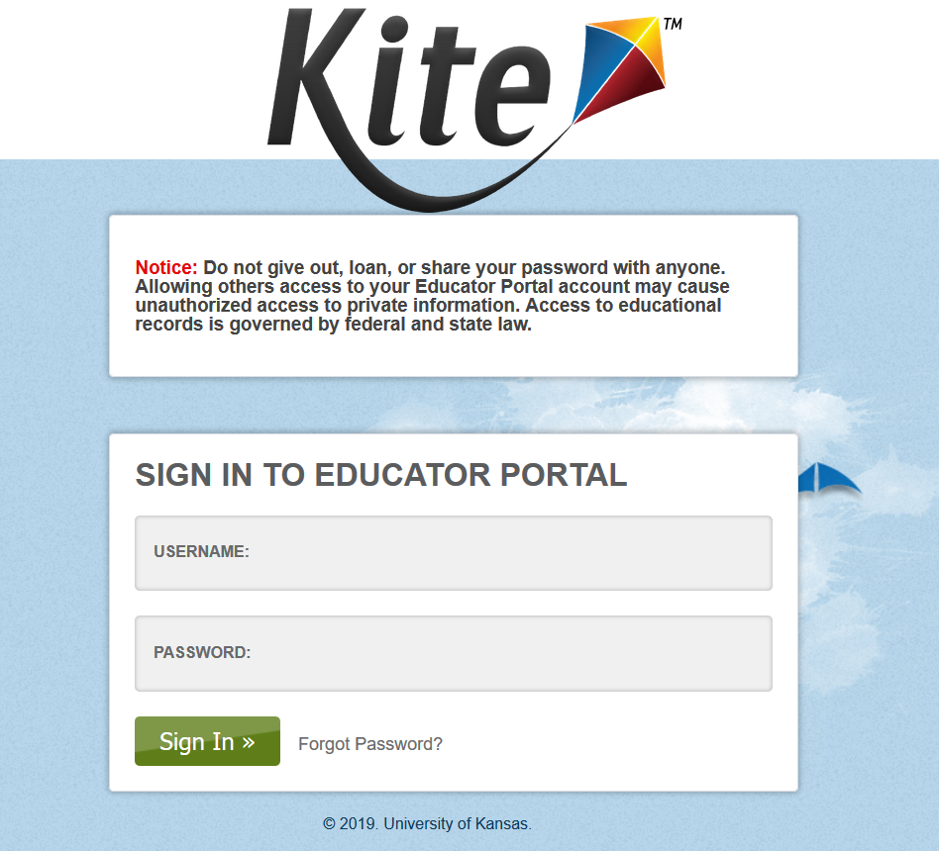
Tasks in Educator Portal
TEACHERS/TEST ADMINISTRATORS
Log into Kite Educator Portal
Electronically sign the Test Security Agreement
Verify roster and student information
Complete the PNP and First Contact survey for each student
Complete Test Administration Training through Moodle
Notes:
Again, the first thing the test administrator must do in Educator Portal is sign the Test Security Agreement. Next, the test administrator should check available rosters to make sure all of the students to be assessed are listed and that each student’s information is accurate. Then the test administrator must customize each student’s PNP as needed and complete each student’s First Contact survey, which will be discussed over the next few slides.
Please note that on the State pages of the DLM website, there is an Educator Portal User Guide under the Manuals and Blueprints tab and helplet videos regarding Educator Portal, the PNP, and the First Contact survey under the Resources for Educators and District Staff tab. These resources provide step-by-step instructions, often with screenshots, for completing tasks and accessing student information in Educator Portal.

Slide 35
Requirements for Use of Instructionally Embedded Assessment
Teacher must
Complete Required Test Administrator Training
Sign Security Agreement
Have updated Kite Student Portal installed on testing device
Students must
Be enrolled and rostered to teacher
Have First Contact survey and PNP completed
*These are the same requirements for year-end testing.

Slide 36
Complete the PNP and First Contact Survey for Each Student
Personal Needs and Preferences (PNP)
The test administrator selects the accessibility supports a student needs.
First Contact survey
The test administrator answers questions about the student.
The system uses the test administrator’s responses to determine the appropriate linkage level for the student’s first testlet.
*These are the same requirements for year-end testing.
Notes:
Module 2 addressed the various accessibility supports available in the DLM alternate assessment. In the Personal Needs and Preferences profile within Educator Portal, the test administrator who is most familiar with the student selects the supports for each student as agreed upon by the IEP team. This is the test administrator’s opportunity to customize the assessment by selecting the accessibility supports each student will need in order to access their testlets.
The assessments are then delivered to the student using Student Portal, which includes the chosen supports. By combining the supports in Student Portal along with allowable assessment practices and flexible test administration procedures, a test administrator can help to eliminate barriers, allowing students to demonstrate what they know and can do with the most appropriate level of independence, thus improving student success.
The test administrator must also complete a First Contact survey for each student in Educator Portal. Remember the First Contact survey is where the test administrator supplies information about each student’s learning characteristics so that the system can determine which linkage level is best for the student’s first testlet. Therefore, an initial testlet will not be available for a student until the test administrator completes the First Contact survey for that student.
Although this training does not show how to fill out the Personal Needs and Preferences profile or the First Contact survey, a Personal Learning Profile training is available on the state pages of the DLM webpage. Several states require completion of the Personal Learning Profile training as a part of this required Test Administrator Training. If required, the training will appear in Moodle after the completion of the Module 4 post-test.

Slide 37
First Contact Survey
Must be submitted every year for each student
Includes questions about
Sensory and motor characteristics
Computer access
Attention
Communication
Academic skills
Determines linkage level for first testlet
*These are the same requirements for year-end testing.
Notes:
Again, a First Contact survey must be completed for each student before the first testlet is administered each year. The survey has questions regarding the student’s sensory and motor characteristics, computer access, attention, receptive and expressive communication modes, and academic content skills. The system will save a student’s First Contact survey from one year to the next, but the teacher must update and resubmit it each year.
The test administrator must answer all required questions in order for the system to acknowledge the First Contact survey as complete. The primary reason the First Contact survey is so important is because it provides the system with information to deliver a testlet at the linkage level most appropriate for each student in a subject area. After the student completes a testlet in a subject area, the system analyzes the student’s performance on the testlet to determine if the next testlet will be at the same linkage level, one level lower, or one level higher.

Slide 38
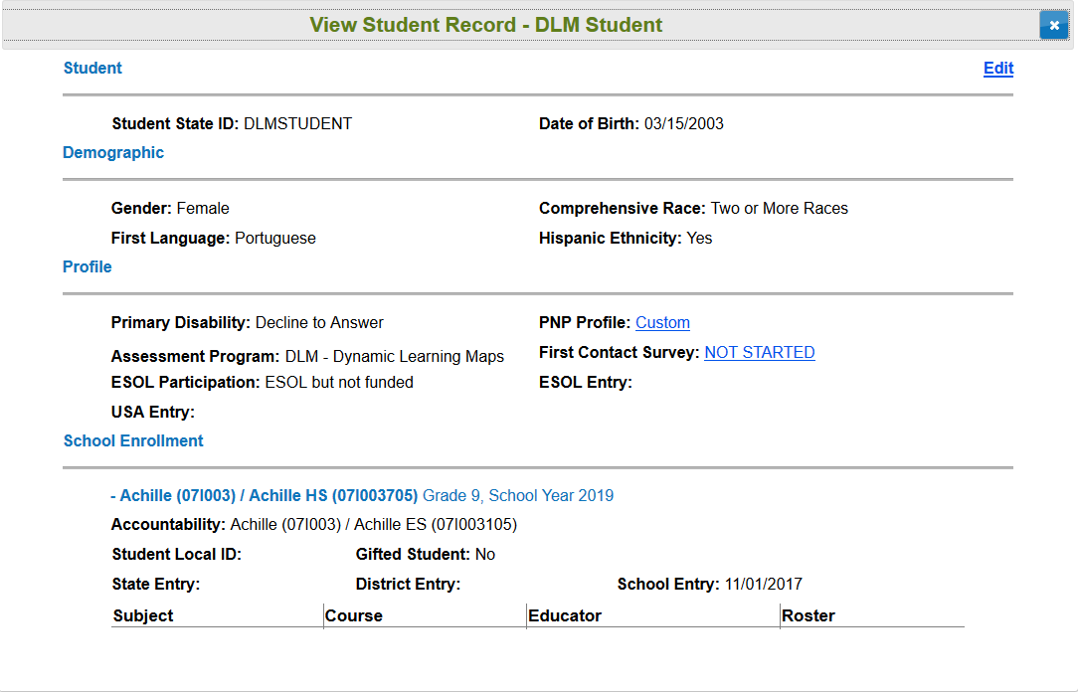
View Student Record
Test administrator view
Notes:
This is a screenshot of a sample student record as it appears in Educator Portal. It shows the type of personal information found in Educator Portal, which the test administrator will need to confirm is accurate.
Before completing the PNP, the link will read “No Settings.” After it has been completed, the link will read “Custom,” indicating that the student’s Personal Needs and Preferences profile has been customized. Similarly, before completing a student’s First Contact survey, the link will read “Not Started.” Once it is completed, the link will read, “Completed,” meaning all of the required questions in the survey have been answered.
The list of questions that appear in the First Contact survey are included in the appendix of the Test Administration Manual.

Slide 39
using Instructionally Embedded Assessments
DLM® Alternate Assessment
© 2019 Center for Accessible Teaching, Learning, and Assessment Systems (ATLAS)
Notes:
This training provides step-by-step instructions for how to use the instructionally embedded assessments.

Slide 40
What Are Instructionally Embedded Assessments?
Instructionally Embedded Assessments are
computer-based assessments intended to be integrated with classroom instruction
administered during a fall/winter assessment window from September 9, 2019 – February 26, 2020
Notes:
Instructionally embedded assessments are very much like the assessments students take during the spring assessment window. However, instructionally embedded assessments are administered during the fall and winter months and are intended to be integrated with classroom instruction.

Slide 41
Why Use Instructionally Embedded Assessments?
Benefits for Teachers
Instructional guidance
Experience administering testlets
Benefits for Students
Experience taking testlets that are customized to individual needs
More opportunities to show what they know and can do
Immediate feedback
Integrate instruction with assessment seamlessly
Notes:
Both teachers and students benefit from using instructionally embedded assessments. The following slides will address these benefits in more detail, but as an overview, the instructionally embedded assessments provide opportunities for teachers and students to use the DLM system ahead of the spring assessment window to hopefully build familiarity and confidence while establishing a mutualistic relationship between instruction and assessment.
The primary intention of the Instructionally Embedded assessments is to connect instruction and assessment to a student’s individual goals. It may be tempting to think the instruction-assessment relationship encourages “teaching to the test,” but it is actually the other way around. They encourage assessing a student on what the student was taught using a cycle of instruction and assessment that gives students with the most significant cognitive disabilities opportunities to show what they know and can do. The testlets are used as snapshots of what a student has learned through the teacher’s rich instruction in order to provide insight as to whether a student needs continued instruction for a particular skill or concept or is ready for instruction on a new skill or concept.
The instructionally embedded assessment is structured around the English language arts and mathematics test blueprint requirements. Teachers make choices within the blueprint requirements based on each student’s academic goals for instruction and assessment.
Instructionally embedded assessments are administered in both a fall and spring window during the school year as the assessment is intended to be integrated within classroom instruction.

Slide 42
Instructionally Embedded Assessments
Are taken any time during the window when a student is prepared, based on the teacher -provided instruction
Are an individual assessment, not a group assessment where the class takes the same test at the same time.
Notes:
The assessment is delivered in testlets. Each testlet assesses one Essential Element at one Linkage Level except for writing. Instructionally embedded assessments are administered after the student has received instruction an Essential Element or Essential Elements. Each student is assessed individually even if in the same grade and classroom. Since not all students will have the same academic goals, have the same Essential Elements chosen, receive the same instruction or progress at the same rate, the assessment is different for each student and delivered individually at the appropriate time.
Instructionally embedded assessments should be administered throughout an assessment window. Students with the most significant cognitive disabilities are best able to demonstrate what they know and can do when a cyclical approach to their instruction, assessment, and evaluation is used, as opposed to being assessed at the end of a semester or school year on a mass of instruction they must recall from prior weeks and months.

Slide 43
Using Instructionally Embedded Assessments
Identify student’s knowledge, skills, and understanding relative to grade-level targets
Utilize student progress reports to
Evaluate if additional instruction is needed
Determine the student is ready to move on to another linkage level or Essential Element
Notes:
Instructionally embedded assessments can be used to identify a student’s knowledge, skills and understanding relative to the grade-level targets, or Essential Elements.
The student’s progress report may be used at any time within the cycle to evaluate if additional instruction is needed or the student is ready to move on to another linkage level or Essential Element.

Slide 44
Benefits for Teachers – Instructional Guidance
Instructionally embedded assessments
Promote the use of mini-maps
Allow teachers to choose Essential Elements and linkage levels
Give teachers time to develop and implement instruction for the chosen Essential Elements
Help teachers understand how the skills and understandings across Essential Elements often overlap
Notes:
Recall that mini-maps show the skills and understandings involved at each linkage level for an Essential Element and the multiple pathways of learning students may take from one level to another. The instructional plans created when using the instructionally embedded assessments process promote the use of the mini-maps so that a teacher can gauge any skills and understandings a student already has and then identify those the student would need to learn in order to progress. In this process, teachers are given the flexibility of choosing the Essential Elements and linkage levels for each of their students, using professional judgment. Then, throughout the rather lengthy instructionally embedded assessment window, teachers can develop and implement instruction for their students. As a teacher becomes more and more familiar with the mini-maps for the Essential Element, it will become apparent that many skills and understandings overlap from one Essential Element to another, even across grades. This shows how it is not necessary nor is it intended to teach Essential Elements or the linkage levels thereof, in isolation. This is, of course, not exclusive to the instructionally embedded assessments, but, again, the process teachers are led to use during the instructionally embedded assessment window brings these aspects of the assessment to light and therefore help inform instructional planning.

Slide 45
Benefits for Teachers – Test Admin Practice
Instructionally embedded assessments
Give teachers experience administering testlets
Allow teachers to adjust instructional plans and reassess students as needed
Notes:
For each Essential Element and linkage level a teacher chooses during the instructionally embedded assessment window, the teacher develops and implements instruction. After enough instruction has been provided, which is determined by the teacher, a testlet is then administered for the chosen Essential Element and linkage level. This gives the teacher an opportunity to gain experience administering testlets to students, using their individual accessibility features and other supports. Teachers are also able to adjust their plans and reassess a student as needed, such as at a different linkage level for the Essential Element or for a different Essential Element.

Slide 46
Benefits for Teachers – Feedback
Instructionally embedded assessments provide immediate feedback via an individual student report

Slide 47
Benefits for Students – Test Admin Practice
Instructionally embedded assessments
Provide opportunities for students to take testlets customized for individual needs
Provide more opportunities for students to show what they know and can do
Notes:
As mentioned earlier, the released testlets DLM provides use demo student credentials. Instructionally embedded assessments are accessed using a student’s own credentials. Therefore, the testlets students take during the instructionally embedded window are customized for the student. The Essential Element and linkage level of each testlet is chosen by the teacher, and the accessibility features are activated by the teacher. This gives the student the opportunity to take testlets that are very similar to the testlets to be taken during the spring assessment window. Since the instructionally embedded assessment window spans the fall and into the winter months, students have considerable time to show what they know and can do. The individual progress reports help the teacher track a student’s progress and determine further instruction and assessments as needed.

Slide 48
Other Benefits of Instructionally Embedded Assessments
No set limit on the number of testlets that must be taken
Only one Essential Element is assessed per testlet
Performance on instructionally embedded assessments does not impact a student’s year-end score report
Notes:
There is no set number of testlets that must be taken during the instructionally embedded assessment window. During the spring assessment window, students will take a set number of testlets, which varies by grade and subject area. Testlets during the spring assessment window cover the entire test blueprint for a grade and subject area. So, a single testlet during the spring assessment window may address more than one Essential Element, although all items within the testlet will be written at the same linkage level and the testlet will still have a limited number of items. Instructionally embedded testlets assess only one Essential Element at a time. Finally, student performance on instructionally embedded assessments does not impact the student’s year-end score report. Therefore, teachers and students should feel relaxed and positive about using the instructionally embedded assessments as practice.

Slide 49
Doesn’t DLM Alternate Assessment Provide Practice Activities and Released Testlets?
Yes, practice activities and released testlets are available and encouraged to be used, BUT they are
Geared more toward orientation to the navigation and accessibility features of the system
Accessed using demo student credentials and are therefore not customized to an actual student
Notes:
DLM provides Practice Activities and Released Testlets, which teachers and students can use to become familiar with the layout and content of testlets. However, the practice activities and released testlets are geared more toward building familiarity with the navigation features of the system and testing out the way different accessibility features affect a student’s experience when taking a testlet. They are accessed using demo student credentials, not an individual student’s own credentials. Therefore, they are not customized to an actual student.

Slide 50
Key Differences
Instructionally Embedded Assessments | Spring Assessments
The teacher chooses the Essential Elements and linkage levels. | The system chooses the Essential Elements and linkage levels.
There is no set number of testlets that must be completed. | A set number of testlets must be completed, which varies by grade and subject area.
Each time a student completes a testlet, a student progress report is generated. | A student progress report is not provided after the student takes each testlet.
Student performance does not impact the year-end score report. | Student performance used for the year-end student score report.
Notes:
This slide outlines the key differences between the instructionally embedded assessments and the spring assessments. Remember that in addition to providing students with opportunities to practice taking testlets customized to individual needs, the instructionally embedded assessments are intended to be used in conjunction with instruction, as their name indicates. They help inform instruction and can be used to help educators better understand the skills and understandings assessed as well as the routes to higher levels of learning.

Slide 51
Cautions
Should be used after instruction has occurred
not appropriate to use a testlet to check baseline prior to instruction
not repeated “progress monitoring” events
Not benchmarks or interim tests
Results do not predict how a student will perform later.
Notes:
Instructionally embedded assessments should only be used after instruction has occurred. If instruction has not taken place, there is nothing to assess. These assessments are not progress monitoring events nor are they pre-test vs. post-test measures. They are also not benchmarks or interim tests, and results do not necessarily predict how a student will perform later and should not be used as such.

Slide 52
INSTRUCTIONALLY EMBEDDED WINDOW
Notes:
The following slides will provide more detailed information about the instructionally embedded assessments window.

Slide 53
Instructionally Embedded Assessment Window
September 9, 2019 – February 26, 2020
The teacher
uses the Instruction and Assessment Planner, accessed in Educator Portal
chooses Essential Elements for instruction and assessment
Chooses the linkage levels
plans and implements instruction
adjusts plans and provides additional instruction as needed
Notes:
As its name implies and as was discussed in the previous section of this training, the instructionally embedded assessments are used in conjunction with instruction. They require the teacher to use the Instruction and Assessment Planner, which is accessed in Educator Portal. The teacher starts by using the test blueprint documents to choose Essential Elements. The teacher develops instructional plans for a student by using each Essential Element’s mini-map to choose a linkage level for the student. Then the teacher provides instruction to the student. Students often require more than a single lesson and may need repeated instruction over time in order to attain the skills and understandings of a linkage level or progress to higher linkage level. Teachers evaluate the effectiveness of their own plans and can make adjustments and provide additional instruction as needed.

Slide 54
Instructionally Embedded Assessment Window
September 9, 2019 – February 26, 2020
The teacher
administers a testlet after instruction on the chosen Essential Element
done in Kite® Student Portal
uses the Instruction and Assessment Planner to make decisions about further instruction
Notes:
When the teacher feels the student is ready to be assessed on an Essential Element, a testlet is administered. One testlet per chosen Essential Element is delivered at a time. Over the course of the instructionally embedded assessment window, each student will be assessed at varying linkage levels for varying Essential Elements, as chosen by the teacher when creating instructional plans for each student. However, the nature of the instructionally embedded assessments is to show the close relationship between assessment and instruction. While teachers are not to try and “teach to the test,” they are encouraged to use the instructionally embedded assessments to help make informed decisions about instruction. As a student completes testlets during the instructionally embedded assessments window, teachers can use the Instruction and Assessment Planner to decide when a student needs further instruction for an already chosen Essential Element or is ready to move on to another Essential Element.

Slide 55
Using Instructionally Embedded Assessments
Identify the student’s current knowledge and understandings relative to grade-level targets following instruction.
Check the student’s readiness for
a higher linkage level
a different Essential Element
Notes:
Instructionally embedded assessments give the teacher an opportunity to identify the student’s current knowledge and understandings relative to grade-level targets and gauge a student’s readiness for a higher linkage level and/or a different Essential Element.

Slide 56
Instructionally Embedded Assessment: Instruction and Assessment Process
Choose
Plan
Instruct
Assess
Repeat this process throughout the instructionally embedded assessments window.
Notes:
To summarize the process for using the Instruction and Assessment Planner, choose an Essential Element and linkage level, use the mini-map for the Essential Element to plan instruction, provide instruction targeting that Essential Element, return to the Instruction and Assessment Planner to assign a testlet and receive the TIP (or makes changes to the plan and repeat the necessary steps), then assess the student.
Reference this training and the helplet video when getting started in the Instruction and Assessment Planner.

Slide 57
DLM blueprints
Notes:
Understanding the ELA and mathematics blueprints is important in making choices for instruction and assessment.

Slide 58
ELA and Mathematics Blueprint
1. Choose where to begin
Blueprints a list of Essential Elements in each claim and conceptual area available for instruction and assessment
Includes the criterion for Essential Element selection to meet assessment requirements
Can be found: https://dynamiclearningmaps.org/oklahoma
Notes:
The blueprint refers to the pool of available Essential Elements in each claim and conceptual area, and the requirements for coverage within each conceptual area. A student must meet blueprint requirements for ELA and mathematics in both the fall and spring assessment windows.

Slide 59
ELA and Mathematics Blueprint
The Blueprint for ELA and mathematics has been updated
Overall fewer Essential Elements
Grade 6 and Grade 9 writing have one new Essential Element
Testlets will assess one Essential Element
Exception all writing Essential Elements will be assessed in one testlet

Slide 60
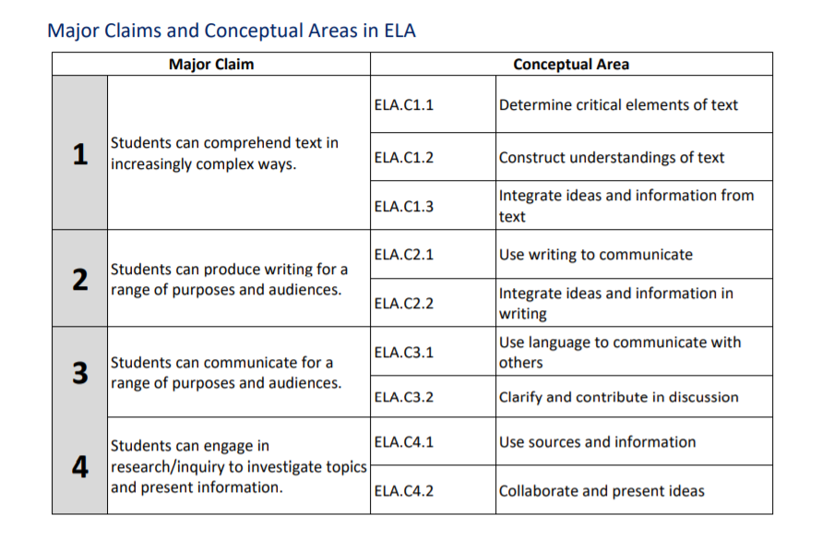
Claims and Conceptual Areas in ELA

Slide 61
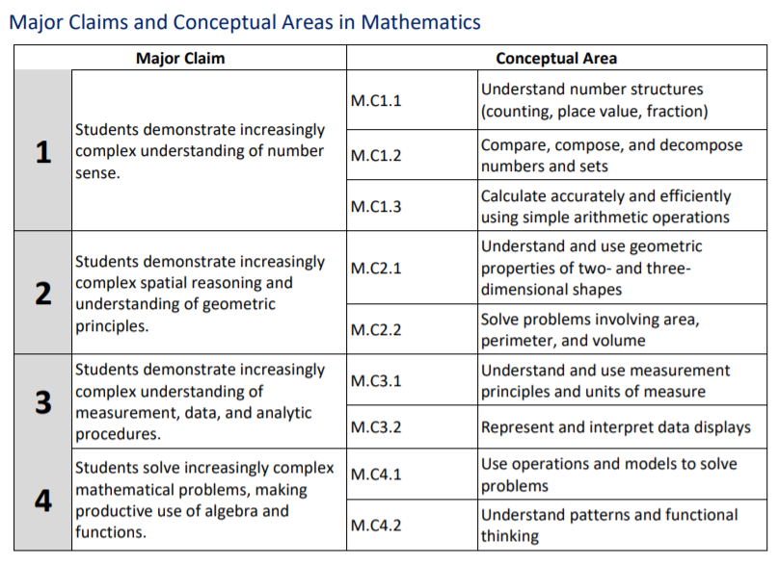
Claims and Conceptual Areas in Mathematics

Slide 62
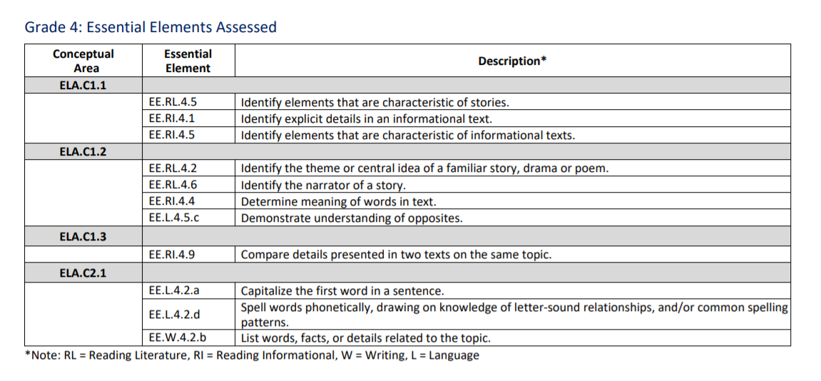
DLM ELA Blueprint Example
Specific Essential Elements assessed in each grade are listed in tables
Notes:
YE ELA blueprint for grade 4

Slide 63
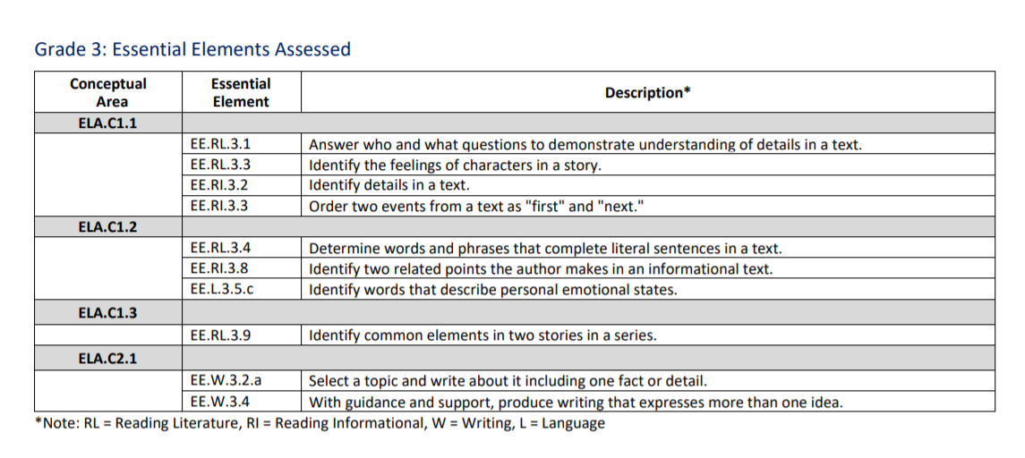
Review the Year-End Test Blueprint
Notes:
In this example I have reviewed the blueprint and selected 3 Essential Elements to teach together in a unit. They are Identify explicit details in an informational text, Compare details presented in two texts on the same topic and then for writing list words, facts, or details related to the topic.

Slide 64
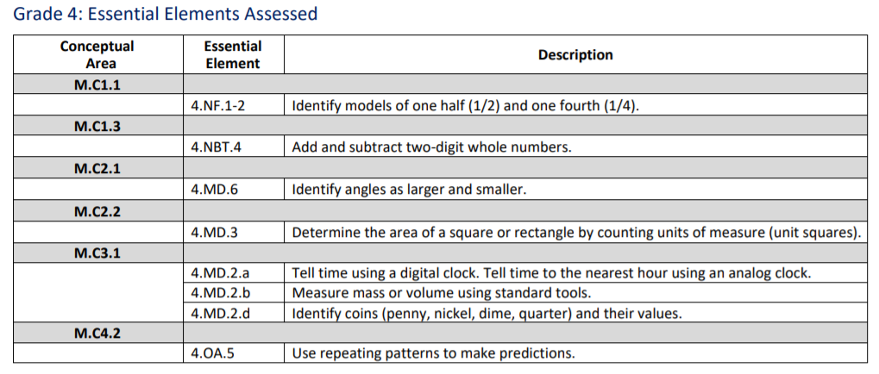
DLM Mathematics Blueprint Example
Specific Essential Elements assessed in each grade are listed in tables

Slide 65
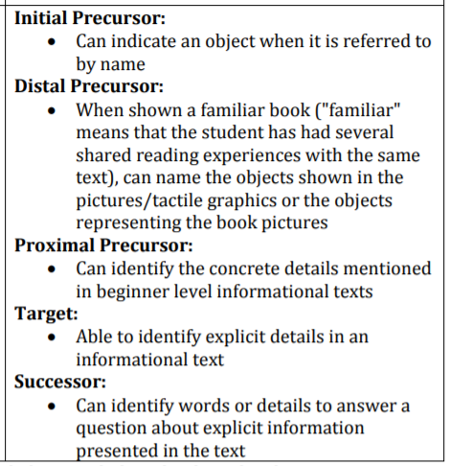
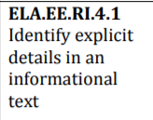
Linkage Levels within Essential Elements (ELA Example)
Essential Element
Linkage Levels
After selecting an Essential Element, the linkage level is selected for instruction and assessment.
Notes:
Each Essential Element in ELA and mathematics has five linkage levels. When planning instruction and assessment for an Essential Element the teacher must consider which linkage level would provide the student appropriate goal and challenge.

Slide 66
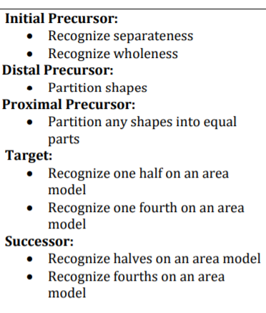
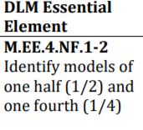
Linkage Levels within Essential Elements (Math Example)
Essential Element
Linkage Levels
After selecting an Essential Element, the linkage level is selected for instruction and assessment.
Notes:
Each Essential Element in ELA and mathematics has five linkage levels. When planning instruction and assessment for an Essential Element the teacher must consider which linkage level would provide the student appropriate goal and challenge.

Slide 67
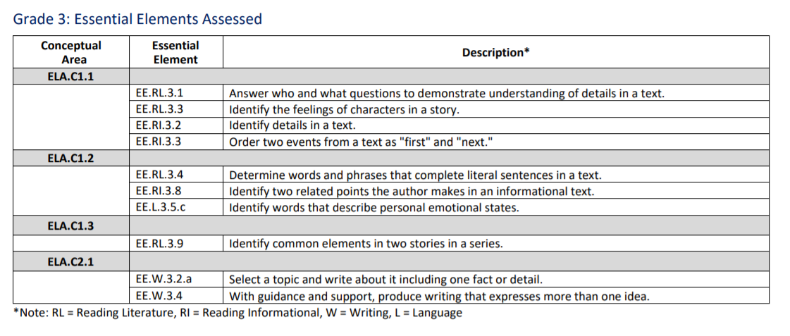
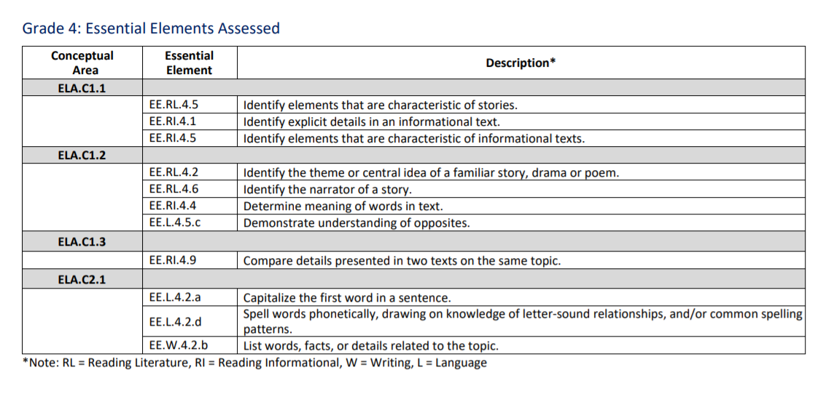
Creating Instructional Units In Your Classroom
ELA Grade 3
ELA Grade 4
Grade 3 ELA: EE.RI.3.2
Identify details in a text
Grade 4 ELA: EE.RI.4.1 and EE.RI.4.9
Use details from the text
Notes:
When thinking about instructional units in a multi-grade level classroom, it is beneficial to first look at all the essential elements and blueprint requirements needed for all students.
For instance, if the teacher had grades 3 and 4 in the classroom, they might want to combine EE.RI.3.2 from grade 3 and either EE.RL.4.1 or EE.RL.4.3 when teaching because they all are working on identifying and using details in a text. To meet the exact blueprint requirement, a teacher may need to expand on the lesson for the higher grade levels, however the bulk of instruction on identifying details in a text can be taught to all grade levels.

Slide 68
Creating an Instructional Unit in Your Classroom
Notes:
Several Essential Elements can be combined into one instructional unit. In this example, four Essential Elements are included in the lesson:
Answer who and what questions to demonstrate understanding of details in a text
Identify details in a text
Select a topic and write about it including one fact or detail

Slide 69
Creating an Instructional Unit in Your Classroom
Mathematics Grade 3
Mathematics Grade 4
Notes:
Likewise in mathematics, addition and subtraction is assessed in both grade 3 and 4. While grade 4 extends to addition and subtraction using two-digit whole numbers, a majority of the teacher’s instruction on addition and subtraction can be taught to students in both grade levels.

Slide 70
Instruction and Assessment Process
Choose
Plan
Instruct
Assess
Repeat this process throughout the instructionally embedded assessments window.
Notes:
To summarize the process for using the Instruction and Assessment Planner, choose an Essential Element and linkage level, use the mini-map for the Essential Element to plan instruction, provide instruction targeting that Essential Element, return to the Instruction and Assessment Planner to assign a testlet and receive the TIP (or makes changes to the plan and repeat the necessary steps), then assess the student.
Reference this training and the helplet video when getting started in the Instruction and Assessment Planner.

Slide 71
Steps to using Instructionally embedded assessments in the instruction and assessment planner
Notes:
Now it’s time to take a closer look at the steps involved to take advantage of the instructionally embedded assessments.

Slide 72
Access to the Instruction and Assessment Planner
Instructionally Embedded Window must be open
Teacher must have
Signed security agreement
Completed required test administrator training
Student(s) must be
Enrolled
Rostered to the teacher for the subject
Have a completed First Contact survey

Slide 73
Step One: Log in to Educator Portal
Notes:
If you have not signed into Educator Portal with your own credentials this year yet, you will have to sign the security agreement again when you log in.

Slide 74
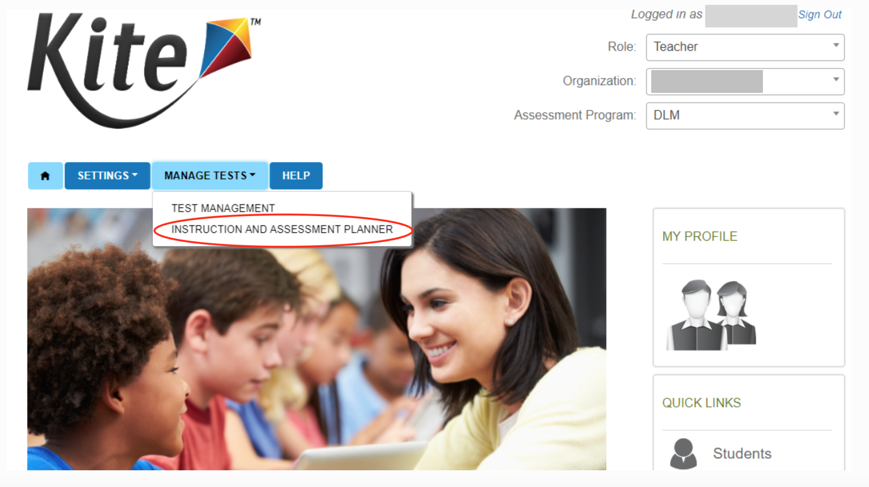
Step Two: Create an Instructional Plan
Select Manage Tests.
Select Instruction and Assessment Planner.
Notes:
To complete an instructional plan, select the Manage Tests tab on the Educator Portal landing page then select Instruction and Assessment Planner from the dropdown menu.

Slide 75
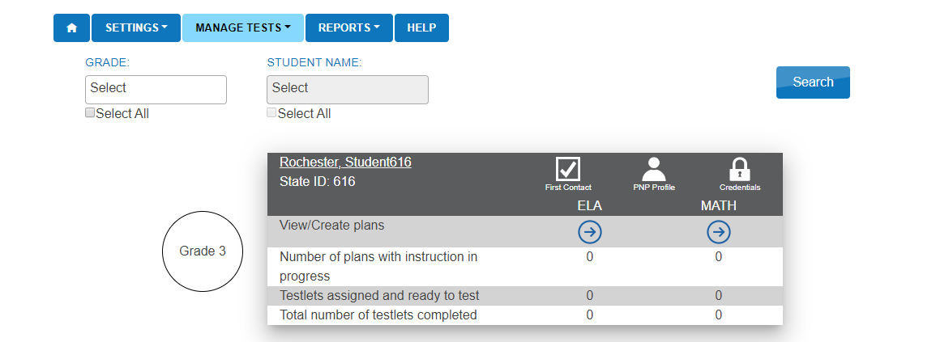
Step Three: Student Activity Table
This is the other way to complete the First Contact survey and PNP Profile.
Notes:
The landing page in the Planner is the Student Activity Table.
Students rostered to the teacher appear along with subjects. To select Essential Elements click on the arrow under the subject. For Year End state users there are no blueprint requirements as use is optional but very beneficial to teachers and students.
Rostered students will appear in the Instruction and Assessment Planner. Shown here is a student in Grade 4.
Going back to Step Two from a few slides ago, the second way the First Contact survey and PNP Profile can be completed is directly within the Instruction and Assessment Planner. When using instructionally embedded assessments, this option is particularly convenient. Before the First Contact survey is completed, a caution icon will appear above First Contact. Once it has been completed, a checkmark icon will appear. The student’s record, as shown earlier in this presentation, can be accessed by selecting the student’s name. Notice also the student’s credentials for Student Portal are also accessible here.
To create an instructional plan, select the arrow under the desired subject.

Slide 76
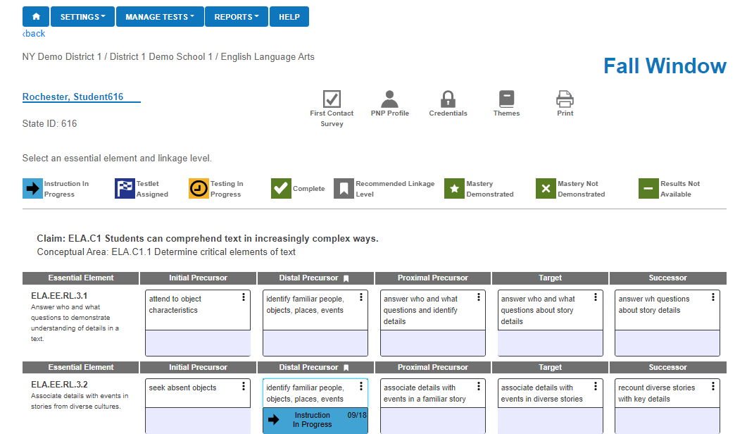
Instruction and Assessment Planner: Key Features
Notes:
Point out the icons and what each mean
When a linkage level is selected, a longer description of the linkage level will appear, as well as a mini-map PDF. When a linkage level has been decided, click Begin Instruction, which places the instructional plan in active status.
Shown here are Essential Elements for Grade 4 ELA.
At the lower part of the screen you see eight symbols which have descriptions beside them and will appear at various stages in process of instruction and assessment on the cards for the student. These symbols are not interactive.
Instruction in Progress
Testlet Assigned
Testing in Progress
Complete
Recommended Linkage Level
Mastery Demonstrated
Mastery Not Demonstrated
Results Not Available

Slide 77
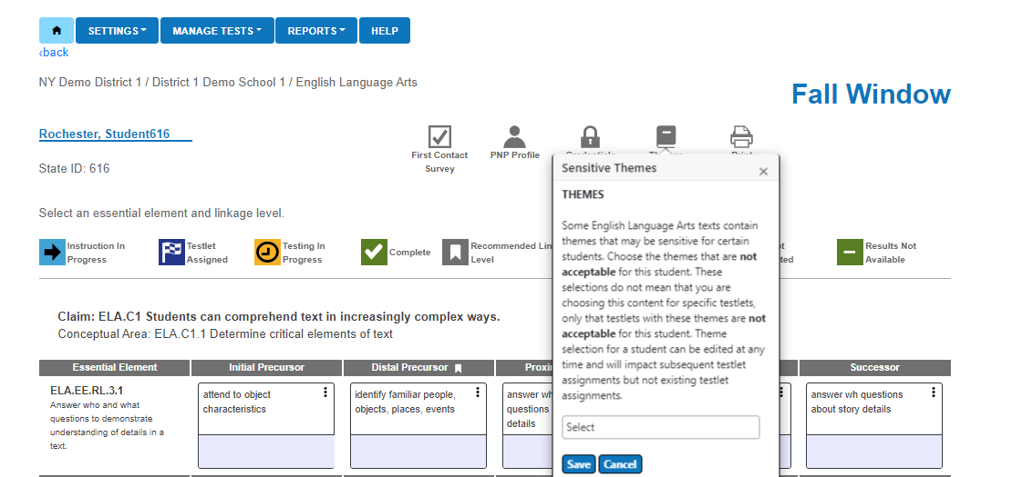
Instruction and Assessment Planner: Key Features
Notes:
The teacher can access the Essential Elements Status Report for fall and can print the report. It shows information like the blueprint coverage and mastery.
The themes icon brings up choices for the teacher. The teacher selects the themes that a student should NOT receive. These themes need only be selected one time for the entire year and will affect each Essential Element during both windows. It will also carry over to the next year. However, a teacher can change the selections at any time.
This page has several interactive icons to click on to inform the teacher. Again, we see the First Contact survey icon which can be accessed if the teacher wants to make changes. The PNP Icon, the Credentials, icon, themes for ELA and the print icon are all available to use and are interactive when clicked.

Slide 78
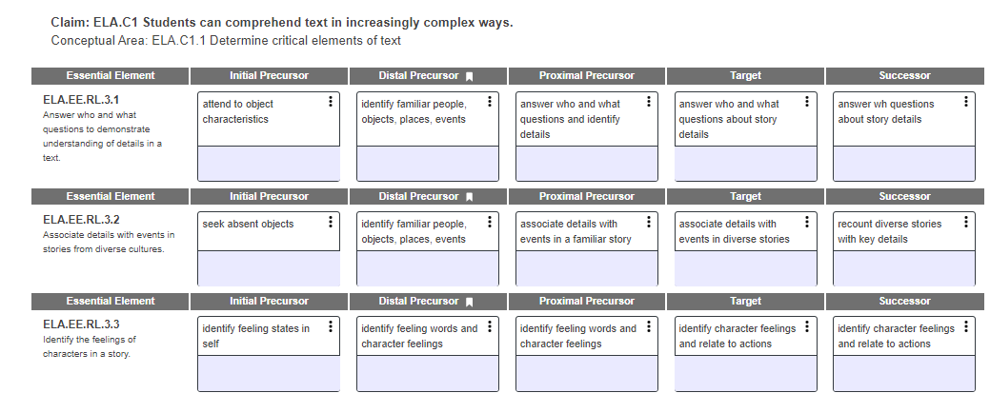
Step Four: Select Essential Elements and Linkage Levels
Notes:
Note: Year End states are using the assessment that has been developed for Instructionally Embedded model states.
The view shown does not contain all of the Essential Elements that were seen on the blueprint however that is just due to size limitations.
Note some Essential Elements appear that are not on the Year End blueprint. The IE blueprint has more Ees than the Year end.

Slide 79
Step Four: Select Essential Elements and Linkage Levels
While viewing the Instructional Information provided ask the following questions:
What are the skills and knowledge that will be assessed at the chosen linkage level?
Is the chosen linkage level appropriate for the student? (Not too hard, not too easy)
What type of activities and instruction might be used prior to assessing the student on the Essential Element?

Slide 80
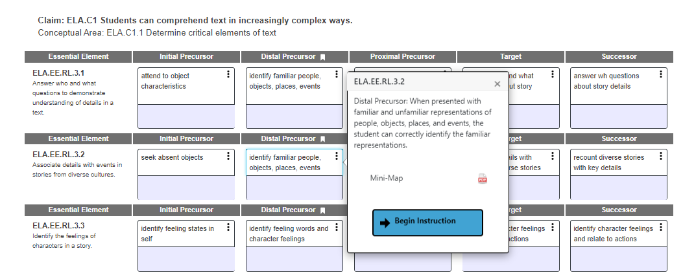
Step Four: Select Essential Elements and Linkage Levels

Slide 81
Mini-Map

Slide 82
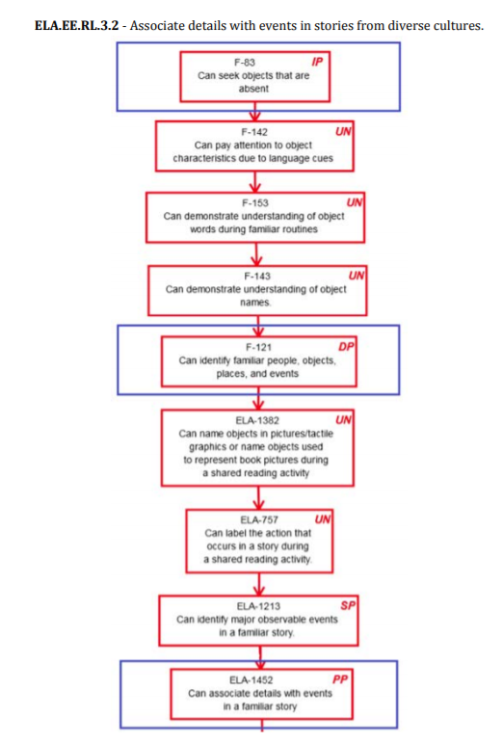
Mini-Map

Slide 83
Instruction and Assessment Process
Choose
Plan
Instruct
Assess
Repeat this process throughout the instructionally embedded assessments window.
Notes:
To summarize the process for using the Instruction and Assessment Planner, choose an Essential Element and linkage level, use the mini-map for the Essential Element to plan instruction, provide instruction targeting that Essential Element, return to the Instruction and Assessment Planner to assign a testlet and receive the TIP (or makes changes to the plan and repeat the necessary steps), then assess the student.
Reference this training and the helplet video when getting started in the Instruction and Assessment Planner.

Slide 84
Provide Instruction!

Slide 85
Instruction and Assessment Process
Choose
Plan
Instruct
Assess
Repeat this process throughout the instructionally embedded assessments window.
Notes:
To summarize the process for using the Instruction and Assessment Planner, choose an Essential Element and linkage level, use the mini-map for the Essential Element to plan instruction, provide instruction targeting that Essential Element, return to the Instruction and Assessment Planner to assign a testlet and receive the TIP (or makes changes to the plan and repeat the necessary steps), then assess the student.
Reference this training and the helplet video when getting started in the Instruction and Assessment Planner.

Slide 86
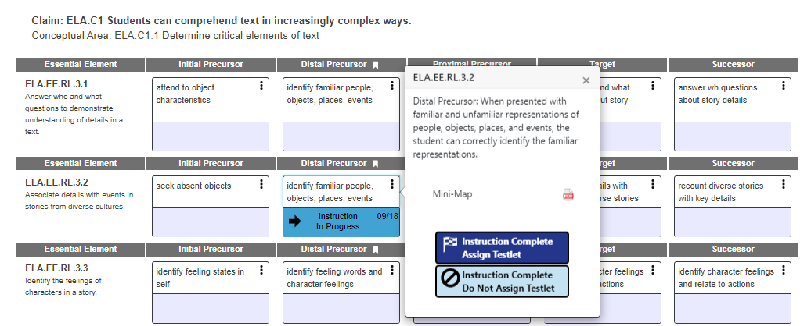
Assess Step One: Assign the Testlet

Slide 87
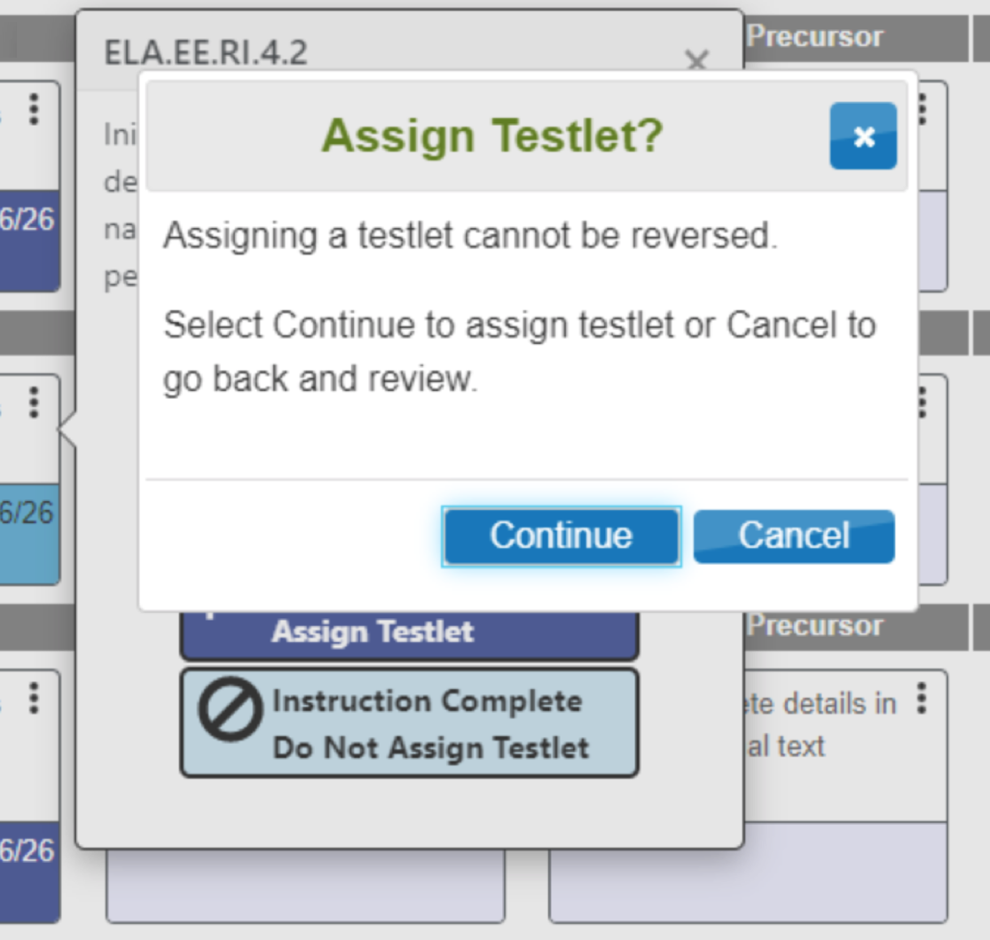
Assess Step Two: Assign the Testlet

Slide 88
Assess Step Three: Assess the Student
Retrieve the Testlet Information Page from Educator Portal!
Notes:
Each time a testlet is assigned to Educator Portal, a corresponding Testlet Information Page becomes available in Educator Portal, which helps the teacher prepare to administer the testlet. The Testlet Information Page provides information about any materials needed to administer the testlet so that the teacher is not surprised and inconvenienced when sitting down with a student to administer the testlet in Student Portal.
A Testlet Information Page is only available once Instruction Complete Assign Testlet is selected in the Instruction and Assessment Planner because a Testlet Information Page is testlet-specific.

Slide 89
Assess Step Four: Access Kite Student Portal
In Student Portal
Install or Reinstall Kite Student Portal on computer/tablet.
Kite Student Portal has been updated for 2019-2020
Log in using the student’s credentials.
Remember, the credentials are accessible in the Instruction and Assessment Planner
Select Take A Test.
Select the desired testlet, if more than one testlet is in the queue.

Slide 90
Repeat!
Choose
Plan
Instruct
Assess
Notes:
The final step is to repeat the process of choosing Essential Elements and linkage levels, creating instructional plans, providing instruction, assigning testlets, and assessing. This process continues throughout the instructionally embedded assessments window.
When starting the process again, decide whether the student needs additional instruction on the previously chosen Essential Element, perhaps at a different linkage level (higher or lower) or if the student is ready to move on to another Essential Element.

Slide 91
Wrap-up
Having a student complete instructionally embedded testlets WILL
Provide the student and teacher experience in the system
Allow for an assessment experience following instruction on an Essential Element
Having a student complete instructionally embedded testlets will NOT
Impact testlets delivered in the Spring Assessment Window
Impact a student’s score report
The Instruction and Assessment Planner is a tool that can be used to plan instruction for a student’s academic goals

Slide 92
DLM testlet examples
Released testlets

Slide 93
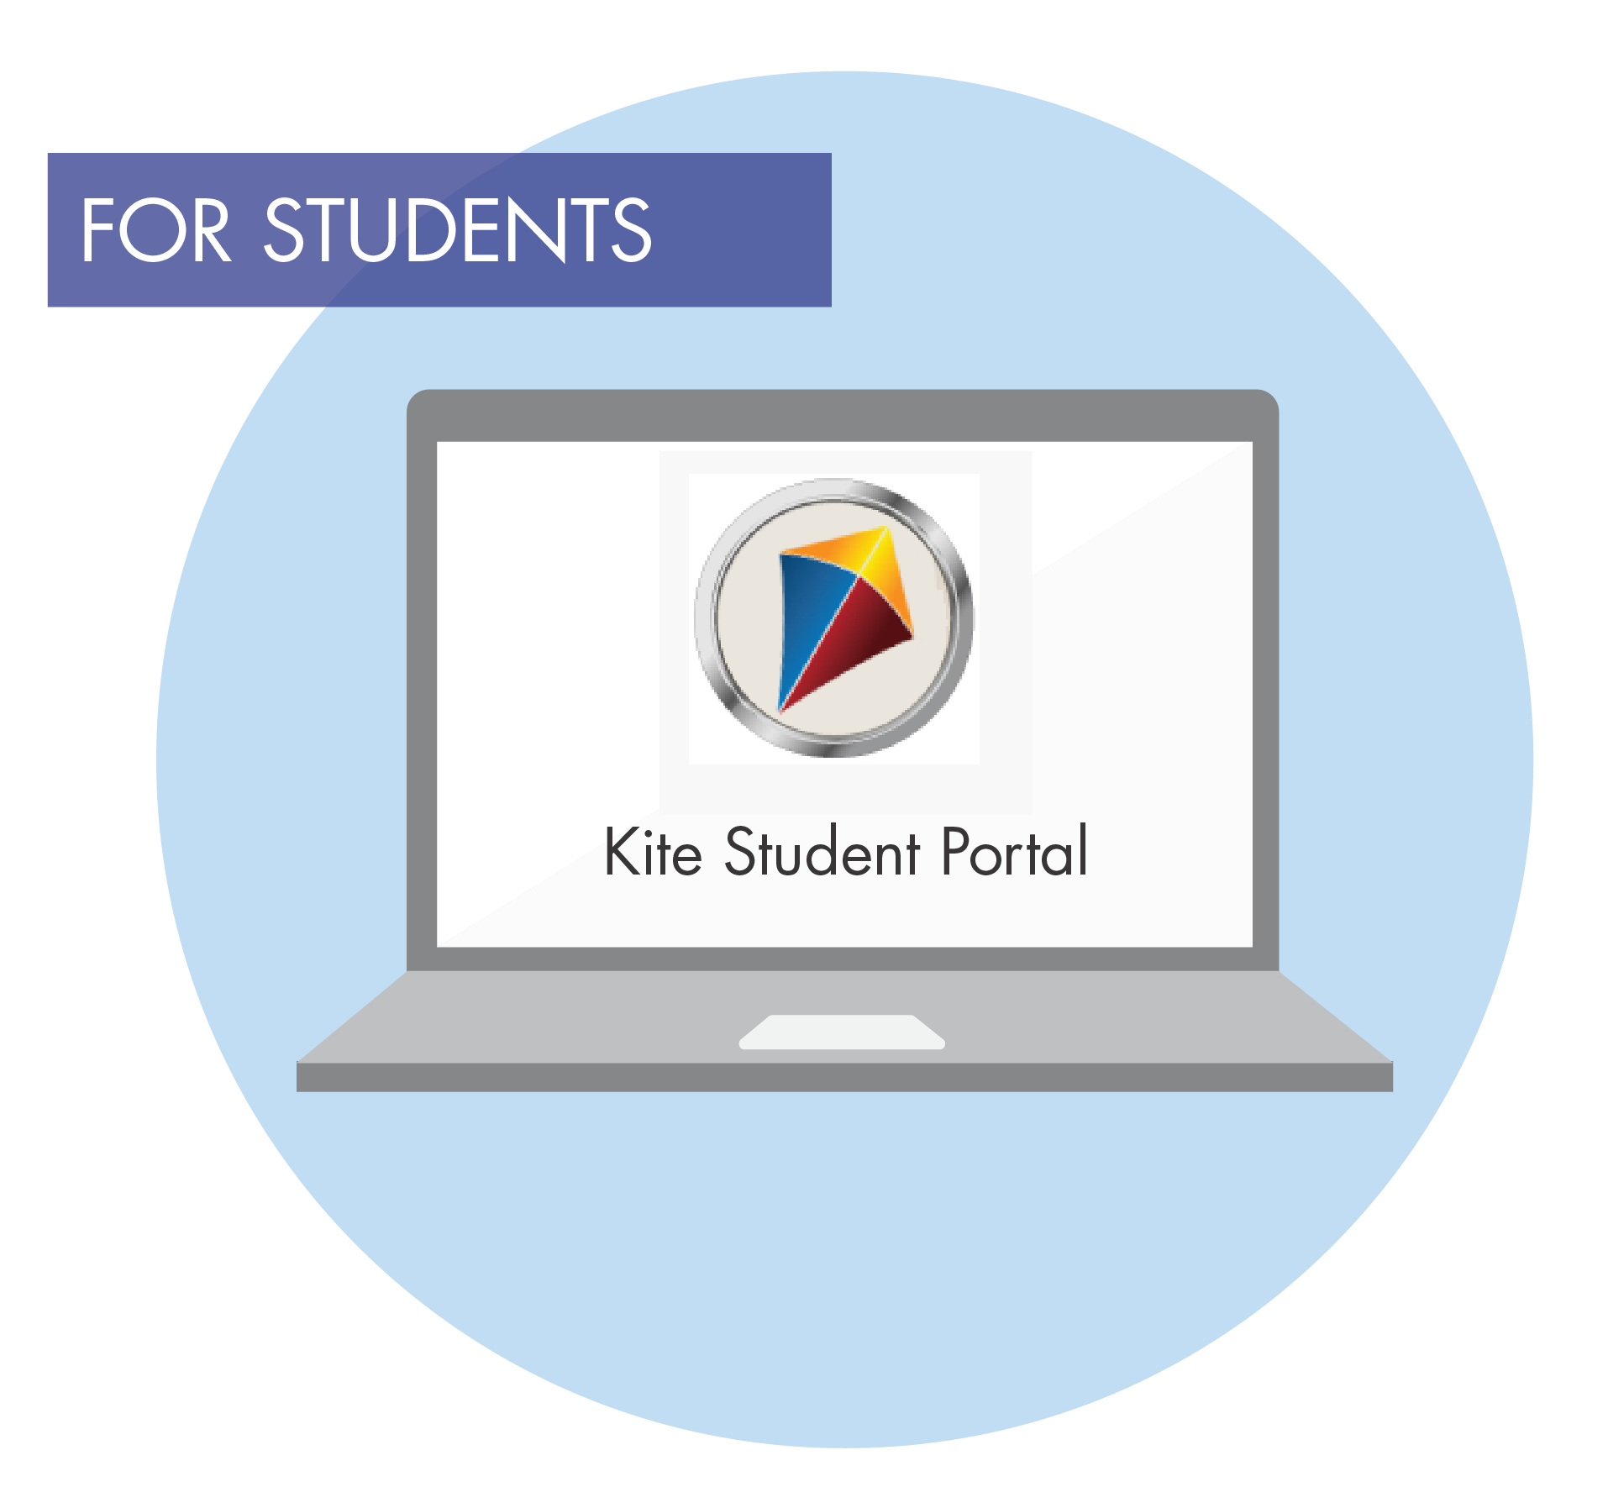
Testlet Types
Computer-Delivered
Teacher-Administered
Notes:
There are two types of testlets: computer-delivered and teacher-administered. Both are delivered in Student Portal. They mean exactly what their names indicate. A computer-delivered testlet is completed by the student on a computer or tablet in Student Portal. A teacher-administered testlet is delivered in Student Portal; however, scripted directions are provided to the test administrator, and the test administrator interacts directly with the student in administering the testlet. Then the test administrator records the student’s responses in Student Portal.
As discussed in Module 1, testlets include two primary parts: the engagement activity and the actual testlet items or questions.

Slide 94
Computer-Delivered Testlets
Maximize student interaction
Items are written to the student
An engagement activity, followed by 3-9 items
Maximize student independence
Student selects response choices independently
Supports Allowed for
Entering the student’s responses
Navigating screen to screen
Notes:
Most testlets are computer-delivered. There are several different types of items students will encounter in computer-delivered testlets, which will be explored over the next several slides.
Before looking at the different item types, it is important to understand that computer-delivered testlets should do two things: maximize student interaction and student independence. The items are written to the student. If able, the student enters their responses independently. If the student needs assistance, the test administrator may enter the student’s responses. The student may also receive support in navigating from one screen to the next, but prompting is not allowed. Other allowable and unallowable test administration practices will be covered later in the training.
Keep in mind that while the DLM alternate assessment is computer-based, it is not intended to assess a student’s ability to use the technology, which is why accessibility features are built in and supports are allowed.

Slide 95
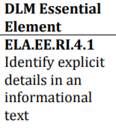
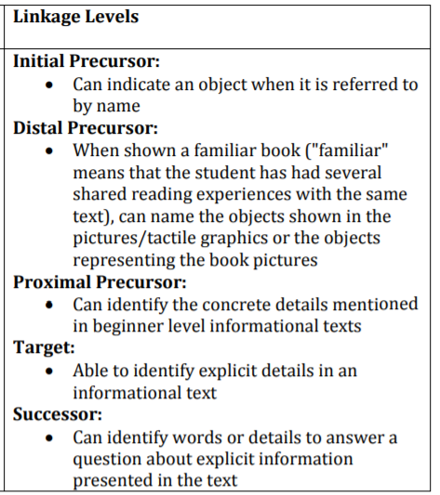
ELA.RI.4.1.PP
Identify explicit details in an informational text.

Slide 111
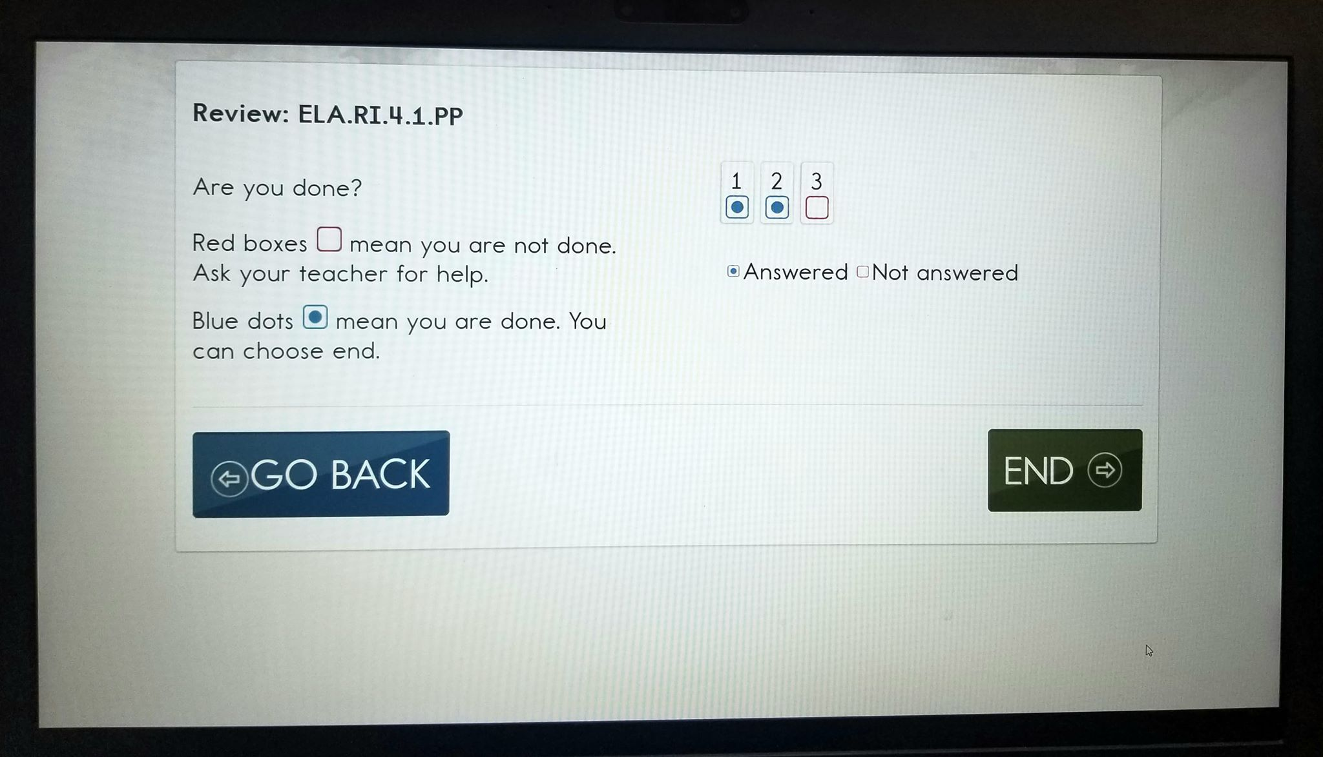

Slide 112
Teacher-Administered Testlets
Directions to the test administrator in Student Portal
Scripted statements/interactions
Items are for the test administrator to complete based on observation of behavior
Used for
Some testlets at the Initial and Distal Precursor linkage levels
All writing testlets are administered by the teacher
Notes:
Teacher-administered testlets are written to the test administrator. Still, like computer-delivered testlets, teacher-administered testlets are accessed in Student Portal. The test administrator is given a script to follow, step by step. The script tells the test administrator what to say and do throughout the testlet, and the test administrator observes what the student does in response to the script, and then enters the student’s responses based on those observations.
Teacher-administered testlets are predominantly at the lower linkage levels because students with the most complex needs may still be developing symbolic understandings. Teacher-administered testlets are also used when the content cannot be assessed with information presented on the computer screen.
Also, no matter what grade or linkage level, one of the student’s ELA testlets will be a writing testlet. All writing testlets are teacher-administered.

Slide 113
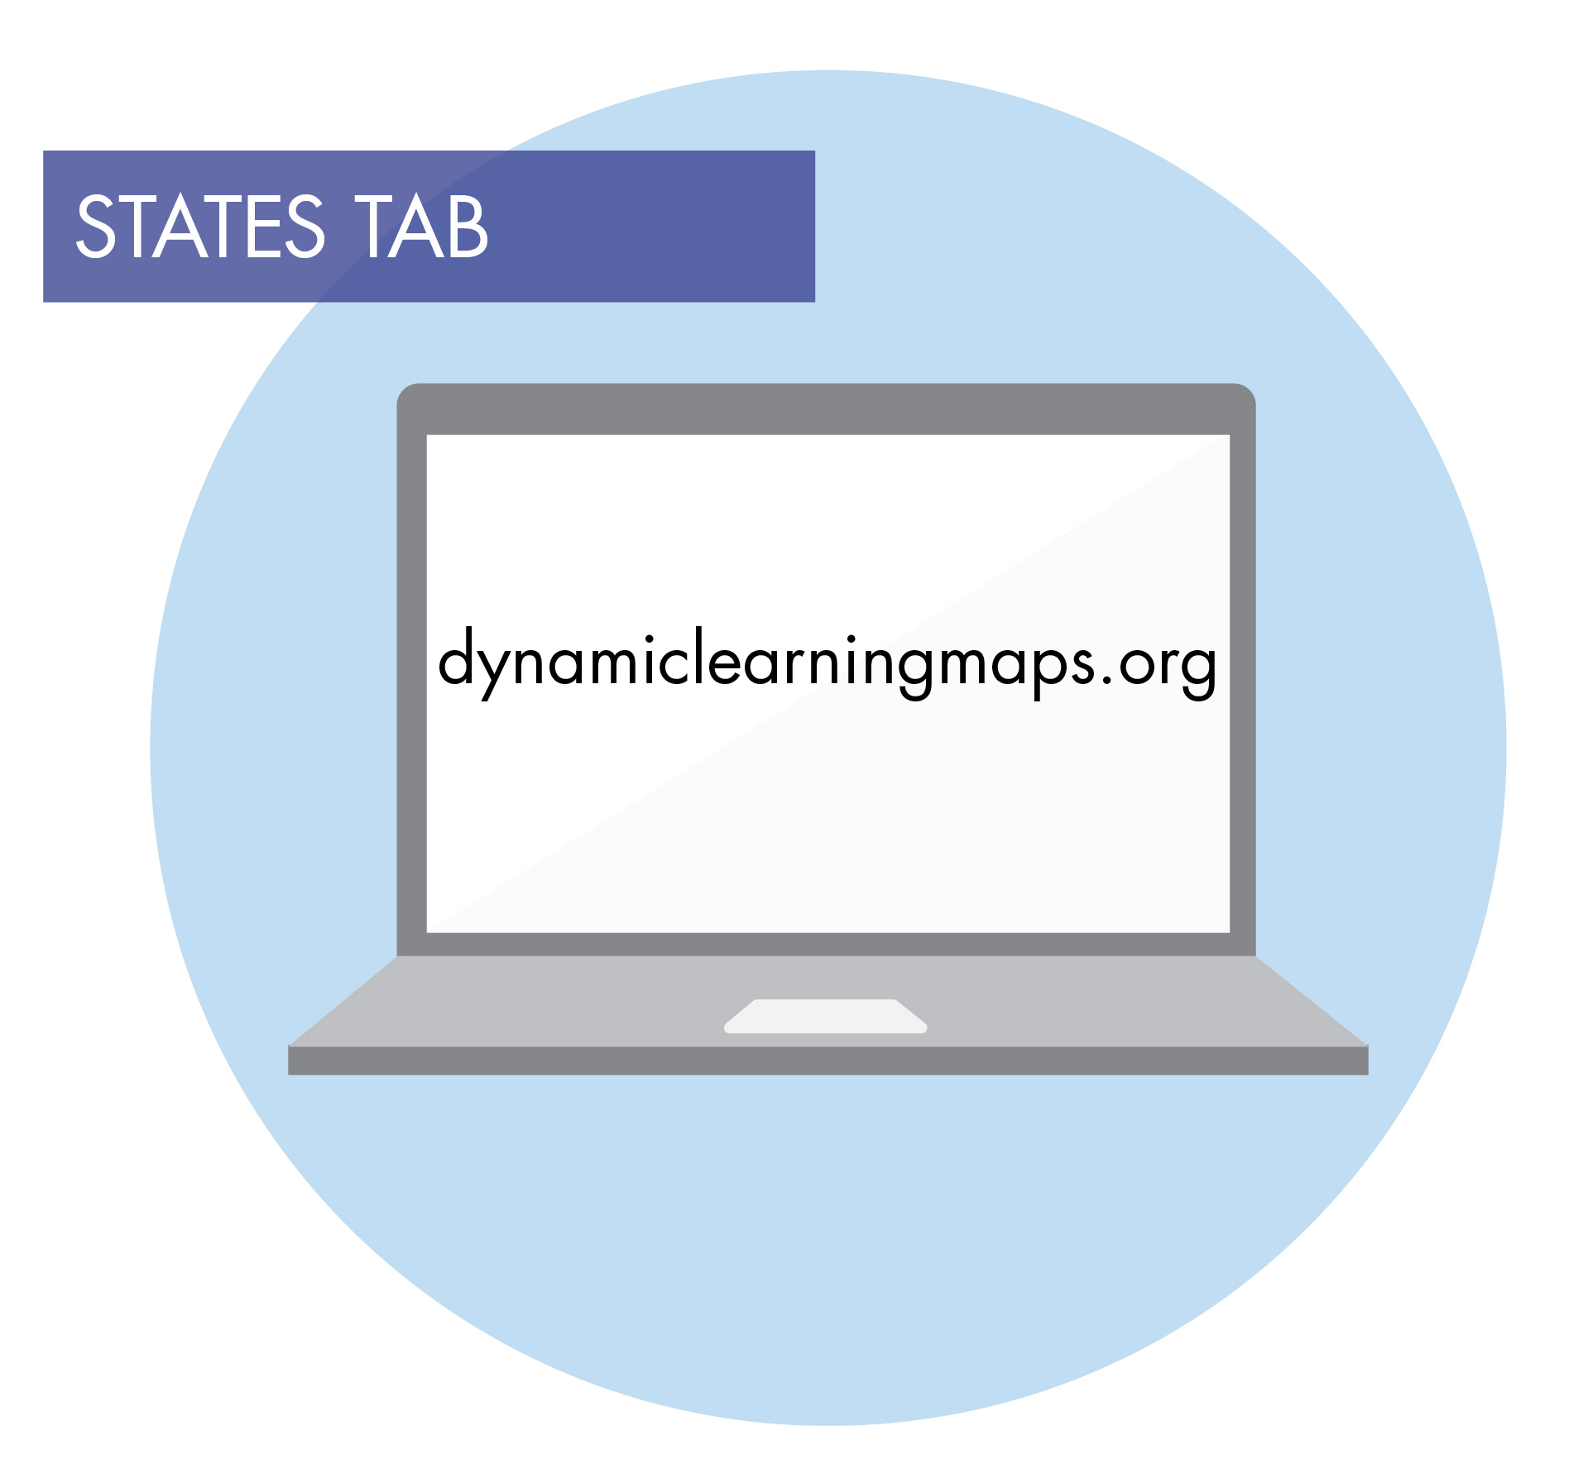
Teacher-Administered Writing Testlets
Engagement activity requires the student to select a topic
Test administrator
Follows Educator Directions
Interacts with student
Observes and records observations of student writing
Writing product is not submitted
Video regarding writing testlets
Notes:
All writing testlets are teacher-administered. The test administrator delivers a structured writing activity to the student. The testlet begins with an engagement activity that requires the student to select a writing topic. Then step-by-step scripted directions are provided which ask the student to engage in writing tasks. After each step, the test administrator records the student’s response in Student Portal. Some writing testlets also require the test administrator to evaluate the written product. In all cases, selections are made from the onscreen options that best reflect the test administrator’s observations. The student’s writing product is not submitted.
There is a separate video that provides more information about the writing testlets. Access the video on the Educator Resource Page found on the state pages of the DLM website.

Slide 114
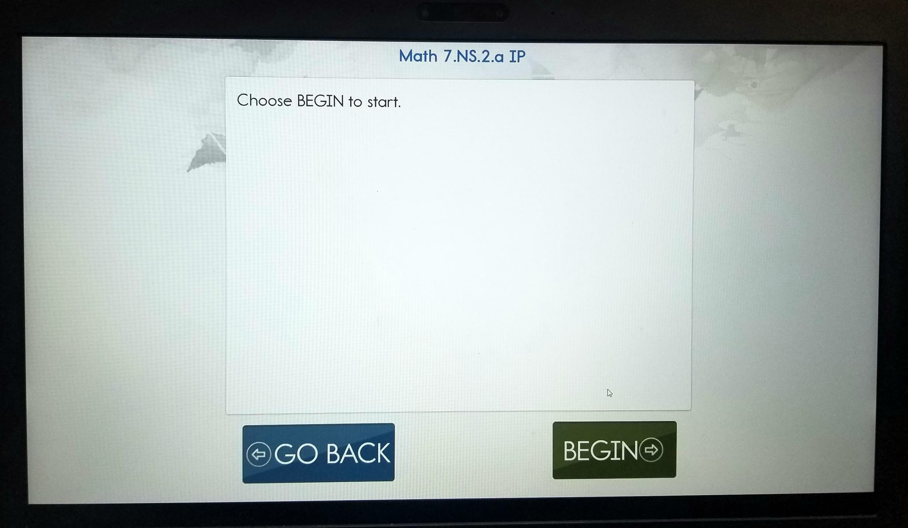
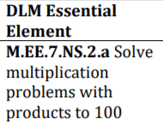
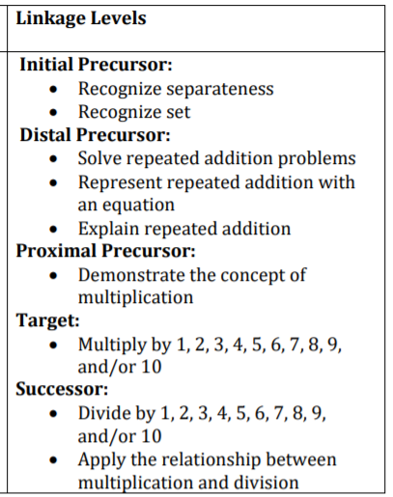
M.EE.7.NS.2.a
Solve multiplication problems with products to 100

Slide 126
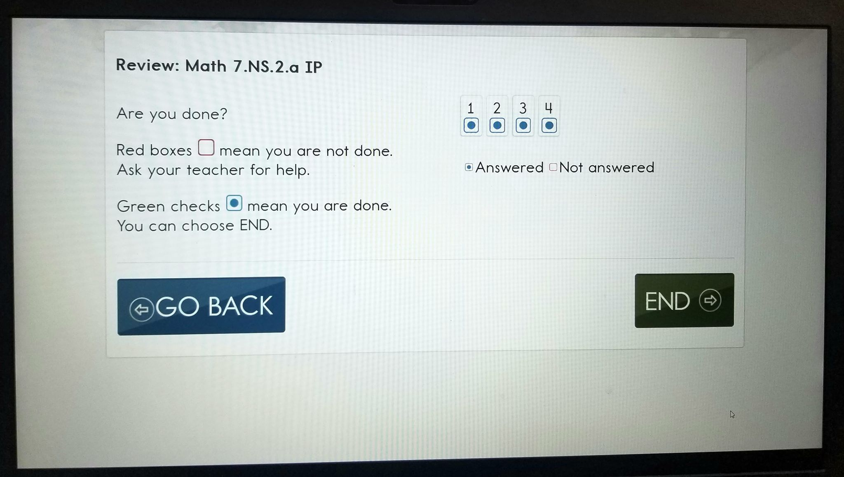

Slide 127
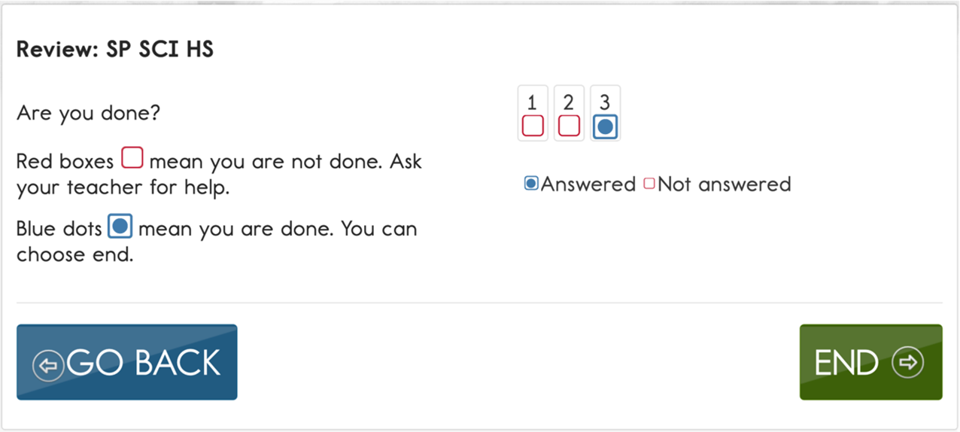
Kite Student Portal End Page of Testlet
Green checkmarks have been replaced with blue dots to indicate an item was answered.

Slide 128
Spring assessment window

Slide 129
The Spring Assessment Window
OK Spring Assessment Window
March 9, 2020 – May 1, 2020
Students complete 5 to 10 testlets in each subject area.
All testlets for each student must be completed during the spring assessment window.
Notes:
Test administrators are required to assess students each spring. Each state chooses its own spring assessment window sometime between mid-March and early June. Be sure to follow state guidance regarding the dates for the spring assessment window. Remember students complete 5 to 10 testlets in each subject area, and all testlets for every student must be completed by the end of the assessment window. Plan accordingly. Considerations for planning and scheduling assessment sessions are provided in Module 4.

Slide 130
Testlets
Testlet Items | Assessment Scheduling | Number of Testlets Per Subject
3-9 conceptually-related items | 5–15 minutes to complete a testlet | 7–9 for ELA and mathematics, depending on the grade
all items within a testlet are the same linkage level | each testlet administered one-on-one (test admin to student) | 9 for science, regardless of grade
 |  | 6 for H.S. U.S. History
Notes:
The entire assessment for a content area is comprised of a series of mini‐assessments. These mini‐assessments are called testlets. Each testlet is limited to 3‐to‐9 conceptually‐related items to prevent fatiguing the student, and all items within a single testlet align to only one linkage level. Each testlet must be administered one‐on‐one between the test administrator and the student. A student typically takes between 5‐to‐15 minutes to complete a testlet.
Depending on the grade, there are 7‐to‐9 testlets each for the entire ELA and mathematics assessments, and each of these testlets will address one or more Essential Elements. However, for science, there are nine testlets regardless of the grade, and each testlet only addresses a single Essential Element. For states that assess high school science using End of Instruction biology, there are 10 testlets total.
All testlets must be completed within the state‐set spring assessment window.
The system determines the linkage level of each testlet for each student. More information about how the system makes those determinations is provided later in the training.

Slide 131
Testing Progress
Notes:
For the spring assessment window, the Test Progress column in Educator Portal shows the number of testlets completed by the student for a content area. When a student completes a testlet in Student Portal, the number of testlets remaining will be displayed. If a student wishes to keep track of the number of completed testlets and the number that remain, consider making a testing progress chart for the student with checkmarks or stickers for each completed testlet.

Slide 132
Manage Spring Assessments
View student username and password
Retrieve the Testlet Information Page (TIP)
All testlets for each student must be completed during the spring assessment window.
Notes:
Test administrators are required to assess students each spring. Each state chooses its own spring assessment window sometime between mid-March and early June. Be sure to follow state guidance regarding the dates for the spring assessment window. Remember students complete 5 to 10 testlets in each subject area, and all testlets for every student must be completed by the end of the assessment window. Plan accordingly. Considerations for planning and scheduling assessment sessions are provided in Module 4.

Slide 133
View Student Username and Password

Slide 134
View Student Username and Password

Slide 135
View Student Username and Password

Slide 136
View Student Username and Password
HINT: The Test Progress column on the Test Management screen shows the number of testlets that have been completed out of the number of required testlets required for a subject during the spring assessment window. OK will see all subjects being tested.

Slide 137
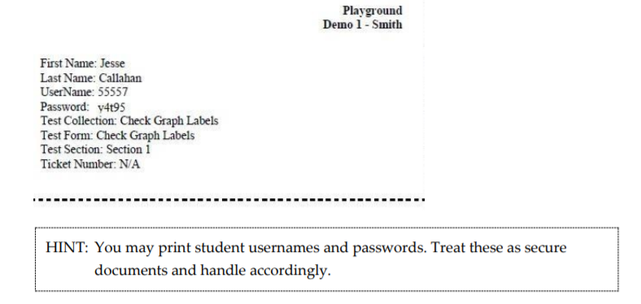
View Username and Password
5. Click Open with, choose Adobe Acrobat
6. Click OK
7. View the student username and password

Slide 138
Testlet Information Page (TIP)
Download/print the TIP ahead of testing
Spring assessment window
Accessed from the Test Management section of Educator Portal
Securely destroy each TIP after use.
Notes:
Each time a testlet is assigned to a student, a unique Testlet Information Page, commonly referred to as a TIP, becomes available in Educator Portal under the Test Management section during the spring assessment window. The TIP provides information the test administrator will need in order to administer the testlet to the student. Test administrators may download or print the TIP if desired; however, after the testlet is administered, the downloaded or printed TIP must be destroyed because TIPs are considered secure testing materials.

Slide 139
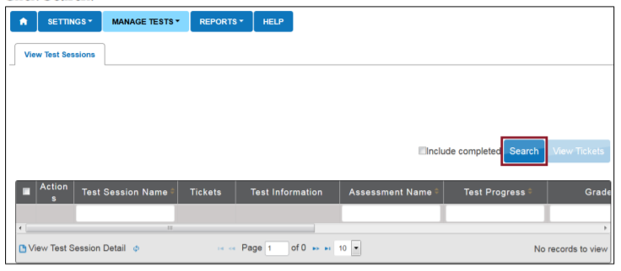
Retrieve the TIP
TIPs are located on the Test Management screen
Manage Tests
Select Test Management
Click Search

Slide 140
Retrieve the TIP

Slide 141
Testlet Information Page (TIP)
Testlet type
Number of items
Materials needed
Materials use
Suggested substitutions
Notes:
The sample TIP shown here is for a mathematics testlet. Like all TIPs, it provides specific information about the testlet, including the type of testlet (computer-delivered or teacher-administered) the number of items, any materials that may be needed, and suggested substitutions for materials. When applicable, the TIP also includes alternate text for students with visual impairments, accessibility supports not allowed, and science picture response cards to be printed.
A test administrator should never attempt to administer a testlet without first reading the TIP for that testlet.

Slide 142
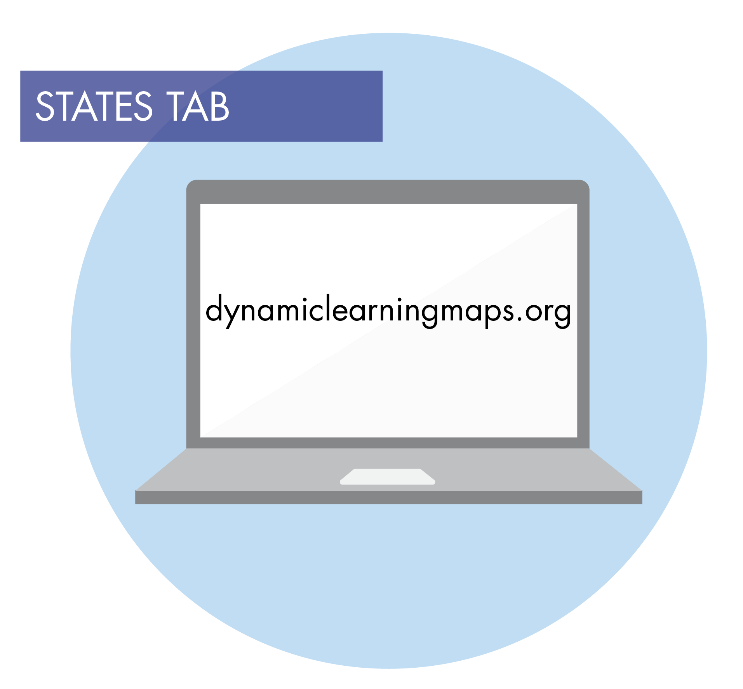
Materials Collection Lists
Common materials are listed by subject area and grade.
Notes:
To help test administrators prepare, the TIP lists any materials needed to administer a specific testlet. Materials collection lists are provided on the DLM website. The lists are specific to subject area and grade.

Slide 143
Substituting Materials
Materials Needed: 2 identical erasers and 2 identical blocks
Materials Use: The student will use the materials to recognize objects that are the same and objects that are different.
Suggested Substitute Materials: 2 pairs of objects, each identical to one another, for example 2 identical checkers and 2 identical glue sticks. Use objects familiar to the student.
Notes:
The sample mathematics TIP on the previous slide states that two identical erasers and two identical blocks are needed for the testlet. The TIP also states the student will use these to recognize objects that are the same and objects that are different. Therefore, erasers and blocks are not the only objects that would be appropriate for this testlet. Suggested substitute materials include two identical checkers and two identical glue sticks, but think of all of the other materials that could also be used. The TIP suggests using objects familiar to the student. The testlet items will refer to the materials listed on the TIP. Therefore, if substitutions are made, remember to substitute the name of the objects when administering the testlet.

Slide 144
Instructional resources

Slide 145
Instructional Resources
Educator Resource Page
Essential Elements and Learning Map Model Resources
Guide to the foundational area of the learning map model
Professional development modules supporting Essential Elements dlmpd.com
Assessment Administration Resources
Instructional and Informational Videos

Slide 146
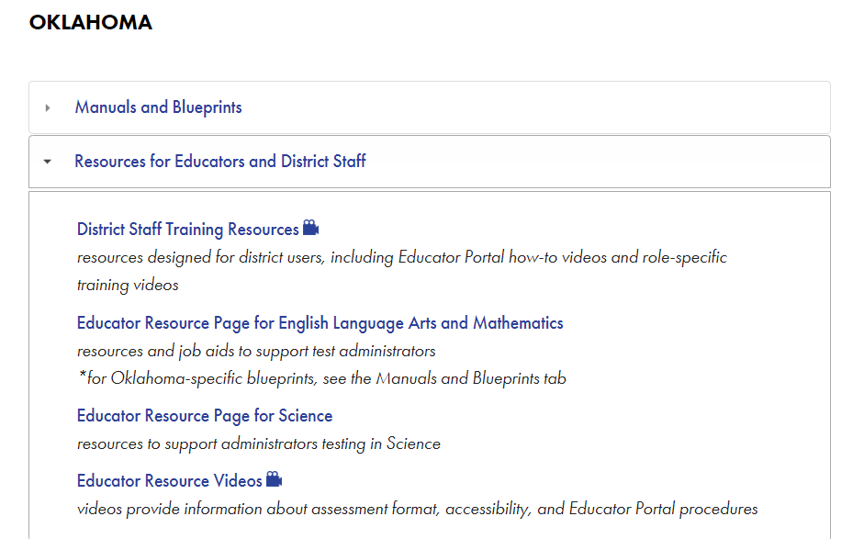
Instructional Resources

Slide 147
Helplet Videos
States >
Resources for Educators and District Staff tab >>
Educator Resource Videos
Using the Instruction and Assessment Planner
Overview of the Instructionally Embedded Assessments
https://dynamiclearningmaps.org/erp/videos
Notes:
Remember, there are several helplet videos on the DLM website. One such video is an Instruction and Assessment Planner tutorial, and another is an overview of instructionally embedded assessments. Go to the States tab, select New York, then click the Resources for Educators and District Staff tab. Next, click the Educator Resource Videos link. Scroll down the page to find the applicable helplets.
Refer to the helplets and this training when using the Instruction and Assessment Planner.

Slide 148
OK DLM Webpage Educator Resource Page - ELA

Slide 149
Familiar Texts
18
Notes:
The DLM website also provides a list of familiar texts for ELA by grade. They are called familiar texts because the expectation is that the teacher uses them during instruction so students are already familiar with them prior to taking assessments. Most testlets that use a familiar text are at lower linkage levels, and the text will be named on the TIP. Teachers may print the texts. However, presenting them on the computer may be another good way to give students experience working with the computer because the texts are displayed similarly to the way they would be displayed in a testlet. A student is allowed to have a printed copy of the text during the assessment if it was also provided during instruction.

Slide 150
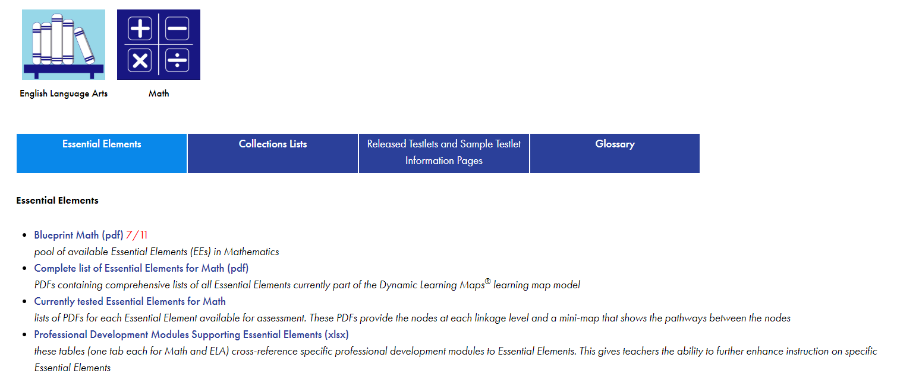
OK DLM Webpage Educator Resource Page - Mathematics

Slide 151
Professional Development Site Update
Notes:
Professional Development Modules organized by claim or by domain. Also on dlmpd.com, are the exemplar text supports and other instructional resources.

Slide 152
Professional Development
Notes:
There are a number of professional development videos available at dlmpd.com or by clicking on the Professional Development tab of the DLM website home page. The University of North Carolina at Chapel Hill developed these modules. They typically have a short running time.

Slide 153
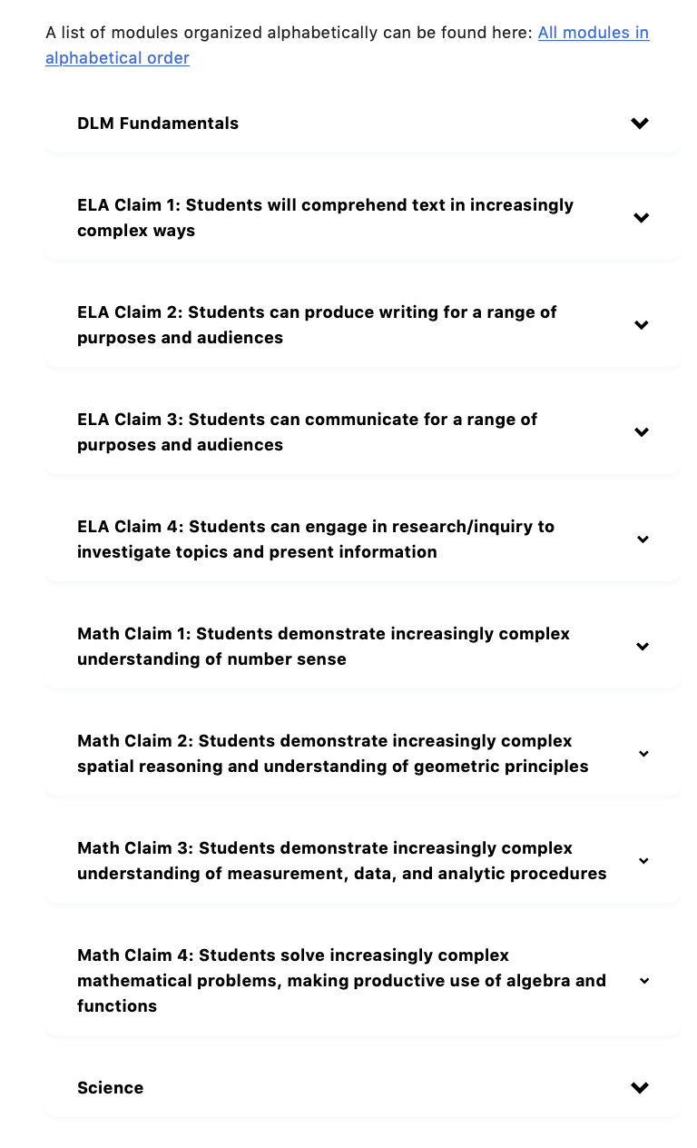
153
Notes:
Although searching the professional development modules alphabetically is an option, searching by Claim or Domain is particularly helpful in narrowing the search to a particular topic or set of topics. Click DLM Fundamentals for a list of professional development modules on topics such as Universal Design for Learning and IEPs linked to the DLM Essential Elements. Click an individual claim for ELA or mathematics for a list of professional development modules related to the chosen claim. Click Science for a list of professional development modules specific to science.

Slide 154
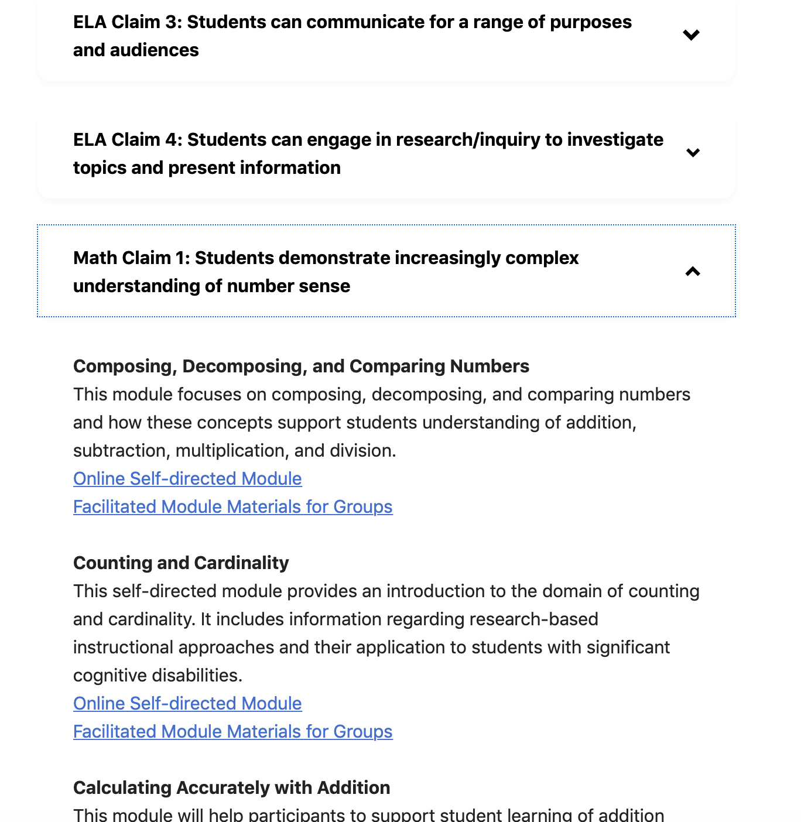
Example:
Continue scrolling for more modules.
154
Notes:
All of the modules are offered in two formats: online, self-directed modules or facilitated module materials for groups.

Slide 155
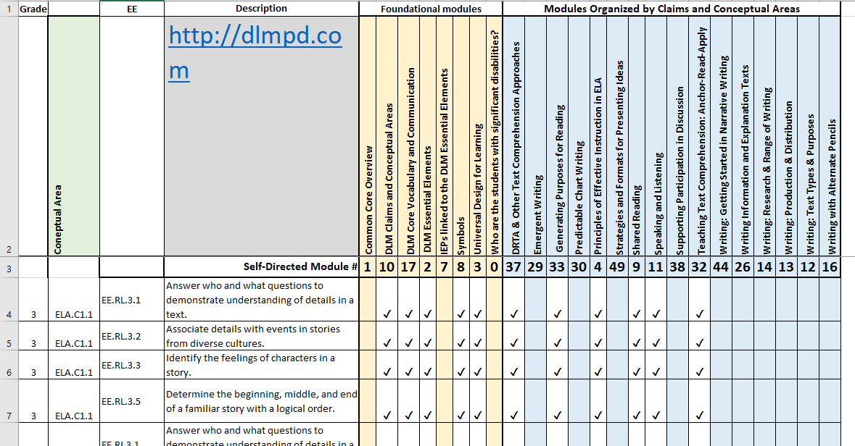
PD Modules Supporting Essential Elements
Notes:
The spreadsheet lists all of the Essential Elements by grade and cross-references them to the available PD modules. When developing instruction for a particular Essential Element or set of Essential Elements, check the spreadsheet for professional development modules that may be helpful to better understanding the Essential Elements.

Slide 156
Thank you!

