Slide 1
Whiteboard Zoom Out
OKED TLE Pilot Facilitator
Training

Slide 2
Whiteboard Zoom In
Objectives for today’s session
Offer suggestions for organizing and facilitating school-based dashboard trainings
Preview plan for gathering feedback during the pilot
Review dashboard functionality
Allow time for discussion and questions from training facilitators

Slide 3
Whiteboard Zoom In
AGENDA
School-Based Training Suggestions
Dashboard Usage Expectations
User Access to Dashboard
Feedback Opportunities
Next Steps and Resources

Slide 4
Whiteboard Zoom Mid
School-Based Training Suggestions
Option 1: In-person setting
Option 2: Independent learning
Option 3: Hybrid of in-person setting and independent learning
Option 4: Create your own model

Slide 5
Whiteboard Zoom Mid
Option 1: In-person setting
Between today – April 17, 2015:
Show training video provided by TLE team
Provide 15-20 minutes for pilot participants to explore the OKED TLE demo site
Encourage them to navigate the site as a teacher and an administrator
Identify resources available to users
Explain your district process for how/where users should submit questions
Summarize feedback expectations
Distribute a feedback form regarding the online training video and school-level training
Direct users to their live dashboards

Slide 6
Whiteboard Zoom Mid
Option 2: Independent learning
Between today – April 17, 2015, ask pilot participants to:
View training video provided by TLE team
Spend 15-20 minutes exploring the OKED TLE demo site
Encourage them to navigate the site as a teacher and an administrator
Review resources available to users
Submit questions through the district developed process previously communicated
Complete a feedback form regarding the online training video and school-level training
View live dashboards

Slide 7
Whiteboard Zoom Mid
Option 3: Hybrid of in-person setting and independent learning
Between today – April 17, 2015:
In advance of in-person trainings:
Participants view TLE dashboard video modules and spend 15-20 minutes exploring the OKED TLE demo site as a teacher and then as an administrator
During the in-person training:
Identify resources available to users
Explain how/where users should submit questions
Summarize feedback expectations
Distribute a feedback form regarding the online training video and school-level training
Direct users to their live dashboards

Slide 8
Whiteboard Zoom Mid
Option 4: Create your own model
Between today – April 17, 2015:
Design and deliver your own training for the OKED TLE dashboards
Consider sharing training plan with other Pilot Facilitators

Slide 9
Whiteboard Zoom In
AGENDA
School-Based Training Suggestions
Dashboard Usage Expectations
User Access to Dashboard
Feedback Opportunities
Next Steps and Resources

Slide 10
Whiteboard Zoom Mid
Dashboard Usage Expectations
Explore the dashboard as a teacher
Explore the dashboard as an administrator

Slide 11
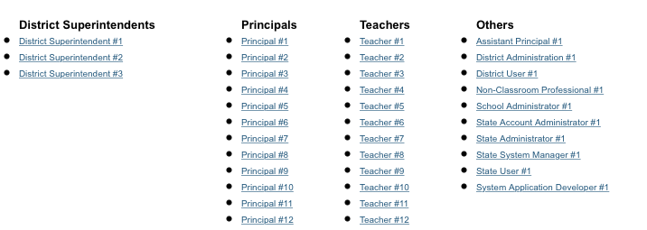
Whiteboard Zoom In
Explore the dashboard as a teacher

Slide 12
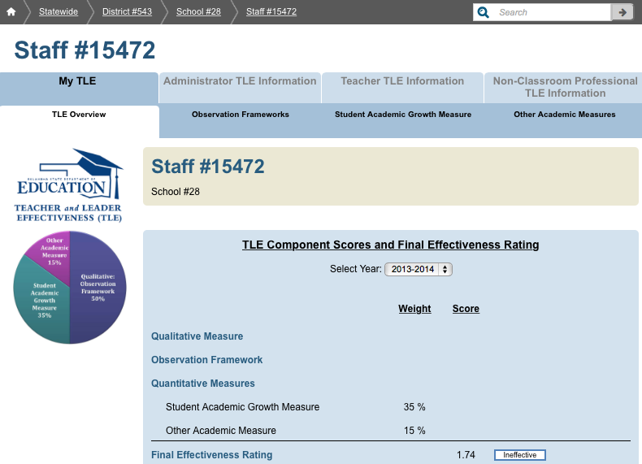
Whiteboard Zoom In
Explore the dashboard as a teacher
Notes:
Encourage to click around each tab to fully understand the type of data to expect as a teacher

Slide 13
Whiteboard Zoom In
Explore the dashboard as a teacher
While exploring the teacher dashboards, participants should try the following:
Viewing my own TLE overview information
Viewing information about each TLE component
View past and current TLE information
Viewing summary information about average TLE performance in my school and/or district
Notes:
Encourage to click around each tab to fully understand the type of data to expect as a teacher

Slide 14
Whiteboard Zoom In
Explore the dashboard as an administrator

Slide 15
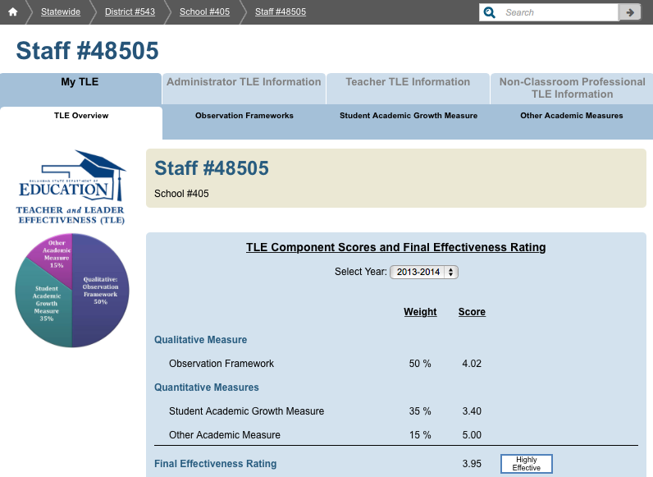
Whiteboard Zoom In
Explore the dashboard as an administrator
Notes:
Encourage to click around each tab to fully understand the type of data to expect as an administrator

Slide 16
Whiteboard Zoom In
Explore the dashboard as an administrator
While exploring the administrator dashboards, participants should try the following:
Viewing my own TLE overview information and individual component scores
Viewing past and current TLE information
Viewing information about all teachers in my school
Viewing information about individual teachers in my school
Viewing summary information about average TLE performance in my school and/or district

Slide 17
Whiteboard Zoom In
AGENDA
School-Based Training Suggestions
Dashboard Usage Expectations
User Access to Dashboard
Feedback Opportunities
Next Steps and Resources

Slide 18
Whiteboard Zoom Mid
User Access to Dashboard
Demo vs. Live OKED TLE Dashboards
Granting pilot participants access to the dashboard
Instructions on navigating to the dashboard

Slide 19
Whiteboard Zoom In
Demo Site vs. Live Site
Oklahoma Educator Dashboards for Teacher Leader Effectiveness - Demo Site
This is the site pilot participants will use for training
It contains sample data, including a full set of TLE evaluation data for the 2014-15 school year (which does not exist yet on the live site)
Users gain access to this site through the SSO2 portal

Slide 20
Whiteboard Zoom In
Demo Site vs. Live Site
Oklahoma Educator Dashboards for Teacher Leader Effectiveness- (Live Site)
The “live site” contains real TLE data including:
VAM results for the 2013-14 evaluation year (based on 2012 – 2013 test results)
Observation data for the 2013-14 evaluation year
VAM results for the 2014-15 evaluation year (based on 2013 – 2014 test results)
OAM results for the 2014-15 TLE evaluation year (OAM data completed during SY2013-14)

Slide 21
Whiteboard Zoom In
Demo Site vs. Live Site
Oklahoma Educator Dashboards for Teacher Leader Effectiveness- Live Site
Pilot participants should be directed to use this site only after they have been trained on the demo site
Teachers and administrators will see their own TLE information here
Users gain access to this site through the SSO2 portal

Slide 22
Whiteboard Zoom In
Granting pilot participants access to the dashboard
All Pilot Facilitators should have access to both of the OKED TLE Dashboard applications through Single Sign On (SSO)
Pilot Facilitators should seek permission from District Superintendents to have both of the OKED TLE Dashboard applications added to their SSO accounts
Contact Susan Pinson for technical assistance
susan.pinson@omes.ok.gov

Slide 23
Whiteboard Zoom In
Instructions on navigating to the dashboard
Single Sign On (SSO) URL:
https://sdeweb01.sde.ok.gov/SSO2/Signin.aspx

Slide 24
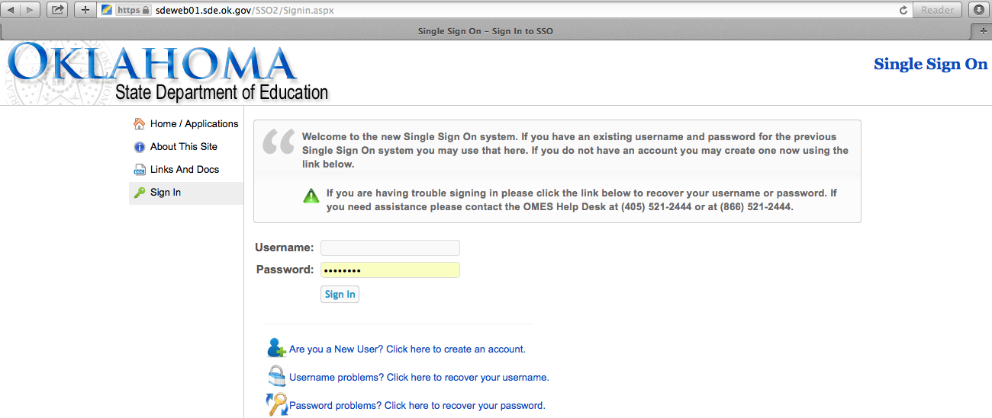
Whiteboard Zoom In
Instructions on navigating to the dashboard

Slide 25
Whiteboard Zoom In
AGENDA
School-Based Training Suggestions
Dashboard Usage Expectations
User Access to Dashboard
Feedback Opportunities
Next Steps and Resources

Slide 26
Whiteboard Zoom Mid
Feedback Opportunities During
The Pilot
May 2015 – An online survey will be distributed to all pilot participants for initial feedback on the look, feel, and user experience of the OKED TLE dashboard.
June 2015 – A subset of pilot participants will be invited to join a focus group to discuss detailed impressions and potential improvements for the OKED TLE dashboard.

Slide 27
Whiteboard Zoom In
Questions to keep in mind as a teacher
While exploring the teacher dashboards, think about the following questions which will be considered in more depth during the pilot feedback sessions:
Is there a better way to display the TLE data and information?
Is navigation around the dashboard seamless?
Are my colleagues likely to see value in this dashboard? If not, what can be improved upon so it does add value?
How can I take this data and make changes within my lesson plans and day-to-day work?
Are there any other changes you would make prior to a statewide rollout of the OKED TLE Dashboard?
Notes:
Encourage to click around each tab to fully understand the type of data to expect as a teacher

Slide 28
Whiteboard Zoom In
Questions to keep in mind as an administrator
While exploring an administrator dashboard, think about the following questions which will be considered in more depth during the pilot feedback sessions:
Is there a better way to display the TLE data and information?
Is navigation around the dashboard seamless?
Are my teachers likely to see value in this dashboard? If not, what can be improved upon so it does add value?
How do I expect my teachers to use this data to drive their lesson planning and day-to-day work?
Are there any other changes you would make prior to a statewide rollout of the OKED TLE Dashboard?
Notes:
Encourage to click around each tab to fully understand the type of data to expect as an administrator

Slide 29
Whiteboard Zoom In
AGENDA
School-Based Training Suggestions
Dashboard Usage Expectations
User Access to Dashboard
Feedback Opportunities
Next Steps and Resources

Slide 30
Whiteboard Zoom Mid
Next Steps and Resources
Next steps for Pilot Facilitators
Resources available to all pilot participants

Slide 31
Whiteboard Zoom Mid
Next steps for Pilot Facilitators
Determine training plan for school participants
Develop process to receive and respond to questions
Create a feedback form (optional)
Ensure all pilot participants have been trained by April 17, 2015
Notes:
Process suggestions include:
Providing pilot participants your email address and/or phone number to ask questions
Developing a google form where participants submit questions
Offer ‘office hours’ where participants can stop by and ask questions
Hold online Q&A webinars or conference calls where people can ask questions

Slide 32
Whiteboard Zoom Mid
Resources available to all pilot participants
District-developed process for seeking technical assistance for the OKED TLE dashboards
OKED TLE Dashboard training video
OKED TLE Dashboard demo site
One page ‘Quick Reference Guide’ on navigating around the dashboard
OKED TLE Dashboard User Guide
VAM PAK
OSDE TLE website and office staff www.ok.gov/sde/tle

Slide 33
Whiteboard Zoom Mid
TLE Dashboard Demo Site Review

Slide 34
Whiteboard Zoom Mid
A few final things to keep in mind as you and your colleagues begin to explore the dashboards…
Some key goals for the pilot are to…
Improve the quality of the data
Improve the data collection process
Improve dashboard functionality
Identify priority features to be included in future updates
Streamline permissions so the users have direct access to the right information

Slide 35
Whiteboard Zoom Mid
This is a new data collection and a new custom data system. During the pilot, as we work toward improvement in the areas mentioned, you are likely to notice…
A few system bugs or “glitches”
Data anomalies or data quality issues
Discovering and addressing these issues is not just expected, it is a large part of why we are conducting a pilot!

Slide 36
Whiteboard Zoom Mid
When you encounter potential data quality issues
Review questions about data quality with your district colleagues first. The data in the dashboards should directly reflect what was submitted by your district to the TLE office
Contact the TLE office if you still have questions about the data you are seeing

Slide 37
Whiteboard Zoom Mid
When you have questions about functionality or believe you may be experiencing a system error
Refer to training materials to confirm how functionality is designed to work.
Make a note of questions and comments, and be prepared to share feedback about functionality during planned feedback sessions. Include even minor issues that do not prevent you from using the system.

Slide 38
Whiteboard Zoom Mid
When you have questions about functionality or believe you may be experiencing a system error
If you are experiencing an urgent issue or error that is preventing you from accessing the system correctly, report the issue to the OSDE Help Desk at (405) 521-3301.

