Slide 1
Precode Training Opens: January 12, 2018 Closes: January 23, 2018
Assessments@sde.ok.gov
405-521-3341

Slide 2
Precode Updates 2017-18
One precode Application for all state tests, including SAT/ACT.
Precode information may be updated until January 23, 2018 @11:59 p.m.
Student labels will be sent to schools with testing materials.
IEP/504 status, Large Print, Paper/Pencil, and Braille will be populated directly from EdPlan.
OAAP status will be populated from the DLM upload.

Slide 3
Precode Updates 2017-18
The following fields must be certified in precode as accurate by districts:
STN
Check the STN wizard to ensure there are ‘No Issues’ with the Data Validation Wizard, STN Wizard, or Ownership Wizard. Students flagged with issues will not populate into precode until those issues are resolved.
First, Last Name
Birthdate
ELL status
Accommodations, including Spanish forms, requiring paper/pencil tests for ELL students will require an additional orders process through Measured Progress. Students will be pre-coded as Online testers (Grades 6-8 & 11).
IEP/504 status (EdPlan must be correct)
Braille
Large Print
Paper/Pencil
Grade

Slide 4
Notes:
For example, students who are enrolled in trimester courses

Slide 5
Precode Exemptions
There are no precode exemptions for the 2017-18 School Year.

Slide 6
Demographic Overlay File & Report
The demographic overlay report will be submitted to the vendor one week after the testing window closes.
Districts must certify the Demographic Overlay report by May 2, 2018 @ 11:59 p.m.
Future Training will be provided regarding the Demographic Overlay Report.
Demographic information should be correct in the WAVE at all times:
Gender, IEP/504, ELL, ELL 1st/2nd year proficient, Migrant, Title X (homeless)
Economically Disadvantaged
Ethnicity/Race
Military
Foster
Most Recent Exit Date
OCAS codes for students assigned to a particular teacher for the class reports.
This eliminates the need to do Class Header/Identification sheets.

Slide 7
Data File Layout
Notes:
If a district sends a local id with any non-numeric values, the field will be rejected and it will not be included in pre-code

Slide 8
The Road to Precode

Slide 9
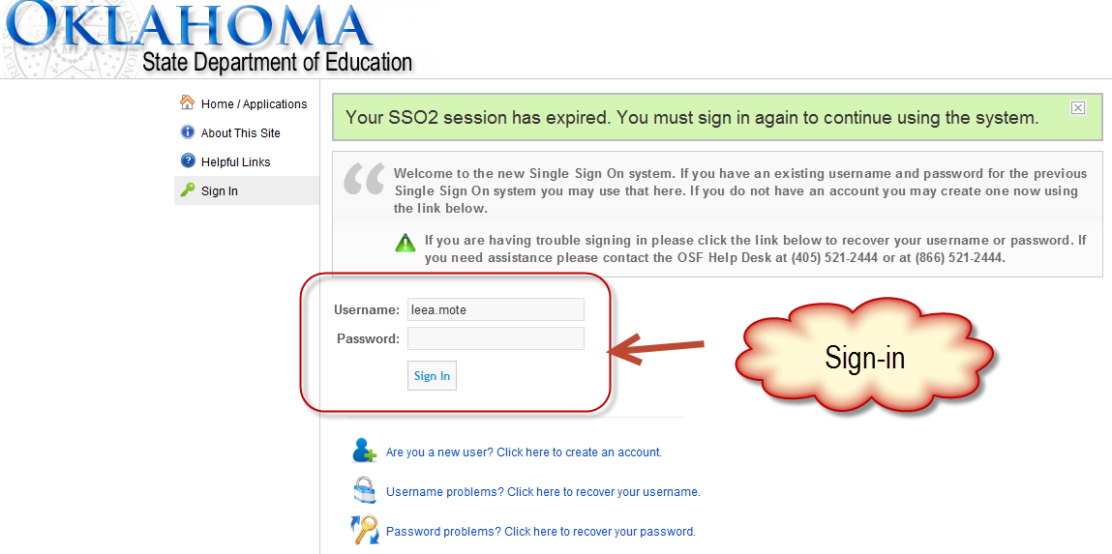
Notes:
Getting into the report, you will go to the single sign on page, which can be found on the SDE webpage. If you do not have access, You can create an account from this page, and request to be assigned to your district. However, the state only manages the superintendent’s account, and user roles and assignment to your district must be added by your superintendent or district login administrator.
Once logged in to single sign on, scroll down to the wave portal.

Slide 10
SSO → The Wave → Reporting tab → State Reporting Certification
Notes:
Once in the wave, CLICK-- go to the reporting tab and find the state reporting certification.

Slide 11
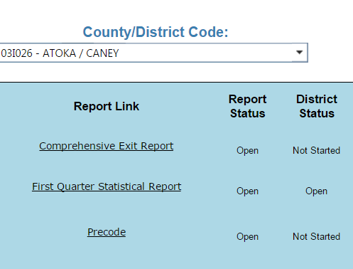
State Reporting Certification Landing Page
Notes:
From there, CLICK
open the Pre-Code application. Please note that no data is actually changed in this report; all changes must be made in your student information system , which is then sent back to the Wave and loaded into application, similar to the October 1 Consolidated Report. CLICK this page also informs you of the district status of the report, which can also be found on the site page.

Slide 12
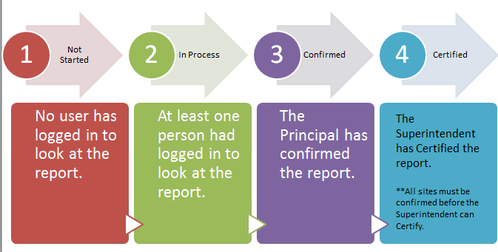
PreCode Application Status
Notes:
The status lets users know where the site is in process. Not started indicates that no one has logged in to review the report. In process means at least one person has logged in to view the report. Confirmed means that all the changes have been made for the site, and the principal has confirmed the accuracy of the report. The principal is the only role that confirm the site report. Certified means the superintendent has certified the report after all sites are confirmed-meaning the superintendent is certifying the district information as accurate. If changes are needed after certifying the report, but prior to the deadline, you must contact the SDE.

Slide 13
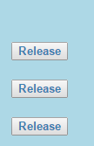
District & Site Certification/Confirmation
Notes:
This will take you to a page where you will select the site you are working on Depending on your district permissions, you may see one site or multiple sites. CLICK
The site principal is able to confirm the report from this landing page and the superintendent can release a site report if changes are needed after confirmation, and the superintendent can certify the district report. CLICK
Changes must be made prior to the January 17 deadline.
CLICK
From this page, you can also see your site status.

Slide 14
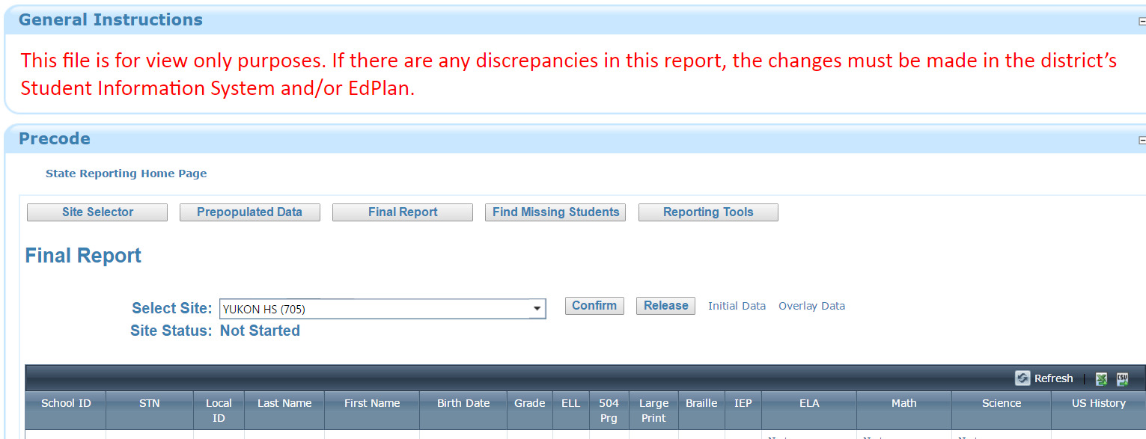
Pre-code First Glimpse
Notes:
Once the site is selected, you will see the navigation bar where you can move to various pages in the report. You can return to the site selector page CLICK, go to the final report CLICK, the find missing students report, CLICK as well as the reporting tools page, which will be covered in later trainings
The final report is the default page where student information will be displayed once a site is selected. Again, no changes can be made in this report, they must all be made in the district student information system.

Slide 15
Precode Header Row for the Final Report
Notes:
The final report is the default page where student information will be displayed once a site is selected. Again, no changes can be made in this report, they must all be made in the district student information system.

Slide 16
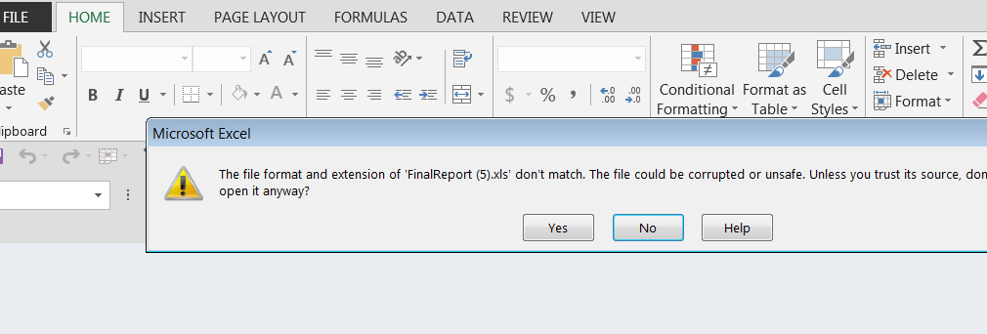
Precode Export Options
Export in .CSV or .XLXS
Notes:
From the final report page, you are able to export all of the site data in an Excel or CSV file. When it downloads, you will receive a message stating the file may be unsafe, and asking if you would like to open it anyway; please say yes.

Slide 17
Precode Landing Page → Find Missing Students
Notes:
From the navigation bar, you can move to the find missing students page. CLICK
This takes you to a list of students the SDE believes should be in your Pre-Code report, but have errors with some of the required fields

Slide 18
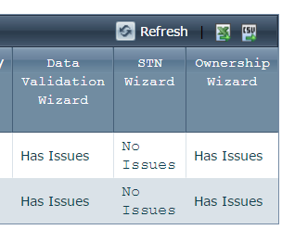
Find Missing Students → Scroll to the furthest right columns
Notes:
When you scroll to the far left of find missing students report, there are three columns where it indicates if the student “Has Issues” in any of the wizards. When it states “Has Issues” a link is provided to the Data Validation, STN Wizard, and Ownership Wizard to the listed issues for the student. For further information about the wizards, you can view the 2016 wave trainings from the documents section under the resource tab in the WAVE.

