Slide 1
A Guide to
Reading
Sufficiency Act
Reading Sufficiency Act
70 O.S. § 1210.508A
70 O.S. § 1210.508B
70 O.S. § 1210.508C
70 O.S. § 1210.508D
70 O.S. § 1210.508E
OAC 210-15-27

Slide 2

Third Grade Graduation Law
The law outlines the adults’ responsibilities in a student’s academic career, leading up to and including third grade, who endorse the student reading on a third grade level before entering fourth grade.
Notes:
Anne E Casey
http://www.aecf.org/~/media/Pubs/Topics/Education/Other/DoubleJeopardyHowThirdGradeReadingSkillsandPovery/DoubleJeopardyReport030812forweb.pdfOverview: How Third-Grade Reading Skills and Poverty Influence
High School Graduation

Slide 3
Third Grade Graduation Law
Oklahoma law states a student may qualify for automatic promotion to the fourth grade if one of these four conditions are met:
Notes:
If
your child scores Unsatisfactory, you will be notified that your child will not be promoted to fourth grade until he or she achieves the required reading level.
OCCT (Oklahoma Core Curriculum Test) Scores are categorized as Unsatisfactory, Limited Knowledge, Proficient and Advanced. An Unsatisfactory score indicates a student is reading at least two years below third grade level.

Slide 4
Third Grade Graduation Law
Conditions:
Demonstration of Third Grade Level Proficiency on a Screening/Benchmark Assessment
Qualification through use of a student portfolio
Scoring Limited Knowledge on the OCCT
Application of the other Good-Cause Exemptions

Slide 5
Benchmark Assessment
Districts are still required to conduct beginning, middle and end of the year screening/benchmark assessments.
Amendments to the law exempt students who demonstrate proficiency in reading at a third grade level from the retention requirements of RSA.
Determination not made on cut scores, but on requisite level of performance.
Written notification to parents required.

Slide 6
Oklahoma State Board of Education
Thirteen RSA Formative Approved Assessments
aimsweb | Children’s Progress Academic Assessment | Dibels NEXT | DRA+
easyCBM | GRADE | iREADY | Literacy First
mClass Dibels Next | Measured Academic Progress (MPG) | Measures of Academic Progress (MAP) for Primary Grades | STAR Early Learning Enterprise (Star Early Literacy and Star Reading) by Renaissance Learning, Inc.
Woodcock Reading Mastery Tests, Third Edition (WRMT- III), NCS

Slide 7

Oklahoma State Board of Education
Thirteen RSA Formative Approved Assessments
Districts Must Be Aware that Each of the 13 RSA Formative Approved Assessments
Have Allowable Accommodations
These Accommodations Must Be Provided to Students Based on Their IEP.

Slide 8
Portfolio
School district must begin compiling a student portfolio for every student who demonstrates a significant reading deficiency.
  Demonstration of deficiency is based on screening/benchmark assessment (Not scoring at third grade level)
District must” immediately” begin compiling Portfolio
Portfolio must meet requirements of OAC 210: 15-27-2
Detailed parental notification required. See subsection (1) if statute
Student shall continue to receive intensive remediation

Slide 9
Limited Knowledge
Law requires written notification to parents/legal guardians that the student is not reading on grade level and the option for retention if they so desire.
LK students shall be entitled to receive intensive remediation
Student Reading proficiency team is assembled to create IRP
Continued monitoring to ensure requirements of IRP are met

Slide 10
Third Grade Graduation Law
If a third grade student does not meet one of these requirements for automatic promotion then the student will either receive probationary promotion or be retained in the third grade.

Slide 11
Probationary Promotion
A student who does not qualify for Automatic Promotion to the fourth grade may be evaluated by a Student Reading Proficiency Team.
If each member of Student Reading Proficiency Team unanimously recommends the student for Probationary Promotion, the student shall be promoted to the fourth grade.
Once the Student Reading Proficiency Team has made a unanimous recommendation, the recommendation shall be submitted to the superintendent of the school district for approval if promotion is the best option for the student.
If the student is allowed a Probationary Promotion, the Student Reading Proficiency Team shall continue to review the reading performance of the student and repeat the requirements of this paragraph every school year until the student demonstrates grade-level reading proficiency as identified through a screening instrument for the corresponding grade level in which the student is enrolled.

Slide 12
Academic Progress Plan
(APP)

Slide 13
What is the
Academic Progress Plan (APP)?
Describes the child’s specific reading difficulties and includes:
  Identification of assessments used for diagnostic purposes and periodic monitoring
  The results of the assessment used to identify the reading deficiency

Slide 14
Which Students Have The
Academic Progress Plan (APP)?
The law requires schools to develop an Academic Progress Plan (APP) for each student who is retained or reading below grade level.

Slide 15
Why Have The
Academic Progress Plan (APP)?
Intensive teaching practices that will be used to help the child catch up in reading.
Provided during regular school hours in addition to the regular reading instruction.
Each student’s progress will be monitored frequently.
This intensive help will be provided until the reading deficiency is corrected.

Slide 16
What Is In The
Academic Progress Plan (APP)?
A list of the developmental reading skill areas targeted for improvement
  phonological awareness
  phonics
  reading fluency
  vocabulary
  comprehension
  spelling
Phonological Awareness
Phonics
Comprehension
Fluency
Vocabulary

Slide 17
What Else Is In The
Academic Progress Plan (APP)?
A description of the supplemental and/or remedial services and supports provided to the student
Identification of any collaborative services provided to the child in order to facilitate the APP (i.e., Title I, IDEA, ELL/Title III).

Slide 18
What Else Is In The
Academic Progress Plan (APP)?
A description of parental involvement strategies

Slide 19
Three-tiered
Response to
Intervention(“RtI”) model
For purposes of the Reading Sufficiency Act, a “program of reading instruction”

Slide 20
Tier I Intervention
For students identified for Tier I intervention,
  a minimum of ninety minutes of
  uninterrupted
  daily
  scientific-research-based reading instruction

Slide 21
Tier II intervention
For students identified for Tier II intervention,
  at least thirty to forty-five minutes of
  additional
  uninterrupted
  daily
  scientific-research-based reading instruction
  in addition to the ninety minutes of uninterrupted daily reading instruction provided under Tier I

Slide 22
Tier III Intervention
For students identified for Tier III intervention,
  at least forty-five to sixty minutes of
  additional
  uninterrupted
  daily
  scientific-research-based reading instruction
  in addition to the ninety minutes of uninterrupted daily reading instruction provided under Tier I.

Slide 23
Intensive Intervention and
Intensive Acceleration

Slide 24
Intensive Interventions
In Addition to RtI
  Small group instruction
  Reduced teacher-student ratio
  More frequent progress monitoring
  Tutoring or mentoring
  Transition classes containing third- and fourth-grade students
  Extended school day, week, or year
  Summer Academy Reading Program

Slide 25
Intensive Interventions
Students must also be offered at least one of the following options:
  Supplemental scientific research-based reading
  Tutoring before or after school
  A parent-guided Read at Home assistance plan
  A mentor or tutor with specialized reading training
  Once the intensive instruction has begun, the student’s progress will be checked frequently so the teaching strategies may be adjusted if necessary.

Slide 26
Intensive Acceleration Class
If a student has already been retained once in third grade and then scores an Unsatisfactory again,
the school must provide an intensive acceleration class that focuses on
increasing the child’s reading level at least two grade levels
in one school year.

Slide 27
Intensive Acceleration Class must:
Have a reduced teacher-student ratio
Have a high-performing teacher
Provide uninterrupted reading instruction for most of the school day

Slide 28
Intensive Acceleration Class
Must give students the opportunity to master the fourth-grade Oklahoma Standards in other core subject areas
Provide intensive language and vocabulary instruction using a scientifically research-based program, including the use of a speech-language therapist

Slide 29
Intensive Acceleration Class
Must monitor student progress weekly
The district must also offer this student the option of being served in a transitional instructional setting designed to help them meet the fourth-grade Oklahoma Standards, while continuing the remediation of the reading deficiency.

Slide 30
Mid Year Promotion
If the child can demonstrate the required reading level before the start of the next school year, he/she may be promoted to fourth grade.
Notes:
If the child achieves the required reading level during the next school year, the child may be promoted to fourth grade prior to November 1. To be promoted to fourth grade midyear, the child must demonstrate mastery of third-grade reading skills and beginning fourth-grade reading skills. This will ensure the student has made enough progress to be successful in fourth grade. The student may be given a standardized test, or the teacher may put together a portfolio of the student’s work to demonstrate proficiency.

Slide 31
SEVEN GOOD CAUSE EXEMPTIONS FROM
THIRD-GRADE RETENTION

Slide 32
GOOD CAUSE EXEMPTIONS
Some third graders who score Unsatisfactory on the OCCT reading may be exempted from the retention requirement and be promoted to fourth grade. This is called a good-cause exemption. Good-cause exemptions are only given to the following students:

Slide 33
One of SEVEN GOOD CAUSE EXEMPTIONS FROM
THIRD-GRADE RETENTION
Be identified as Limited-English Proficient (LEP)/English Language Learner (ELL) on a screening tool approved by the Oklahoma State Department of Education Office of Bilingual/Migrant Education

Slide 34
One of SEVEN GOOD CAUSE EXEMPTIONS FROM
THIRD-GRADE RETENTION
Have a Language Instruction Educational Plan (LIEP) in place prior to the administration of the third grade criterion referenced test;

Slide 35
One of SEVEN GOOD CAUSE EXEMPTIONS FROM
THIRD-GRADE RETENTION
The student must have had less than two (2) years of instruction in an English Language Learner (ELL) program.

Slide 36
Two of SEVEN GOOD CAUSE EXEMPTIONS FROM
THIRD-GRADE RETENTION
Students with disabilities who are assessed with alternate achievement standards (AA- AAS) under the Oklahoma School Testing Program (OSTP) with the Oklahoma Alternative Assessment Program (OAAP) qualify for the good cause exemption. The student must be identified as needing special education services prior to the administration of the third grade criterion referenced test

Slide 37
Two of SEVEN GOOD CAUSE EXEMPTIONS FROM
THIRD-GRADE RETENTION
The student must have an Individualized Education Program (IEP) in place prior to the administration of the third grade criterion referenced test and the student’s IEP must direct that the student is to be assessed with alternate achievement standards through the Oklahoma Alternative Assessment Program (OAAP) based upon the OSDE Criteria Checklist for Assessing Students with Disabilities on State Assessments.

Slide 38
Three of SEVEN GOOD CAUSE EXEMPTIONS FROM THIRD-GRADE RETENTION
To promote a student using an alternative standardized reading assessment, the following criteria shall apply: The student must score an acceptable level of performance on an approved alternative standardized reading assessment. The following are approved alternative standardized reading assessments that may be used to justify a good cause promotion. The listed score constitutes an acceptable level of performance, and the student must score at or above the following percentiles:

Slide 39
Three of SEVEN GOOD CAUSE EXEMPTIONS FROM THIRD-GRADE RETENTION
Stanford Achievement Test, Tenth Edition, (SAT 10)-45th Percentile
Iowa Test of Basic Skills (ITBS) Complete Battery, Form A, C or E, Level 9, Reading Comprehension -45th Percentile
Iowa Test of Basic Skills (ITBS) Core Battery, Form A, C, or E, Level 9, Reading Comprehension – 45th Percentile
TerraNova, Third Edition Complete Battery Level 13, Reading– 45th Percentile

Slide 40
Three of SEVEN GOOD CAUSE EXEMPTIONS FROM THIRD-GRADE RETENTION
Alternative standardized reading assessments may only be administered following the administration of the Reading portion of the third grade criterion-referenced test.
  The spring test form of the exam shall be administered.
  An approved alternative standardized reading assessment may be administered at any time prior to the start of the next academic year,
  if there are at least twenty calendar days between administrations and different test forms are administered.

Slide 41
Four of SEVEN GOOD CAUSE EXEMPTIONS FROM THIRD-GRADE RETENTION
To promote a student based on evidence from the Student Portfolio,
  Student Portfolio shall include evidence demonstrating the student’s mastery of the Oklahoma state standards in reading equal to grade level performance on the Reading portion of third grade OCCT.
  Such evidence shall be documented through an organized collection of work representing the student’s mastery of such standards

Slide 42
Four of SEVEN GOOD CAUSE EXEMPTIONS FROM THIRD-GRADE RETENTION
including a demonstration of mastery of all of the following essential components of reading:
Phonological Awareness,
Phonics
Vocabulary
Automaticity/Fluency
Comprehension
Spelling/Writing
Phonological Awareness
Phonics
Comprehension
Fluency
Vocabulary

Slide 43
Four of SEVEN GOOD CAUSE EXEMPTIONS FROM THIRD-GRADE RETENTION
The student portfolio shall include clear evidence that the standards assessed by the Reading portion of the third grade OCCT have been met. Clear evidence must include multiple choice items and passages
that are 50% literary text and 50% expository text
that are between 200-600 words,
with an average of 350 words.

Slide 44
Four of SEVEN GOOD CAUSE EXEMPTIONS FROM THIRD-GRADE RETENTION
Such evidence could consist of: Chapter or unit tests from the district’s adopted core reading curriculum that are aligned with the Oklahoma State Standards or Teacher-prepared assessments.

Slide 45
Four of SEVEN GOOD CAUSE EXEMPTIONS FROM THIRD-GRADE RETENTION
Each standard and objective assessed by the Reading portion of the third grade OCCT must include a minimum of four work samples of mastery whereby the student attained a grade of 70% or above.
  Demonstrating mastery of each objective for each standard is required.

Slide 46
Four of SEVEN GOOD CAUSE EXEMPTIONS FROM THIRD-GRADE RETENTION
Each standard and objective assessed by the Reading portion of the third grade OCCT must include a minimum of four work samples of mastery whereby the student attained a grade of 70% or above.
  Demonstrating mastery of each objective for each standard is required.

Slide 47
Four of SEVEN GOOD CAUSE EXEMPTIONS FROM THIRD-GRADE RETENTION
All Students Who Score Below Benchmark
Must Have a Student Portfolio

Slide 48
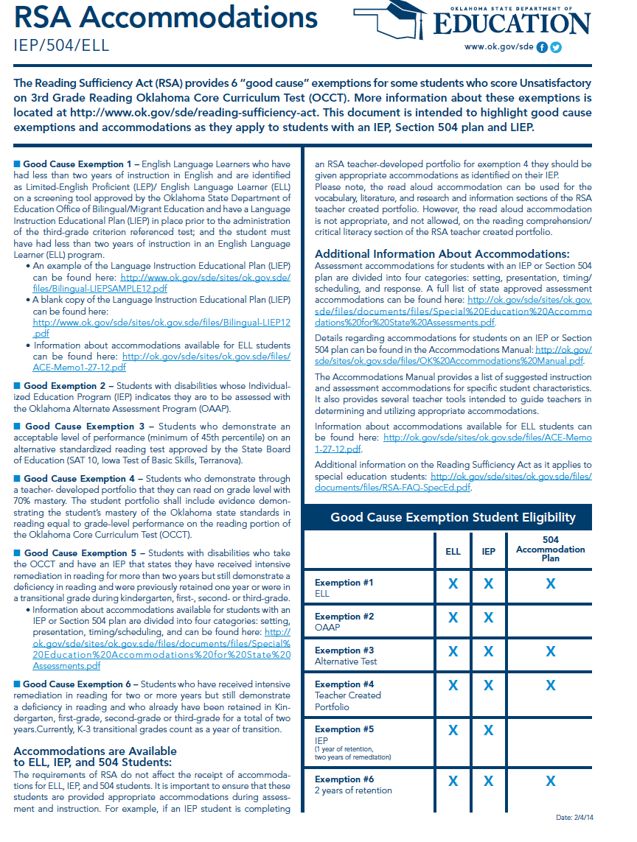
Four of SEVEN GOOD CAUSE EXEMPTIONS FROM THIRD-GRADE RETENTION

Slide 49
Five of SEVEN GOOD CAUSE EXEMPTIONS FROM
THIRD-GRADE RETENTION
Students with disabilities who participate in the statewide criterion-referenced test and have an IEP may qualify for a good cause exemption.
To qualify for this exemption, the student must meet the following criteria:
  The student must have been previously retained in prekindergarten, kindergarten, first grade, second grade, or third grade.

Slide 50
Five of SEVEN GOOD CAUSE EXEMPTIONS FROM
THIRD-GRADE RETENTION
    The student’s IEP must identify Reading as an area of education need for the student or
    identify some type of special education service in the area of reading and
    reflect that the student has received intensive remediation for more than two years.
    Intensive remediation may include any type of program offering intensive reading instruction that is identified as appropriate by the IEP team.

Slide 51
Six of SEVEN GOOD CAUSE EXEMPTIONS FROM
THIRD-GRADE RETENTION
Students who demonstrate a reading deficiency and have been previously retained may qualify for a good cause exemption. To qualify for this exemption, the student must meet the following criteria:
  The student must have been previously retained in prekindergarten, kindergarten, first grade, second grade, or third grade for a total of two years and
  The student must have received intensive reading instruction for two or more years.

Slide 52

Seven of SEVEN GOOD CAUSE EXEMPTIONS FROM THIRD GRADE RETENTION
Students facing exceptional emergency circumstances which prevent the student from being assessed during the testing window.
These must approved by the Office of Accountability and Assessment.

Slide 53
Available Resources
Oklahoma SDE Web pages:
http://ok.gov/sde/reading-sufficiency-act
http://ok.gov/sde/reading-and-literacy
http://ok.gov/sde/parent-resources
For more information, contact:
Office of Instruction Literacy Team
rsa@sde.ok.gov
Created by:
Stephanie Frasier, Director of Reading Sufficiency
Oklahoma State Department of Education

