Slide 1

School Improvement and the
Oklahoma Nine Essential Elements
Desarae A. Witmer, Executive Director
Office of School Support
Oklahoma State Department of Education
desarae.witmer@sde.ok.gov
(405) 522-0140

Slide 2
Poll Everywhere Instructions
On your cell phone open text messages
Enter 22333 in the To space
Enter OST15 in the message space.
“Send”
You will receive a message that you have joined my poll.

Slide 3

Poll Everywhere
What questions brought you to this session?

Slide 4
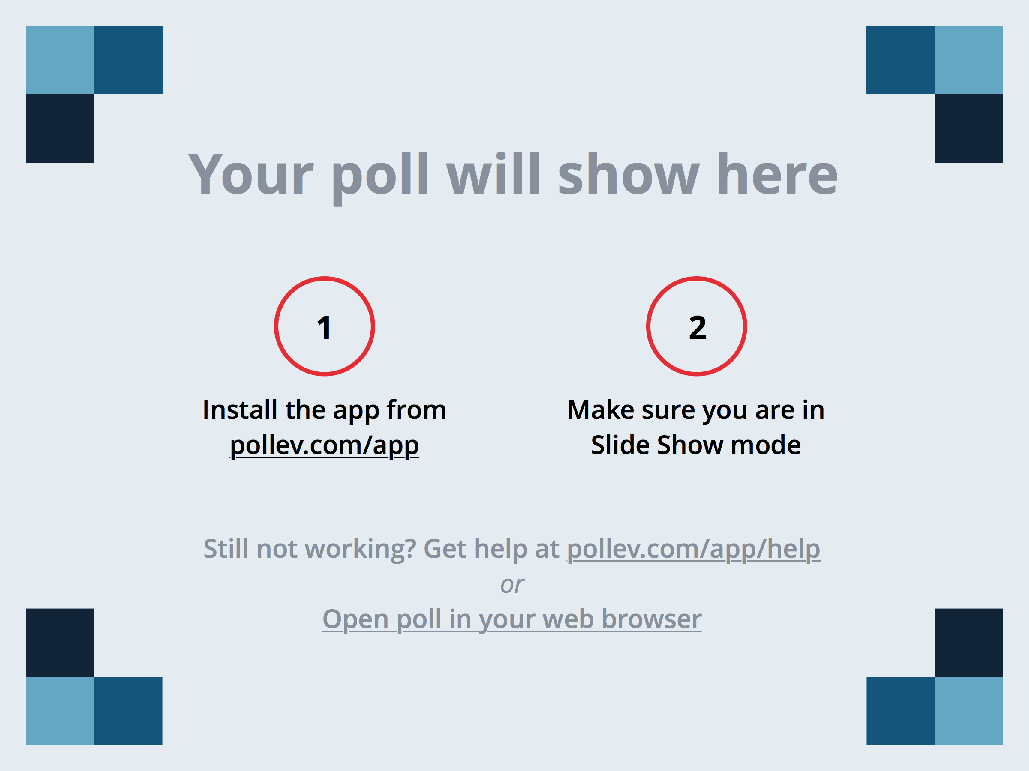
Notes:
What questions brought you to this session?
https://www.polleverywhere.com/free_text_polls/KnBdIQds8SGxQI3

Slide 5



Office of School Support
Formally Known As “Turnaround”
Provide support, financial assistance and/or resources to schools who receive a Priority, Focus or Targeted Intervention Designation.

Slide 6


Poll Everywhere
What does a “Designated School” look like?

Slide 7
Notes:
What does a "Designated School" look like?
https://www.polleverywhere.com/free_text_polls/2pex30WMMheg6n5

Slide 8

Designations
Priority *
Focus *
Targeted Intervention *
Reward
High Performance

Slide 9

Priority Designation
  Any school that receives a grade of “F.”
  Any school in the bottom 5% for the grade span served in reading and math.
  Any high school with a graduation rate below 60% for three consecutive years.
  Any high school with a graduation rate of 50% or less in any given year.

Slide 10

Priority Responsibilities
  Financial Allocation
  Grants Management System
    School Wide/School Improvement Application
      10 Components & 9 Essential Elements
  School Improvement Status Report (SISR)
  - Data Reporting System
  Parent Notification Letter
  Letter Grade and Designation posted on website
  School Choice NOT required for 2015-2016**
  Schools with a designation for 3+ years – principal and superintendent must attend 15 hours of professional development. (June 2015-July 2016)

Slide 11
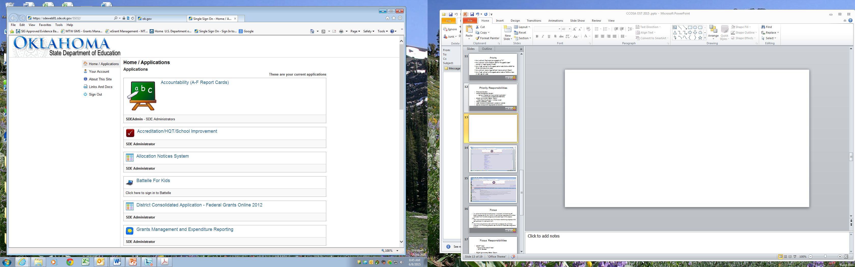
https://sdeweb01.sde.ok.gov/SSO2/Signin.aspx
Where do I find this information?

Slide 12
Schools with a Priority Designation
Need “Single Sign On” Access

Slide 13

Focus
Any school contributing to the achievement for students with disabilities (IEP), English Language Learners (ELL), and/or African American subgroup and the school had higher than the state’s average population percentage for that subgroup.
AND
Have the lowest performance for any of the three lowest achieving subgroups within each grade span for reading and math.
OR
Have the lowest graduation rate for either the two subgroups (ELL and African American) with the lowest graduation rates that have not already been designated as priority.
Have a graduation rate below the state average.

Slide 14

Focus Responsibilities
  SMART Goal
  (Specific Measurable Attainable Results Oriented Time bound)
    Beginning with SY15 designation.
    Will be emailed to all schools with a Focus Designation.
    “Focus” on the area of need.
  Single Improvement Status Report
  - Data Reporting System
  Schools with a designation for 3+ years – principal and superintendent must attend 15 hours of professional development. (June 2015-July 2016)

Slide 15

SMART Goal
Specific
Measurable
Attainable
Results Oriented
Time Bound
Based on your
school’s area of need.

Slide 16

Targeted Intervention
Subgroup graduation rate is
below the national average.

Slide 17
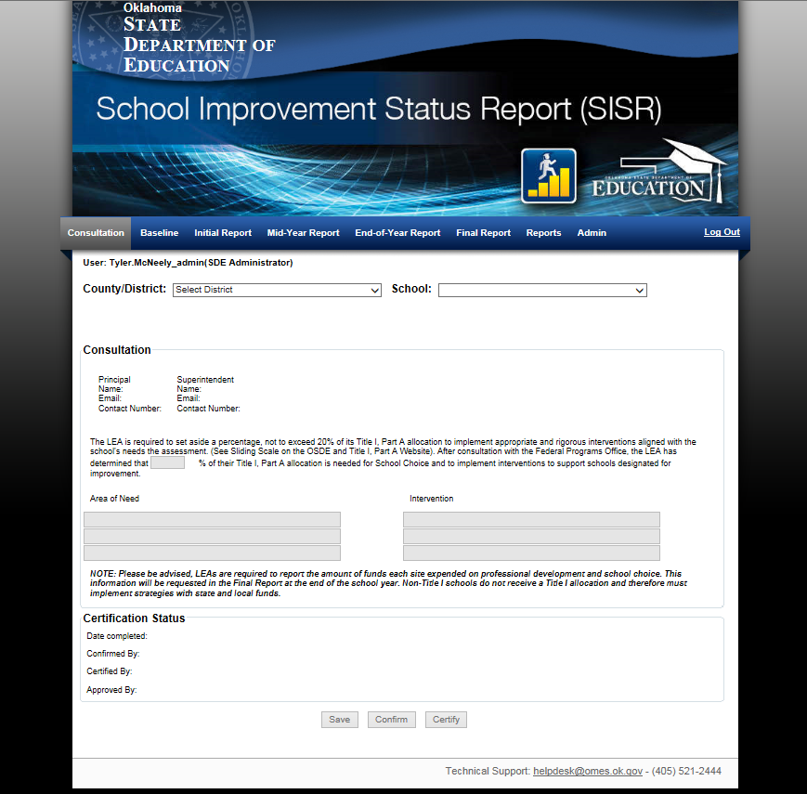
Training provided via WebEx.
Front Page
Outlines Requirements
This report must be completed by all schools with a SY15 designation

Slide 18

Office of School Support Team
Desarae Witmer, M.Ed. Executive Director desarae.witmer@sde.ok.gov
Beth Steele, M.Ed. SIG Director beth.steele@sde.ok.gov
Janie Stewart, Coordinator janie.stewart@sde.ok.gov
Zada Farris, Grants Consultant zada.farris@sde.ok.gov
OSDE School Support Specialists
OSDE School Support Consultants

Slide 19
OSDE School Support Specialists
Nick Clayton
Stephanie Schutt
Jan Foreman
Tina Spence
Deborah Cornelison
Janel Cypert
VaRhea Owens-Hopkins
Email: first.last@sde.ok.gov

Slide 20
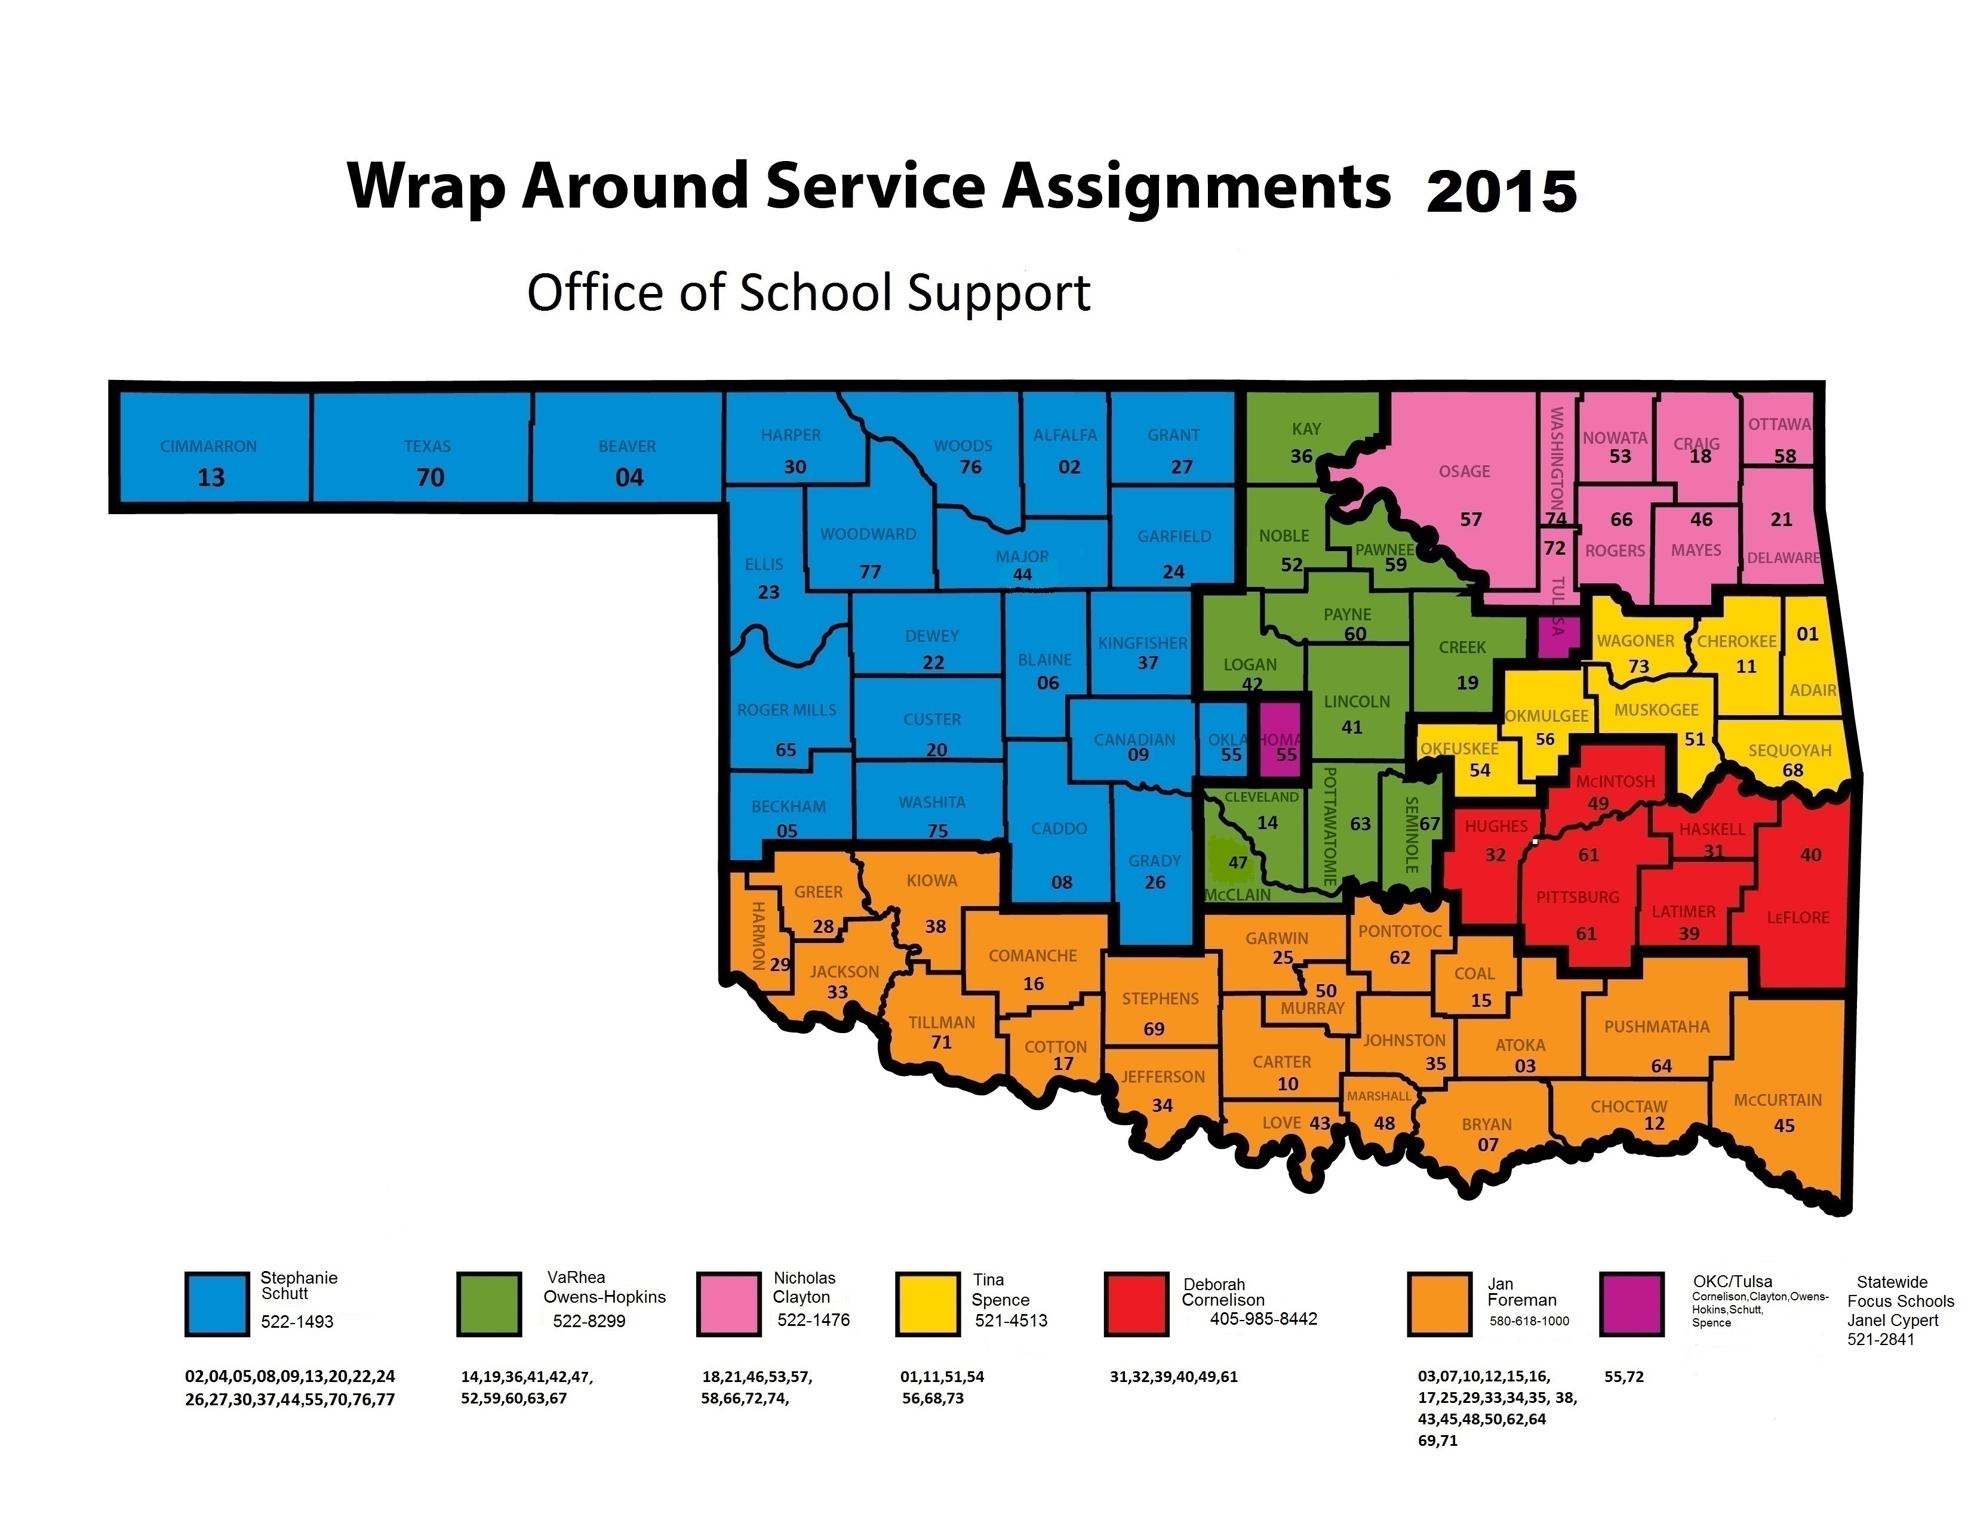

Slide 21
OSDE School Support Consultants
Beta Noel, M.Ed. beta.noel@sde.ok.gov
Dr. Jill Shackelford, Ed.D. jillshackelford@me.com
Linda Hibbs, M.Ed. linda.hibbs@sbcglobal.net
Roberta Ellis, M.A obertacoleellis@gmail.com
Roberta Gaston, M.Ed. mrs.gaston@sbcglobal.net

Slide 22

Poll Everywhere
My school/district has received a visit from a member of the Office of School Support Team

Slide 23
Notes:
My school/district has received a visit from a member of the Office of School Support Team.
https://www.polleverywhere.com/multiple_choice_polls/3FvKh2vsCW6ZwZi

Slide 24
Level 3
OSDE School Support Consultants
New Prin./Supt.
SIG Schools
Level 2
Consult w/ an Emphasized Area
Level 1
School Specialists
40 Sites
Level 4
OSDE Network
Schools with the same designation for 3 or more years.
Wrap Around
Support System
Site visit with an OST Needs Assessment
Based on the OST Needs Assessment

Slide 25
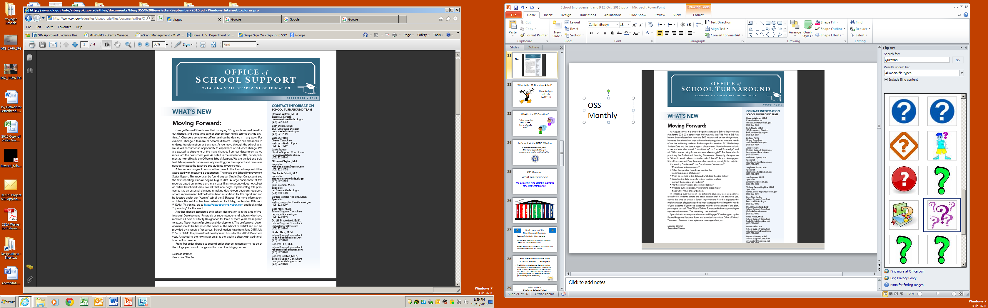

Not getting this newsletter?
Please let us know.
Email me at
Desarae.witmer@sde.ok.gov
or drop off a business card
Other resources?
OSDE Website
www.ok.gov/sde/ school-improvement
Office of School Support Monthly Newsletter

Slide 26

Poll Everywhere

Slide 27
Notes:
Questions
https://www.polleverywhere.com/free_text_polls/fnraX15ROQfyqPr

Slide 28


Slide 29

Let’s look at the OSDE Mission
To champion excellence for all
Oklahoma students through
engagement, service and leadership.

Slide 30

What is the #1 Question Asked?
How do I get off this list???!!!!

Slide 31

#2 Question
What really works?

Slide 32


#3 Question?
“What steps do I take?
Where do I start?”

Slide 33

School Wide/School Improvement Plan
Based on a Formative Needs Assessment
Embedded Nine Essential Elements provides a framework
Contains Guiding Questions

Slide 34

Poll Everywhere
We have/use a formative needs assessment that provides information that can be used during the development of our site improvement plan.

Slide 35
Notes:
We have/use a formative needs assessment that provides information that can be used during the development of our site improvement plan.
https://www.polleverywhere.com/free_text_polls/JSgv4JJuW7tZ3wt

Slide 36

Don’t have a needs assessment?
The Office of School Support will release a “Needs Assessment” on January 1, 2016 based on the Oklahoma Nine Essential Elements. This tool will be an available resource for schools who are looking for a new tool to support the development of their School Wide/School Improvement Plan.

Slide 37
Framework for Success!!
Improved Student Learning
Classroom Evaluation/Assessment
Professional Growth, Development,
and Evaluation
Student, Family, and Community Support
Organizational Structure and Resources
Comprehensive and Effective Planning
Curriculum
School Culture
Instruction
Leadership
Oklahoma Nine Essential Elements Systems Framework
Notes:
The Nine Essential Elements are in three main categories: Academic Performance; Learning Environment; and Efficiency
You have these identified and defined in your portfolio and booklet.

Slide 38

Brief History of the
Nine Essential Elements
Research Project conducted by the Marzano Research Laboratory
Conducted in Oklahoma schools from 2009-2011
- High and low achieving schools
Evidence supported a framework to support school improvement efforts in ALL schools.

Slide 39

How were the Oklahoma Nine Essential Elements Developed?
The Oklahoma Nine Essential Elements evolved from Oklahoma’s participation in a consortium of states through the Chief Council of State School Officers (CCSSO). Oklahoma adapted standards (Essential Elements) and indicators of effective practice first piloted in Kentucky.
Notes:
Oklahoma adopted the Oklahoma Nine Essential Elements in 2005 as a framework for school improvement for all its schools. The Oklahoma Nine Essential Elements evolved from Oklahoma’s participation in a consortium of states through the Chief Council of State School Officers (CCSSO). Oklahoma adapted standards (Essential Elements) and indicators of effective practice first piloted in Kentucky.
Oklahoma developed a self-assessment rating scale of the performance indicators that provided specifics for each of the Oklahoma Nine Essential Elements, and created resources to help schools improve their practices, as defined by the indicators. The Oklahoma Nine Essential Elements now include scoring rubrics with descriptions for each indicator. In 2010, OSDE revised the indicators to add an “active voice” and to designate the person or groups responsible for each indicator.

Slide 40

What Works in Oklahoma Schools Project
Conducted by Marzano Research Laboratory based on Oklahoma’s Nine Essential Elements
33 schools in improvement and 28 higher achieving schools not in improvement with similar demographics
Notes:
Oklahoma contracted with the Marzano Research Laboratory (MRL) to conduct a research study based on the Oklahoma Nine Essential Elements performance indicators. The study includes 33 schools in improvement and 28 schools that are not in improvement, but have similar demographics. The study is designed to: 1) validate the Oklahoma Nine Essential Elements and performance indicators that are integral to the success of Oklahoma schools, 2) provide feedback on strengths and areas of need for a sample of Oklahoma schools, and 3) use the results to create a replicable system for all Oklahoma schools to better identify areas of strength and need.

Slide 41

What Works in Oklahoma Schools Project
Four primary stakeholder groups were identified to participate in the study: (1) teachers, (2) site administrators, (3) parents, and (4) students
Phase I included surveys from the various groups
Phase II included classroom observation, videotaped classroom instruction and analysis, and principal interviews
Notes:
Four primary stakeholder groups were identified to participate in the study:
teachers, (2) site administrators, (3) parents, and (4) students
Phase I included surveys from the various groups
Surveys were given to teachers, site administrators, parents, and students. They were then asked to respond to survey questions related to use and implementation of indicators for the Oklahoma Nine Essential Elements related to their school. The responses of the improvement schools versus the non-improvement schools were then analyzed for significant differences. Correlations were also completed to compare the average scores on the Oklahoma Nine Essential Elements and the proportion of students scoring proficient or above on the state test.
Phase II focused on what occurs in Oklahoma classrooms using data from
principal interviews, classroom observations (on-site), and video recorded observations. Teacher data was anonymous and video recordings of teachers were viewed only by MRL researchers involved in the study.

Slide 42

What Works in Oklahoma Schools 5 Recommendations
1. Administrators and teachers should seek agreement on the school’s strengths and weaknesses regarding school performance.
2. All teachers should set personal goals regarding instructional strategies.
3. Student engagement should receive a schoolwide focus.
4. Students’ perceptions of acceptance and order should be examined.
5. Schools should find ways for staff to work together (e.g., professional learning communities).
Notes:
Based on surveys, principal interviews, on-site observations, and videotape analyses conducted during Phases I and II, MRL provides the following five recommendations to help schools move from Improvement status to Non-Improvement status:

Slide 43

Comprehensive Framework
Builds capacity of districts to meet student achievement goals
Provides support and resources to meet individualized needs of both schools and districts
Based on current research
Based on best practices
Defines high quality initiatives that support student achievement
Notes:
The Nine Essential Elements framework guides districts in meeting the following criteria for school improvement and success.
Builds capacity of districts to meet student achievement goals
Provides support and resources to meet individualized needs of both schools and districts
Based on current research
Based on best practices
Defines high quality initiatives that support student achievement

Slide 44

Maintain the 3 Big Ideas
Learning is our fundamental purpose. Academic Performance
A collaborative culture creates high-performing teams. Learning Environment
Results grounded in evidence places a focus on results rather than intentions.
Collaborative Leadership

Slide 45

Oklahoma Nine Essential Elements
The Oklahoma Nine Essential Elements provide the framework for the continuous school improvement process for all schools – urban, suburban, rural; large or small; high-performing or low-performing.
Notes:
Whether you are in an urban, suburban, rural; large or small; high-performing or low-performing school, The Nine Essential Elements provide the needs assessment, the strategies and the resources for continuous school improvement.

Slide 46
IMPROVED STUDENT ACHIEVEMENT
ACADEMIC PERFORMANCE
LEARNING ENVIRONMENT
LEADERSHIP
Leadership
Organizational Structure and Resources
Comprehensive and Effective Planning
Curriculum
Classroom Evaluation/ Assessment
Instruction
School Culture
Student, Family, Community Support
Professional Growth and Development
Notes:
In order to have a schoolwide framework for continuous school improvement for all schools in the district and all students in the district, this guide establishes a systematic approach to ensuring student achievement for all students.
This slide provides an overview of the three areas of focus: Academic Performance; Learning Environment; and Efficiency. The Guide is designed to help districts:
analyze existing systems of Academic Performance, Learning Environments, and efficiency;
identify additional district-wide structures that may be needed to create a culture for student achievement; and
establish ongoing, reflective, data-driven process for change
Within each of the three areas are three essential elements critical for a successful school system.
Academic Performance includes: Curriculum; Classroom Evaluation/Assessment; and Instruction
Learning Environment includes: School Culture; Student, Family, Community Support; and Professional Growth and Development
Efficiency includes: Leadership; Organizational Structure and Resources; and Comprehensive and Effective Planning
Turn to someone sitting next to you and discuss which two of the nine elements you believe are most critical to student achievement.
Research indicates that Leadership and School Culture are critical before the other areas can be successful elements in a systems approach. The next two areas critical to the process of continuous school improvement are: Classroom Evaluation/Assessment and Professional Growth, Development and Evaluation

Slide 47
Element 1: Academic Performance – Curriculum
The school faculty develops and implements a curriculum that is rigorous, intentional and aligned to the state and local standards.
Performance Expectations:
School leader recognizes and encourages implementation practices that motivate and increase student achievement.
Use of OAS standards are evident
Training is provided to identify Tier I needs based on data.
Training in baseline instructional unit planning

Slide 48
Element 2: Academic Performance – Classroom Evaluation/Assessment
The school faculty uses multiple evaluation and assessment strategies to continuously monitor and modify instruction to meet student needs and support proficient student work.
Performance Expectations:
The school leader communicates both a focused mission to improve student achievement and a vision of the critical elements of curriculum and instructional practices that make high achievement possible.
Focuses on continuous formative assessment.
Monitors lesson plans for rigor.
Student data tracking system.

Slide 49
Element 3: Academic Performance – Instruction
The school faculty provides an instructional program that actively engages all students by using effective, varied, and research-based practices to improve student academic performance.
Performance Expectations:
The school leader recognizes and encourages implementation of instructional practices that best motivate and increase student achievement.
Cross Curricular Collaboration.
Differentiated instruction.
Response to Intervention.

Slide 50
Element 4: Learning Environment – School Culture
The school/district leadership team functions as an effective learning community and supports a climate conducive to performance excellence.
Performance Expectations:
The school leader sets high expectations for all students to learn high-level content.
Consistent Classroom Management.
Structures for Day-to-Day Operations.
Processes to Address Attendance.
Clear Positive Behavior Systems..

Slide 51
Element 5: Learning Environment – Student, Family and Community Support
The school/district leadership team works with families and community groups to remove barriers to learning in an effort to meet the intellectual, social, career, and developmental needs of students.
Performance Expectations:
Has a process to identify students with special needs.
The school leader keeps everyone informed and focused on student achievement.
The school leader includes parents as partners in education and creates a structure for parent and educator collaboration.
Broad community engagement

Slide 52
Element 6: Learning Environment – Professional Growth, Development and Evaluation
The school/district leadership team provides research-based, results-driven professional development opportunities for staff and implements performance evaluation procedures in order to improve teaching and learning.
Performance Expectations:
Provides research-based, results-driven professional development for staff.
Provides training on priorities identified during observations that may include classroom management, lesson plan development, Differentiated Instruction and Content Needs.
Teacher tailored development plans based on regular walk-through visits.
Coaching provided for teachers marked as ineffective.

Slide 53
Element 7: Collaborative Leadership
The school/district leadership team provides instructional decisions focusing on support for teaching and learning, organizational direction, and high performance expectations. The school/district leadership team creates a learning culture and develops leadership capacity.
Performance Expectations:
The school leader creates both a focused mission to improve student achievement and a vision of how to implement the critical elements necessary for the alignment of curriculum, assessment, and instructional practices.
Leadership Team Development.
Teacher Leadership Collaboration.

Slide 54
Element 8: Collaborative Leadership – Organizational Structure and Resources
The school/district leadership team provides instructional decisions focusing on support for teaching and learning, organizational direction, and high performance expectations. The school/district leadership team creates a learning culture and develops leadership capacity.
Performance Expectations:
The school leader acquires and uses resources wisely for the purpose of student achievement.
The school leader uses and organizes time in innovative ways to meet the goals and objectives of school improvement.
Builds in time for intervention.

Slide 55
Element 9: Collaborative Leadership – Comprehensive and Effective Planning
The school/district leadership team develops, implements, and evaluates a comprehensive school improvement plan that communicates a clear purpose, direction, and action plan focused on teaching and learning.
Performance Expectations:
The school leader uses data to initiate and continue improvement in school and classroom practices and student achievement.
School wide data tracking system.
Student intervention plan based on formative data and need for reteach.

Slide 56

School Wide/School Improvement Plan
Nine Essential Elements are embedded into this plan.
Plan opens January 1, 2016.
Schools with a SY14 or SY15 designation have until October 1, 2016 to transition to the new plan.
Why so much time? Many schools with SY14 designation funds have already created a plan for FY16 funds using Project 515. SY14 funds expire on September 30, 2016.
Schools new to designation will only have access to the SW/SI Plan.

Slide 57

Grants Management System

Slide 58
Need “Single Sign On” Access

Slide 59
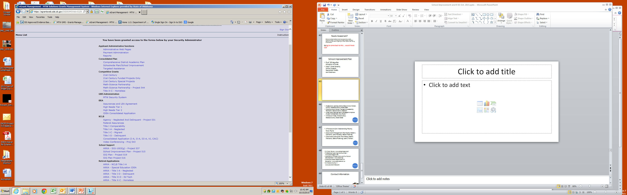
Will need access to two areas.

Slide 60
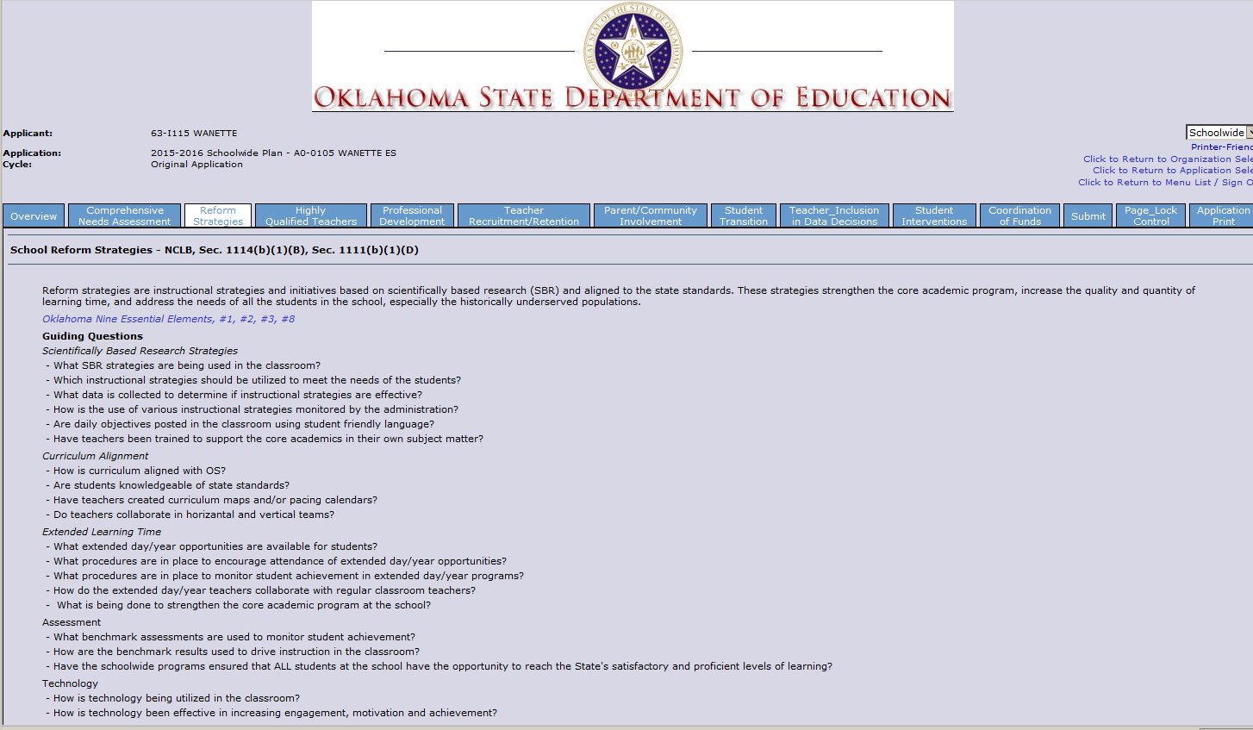
Title I Components AND Oklahoma’s Nine Essential Elements
combined into one School Improvement Plan Application
Oklahoma’s Nine Essential Elements are embedded into the plan.
Guiding Questions

Slide 61
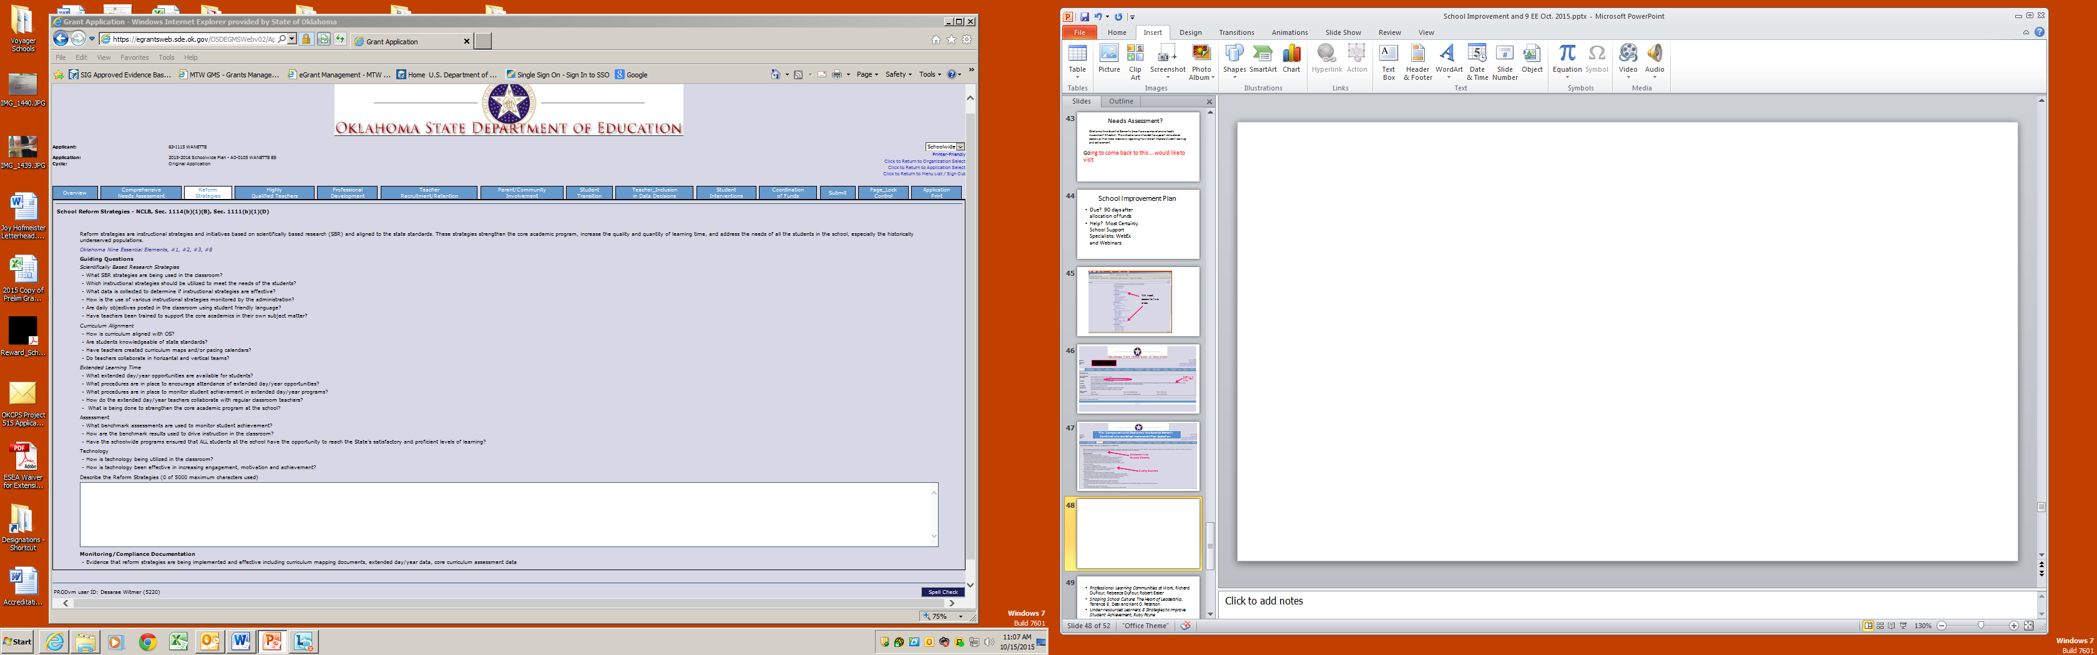
Type the details of the site’s plans.
Not all areas are “required”.
These details should support the items requested in the budget.
Box holds up to 5000 words.

Slide 62
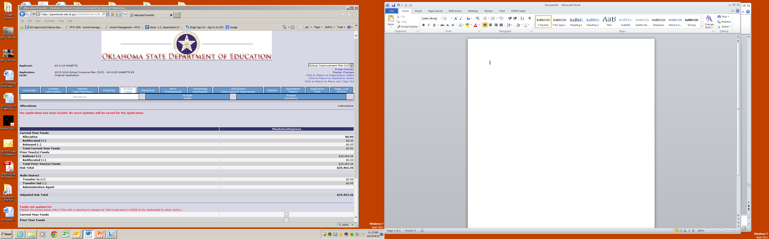
Where FY16 NEW Allocations will be indicated
Carry over funds

Slide 63
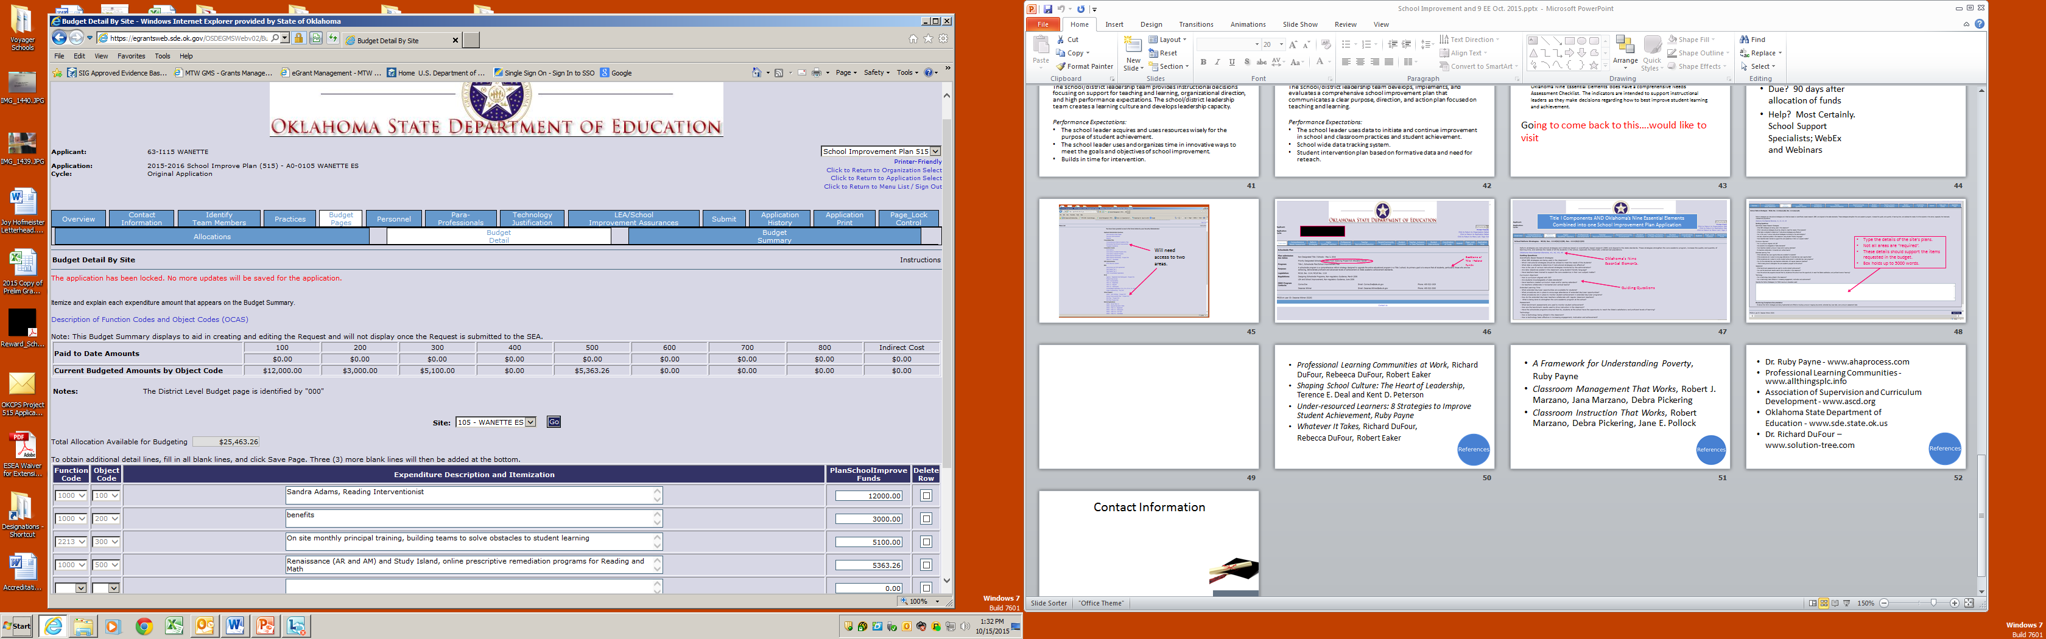
Itemized budget that is supported within the SW/SI Plan

Slide 64

GMS Training
WebEx Training for the SW/SI Plan will begin in December with multiple sessions in January and February.
Past presentations regarding FY16 Project 515 can be found on the School Support Website.

Slide 65
Poll Everywhere

Slide 66
Notes:
What questions do you have?
https://www.polleverywhere.com/free_text_polls/Y8OcF10EhwP6TgV

Slide 67

Professional Learning Communities at Work, Richard DuFour, Rebeeca DuFour, Robert Eaker
Shaping School Culture: The Heart of Leadership, Terence E. Deal and Kent D. Peterson
Under-resourced Learners: 8 Strategies to Improve Student Achievement, Ruby Payne
Whatever It Takes, Richard DuFour,
Rebecca DuFour, Robert Eaker

Slide 68
A Framework for Understanding Poverty,
Ruby Payne
Classroom Management That Works, Robert J. Marzano, Jana Marzano, Debra Pickering
Classroom Instruction That Works, Robert Marzano, Debra Pickering, Jane E. Pollock

Slide 69
Dr. Ruby Payne - www.ahaprocess.com
Professional Learning Communities - www.allthingsplc.info
Association of Supervision and Curriculum Development - www.ascd.org
Oklahoma State Department of
Education - www.sde.state.ok.us
Dr. Richard DuFour –
www.solution-tree.com

