Slide 2
Sovereign Community School
A Presentation to the Oklahoma State Board of Education
Presented by Bill Hickman
August 23, 2018

Slide 3
Mission and Vision for School
Mission Statement
The Sovereign Community School will activate the next generation of indigenous leaders by engaging our youth with rigorous, culturally relevant curriculum that challenges them to understand and affirm their roles as citizens in our many Native nations.
Vision
Our school is born from the ideas of the Native community of Oklahoma City and from them we believe first that meeting student wellness needs is foundational to our children’s academic success. We believe that rigorous and culturally relevant classroom content increases student engagement, learning, understanding and critical thinking while also elevating student consciousness about justice for our communities. We believe that creating a space for indigenous people to build community, fellowship and solidarity in Oklahoma City strengthens our kids, families and our nations. The wisdom of our Grandmothers and Grandfathers is key to realizing our mission and that by placing that wisdom foremost we will activate the next generation of holistically healthy indigenous leaders and empowered citizens.

Slide 4
Target Population
Students and Families
The Sovereign Community School’s academic program and school culture are built to particularly serve the needs of the thousands of Native children and families in Oklahoma City. We also believe that non-Native families in the City would greatly benefit from our unique disposition to curriculum and content as our focus on wellness, academic rigor, and community building are universal values just framed from an indigenous perspective often missing from the dominant cultural education tradition.
Enrollment
Year One: 75 6th graders; 75 9th graders
Year Two: 150 6th and 7th graders; 150 9th and 10th graders
Year Three: 225 Middle Schoolers; 225 9th-11th graders
Year Four: 225 Middle Schoolers; 300 High Schoolers
Year Five: 225 Middle Schoolers; 300 High Schoolers

Slide 5
NACA Inspired Schools Network
Native American Community Academy
Located in Albuquerque, NM
Founded in 2006 and currently in 12th year of operation
Serving 6-12 grades with an expanding elementary school serving K-2
Nearly 400 students from 37 different tribal backgrounds
68% on-time graduation rate (20+ points higher than OKCPS), 90% of graduates matriculate to college
Nearly 3 in 4 alumni still enrolled in college 2 years after graduating
Inspired Schools Network
School design fellowship program dedicated to using community-led design principles that created NACA in ‘05 and ’06
Founded in 2011, school design fellowship launched in 2014
6 schools in network: NACA, Six Directions, DEAP, Dream Diné, Keres Children’s Learning Center, Kha’p’o Community School
‘Network’ model focused on new school start-up and design with menu of back-office and academic program supports for member schools
Not strictly charter schools
Tribal Education Departments National Assembly (TEDNA)
Okla. Advisory Council on Indian Education (OACIE) – July 2018
Integrate more culturally responsive Native curriculum
Encourage and cultivate a greater understanding of Native culture

Slide 6
Educational Program
Curriculum & Professional Development
Traditional Core Curriculum (Reading, Writing, History, Math, Science)
Sourced from a variety of areas: Springboard ELA, Eureka Math, Washington state’s ‘Since Time Immemorial’, NACA-developed
Special Curriculum: We will also adapt and develop specialty curriculum
Indigenous Wellness: Holistic, self-reflective, indigenous-centered
Indigenous Languages: Socio-linguistic Native language program
Indigenous Culture: Melding of arts (song, dance, ceremony,), indigenous philosophies and wisdom into a single class
Near-daily advisory time
Culturally Responsive Teaching Practices
Robust professional development for instructional and leadership staff
One day each week school lets out early and faculty do PD all afternoon, 10 days added to school year to account for missing instructional time

Slide 7
OKCPS Grounds for Denial
Administrative Leadership
Facilities
Transportation
Finance
OKCPS Evaluation Rubric
Evaluation Rubric not timely provided to SCS
Pass – Fail Standard v. Meets Legal Requirements v. Expectations
Purpose of Charter Schools

Slide 8
ISSUE # 1 – Administrative Leadership
OKCPS asserts that “job description does not identify qualifications aligned with administrative or teacher leadership experience.”
Charter law does not require that a job description for the school leader be included in the application.
OKCPS admits “there is concern” but OKCPS does not state that application fails to meet legal requirements.
Lead applicant will not serve as founding school leader, rather a founding principal is being recruited and will hopefully start late Summer 2018.
Presently building a pool of candidates and would consider qualified, experienced school superintendent or principal for position.
Given curriculum innovations, we plan for a robust professional development sequence for instructional and leadership staff
One day each week school lets out early and faculty do PD all afternoon, 10 days added to school year to account for missing instructional time
Non-mandatory job description not grounds for denial

Slide 9
ISSUE # 2 - Facilities
OKCPS grounds for denial is based on the “proposed financial plan.”
OKCPS admits that SCS submits a facilities plan and contingency plans, as required by law.
OKCPS states that renovations are needed during the planning year and not adequately addressed in financial plan.
SCS has a $325,000 grant from Walton Family Foundation for renovations.
Grant covers full cost of any renovations identified by Beck Design
Minimal changes as a former OKCPS school site.
Proposed lease terms include $15,000 renovation allowance from Landlord.
70 O.S. Section 3-135 allows for pre-opening requirements / conditions to monitor start up process to ensure school is prepared to open smoothly and ensure meets all building, health, safety, insurance and legal requirements.
Seminole Academy & LeMonde
SCS meets legal requirements for facilities

Slide 10
ISSUE # 3 - Transportation
Generally, charter schools are not required to provide transportation
Special Education & homeless students
Majority of charter schools do not provide transportation.
OKCPS requested transportation be included so SCS did propose a transportation plan beyond what is required by law.
OKCPS now seeks to use it as a grounds for denial
OKCPS admits that SCS provided a transportation plan, as required by law.
OKCPS actually applauds SCS for providing transportation
OKCPS disputes whether financial plan will support the non-required transportation.
SCS developed budget using market estimates
OKCPS only raised as a concern after Amended Application submitted.
Non-mandatory transportation is not grounds for denial

Slide 11
ISSUE # 4 - Financial
OKCPS admits SCS provided a financial plan as required by law.
OKCPS denies Revised Application with comment that the 5-year Budget, “cannot be relied on as a sustainable plan as Sovereign Charter Schools has not been able to generate sufficient confidence for the reviewer as to their financial acumen and understanding of school finance common knowledge.”
Denial of application because reviewer does not think SCS has the “financial acumen” or “school finance common knowledge” are not valid grounds.
SCS relied upon experts to assist with budgeting, including Andy Evans with OPSRC and others with decades of experience in school finance.
Disagreements about diesel fuel costs and other such estimates are not grounds for denial
Areas of concern were not raised by OKCPS prior to submission of Revised Application.
SCS meets the legal requirements by submitting a financial plan that addresses all required areas.

Slide 12
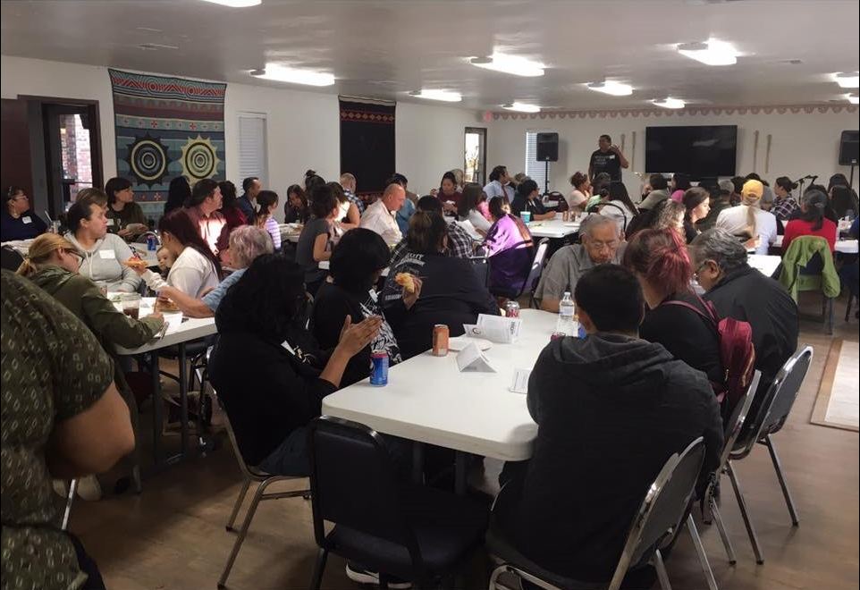
Community Support & Engagement
Community Led Design
The SCS team engaged in a lengthy and robust effort to seek community input into the design of the school.
Our school’s mission and vision are derived from hundreds of points of feedback from focus groups, interviews, surveys, and one-on-one conversations about the issues that are affecting our families. That mission impacts everything else
from academic program design to operational factors like our decision to be the only OKC charter offering a transportation option for families. Closing achievement gaps is critical work – but schools can and should aspire to have a greater community-specific impact too!
Community Engagement & Partnerships
Community partners can help achieve our vision in the areas of wellness and cultural curriculum and content
Opportunity for programs and providers not traditionally involved in our school system to play a bigger role for mutual benefit
Parents and other stakeholders are a part of the school self-assessment process
SCS team wants to partner with authorizer to develop mission-aligned performance framework metrics that help us measure our community impact in addition to the traditional measures found in most charter contracts

Slide 13
Community Support & Engagement Summary
Five Public Community since last fall
- Over 300 attendees at these events in total
Over a dozen letters of support from a coalition of Native and Non-Native parents, community-based organization leaders, Indigneous religious organizations, elected tribal leaders and administrators, Native professors from local universities and other indigenous educators
71 community surveys completed by families interested in SCS offering insight into parent & student needs gathered in two weeks
Social Media - Facebook – Over 700 followers
Nearly a dozen local and national news articles and interviews about possible first Native-focused charter school in Oklahoma
OKCPS has always given SCS a perfect score on its demonstration of community support in its scoring rubric, recognizing the effort and extent of our outreach and efficacy of our community-led design

Slide 14
SDE – CHARTER SCHOOL REVIEW COMMITTEE
SCS’s charter school application “is of appropriately high quality to warrant sponsorship approval by the State Board. Those involved in the development of the proposed school appear to have taken a pedagogically grounded approach to designing a curriculum that will engage students with culturally affirming materials, while meeting state content standards. The intention for ongoing engagement with a network of similarly designed Native American charter schools with a positive track record in their communities suggests SCS will have continuing outside support once the school is up and running. They have also demonstrated the buy-in of local Native communities, another indication of the potential for success in engaging students and families in the coming years.”

Slide 15
SDE – CHARTER SCHOOL REVIEW COMMITTEE
“Beyond meeting the requirements of the Charter Schools Act, the proposed SCS aims to support the particular needs of Native American students and communities, while offering an integrated educational program that can benefit students from any background.”
“Given Oklahoma’s role as the site where so many tribal nations were relocated by force, and where several forced-attendance ‘Indian boarding schools’ once operated with the goal of eradicating Native languages and cultures, for the State Board of Education to sponsor a public charter school accountable to the state and responsive to its indigenous communities is a unique restorative opportunity.”
SCS respectfully requests your approval of the appeal consistent with the SDE’s staff recommendation.

Slide 16
Question and Answer Opportunity

