Slide 1
Charter Schools and Students with Disabilities
Tina Spence
Director of Compliance & Monitoring

Slide 2
Individuals with Disabilities Education Act (IDEA)
The IDEA is the federal special education law.
The IDEA was originally enacted by Congress in 1975 to ensure that students with disabilities have the equal opportunity to receive a free appropriate public education (FAPE).

Slide 3
Identifying Students with Special Needs
Students are identified through Child Find activities.
Child Find requires states and districts to
identify,
locate,
and evaluate
Who?
Children with disabilities, ages birth through 21, who are in need of early intervention (SoonerStart) or special education services.

Slide 4
What is required?
All students with disabilities, residing in the State, whether attending public or private schools, must be identified, located, and evaluated.
SoonerStart is Birth to age 3
Public schools/Charter schools begin at age 3 through age 21 or upon graduation.

Slide 5
What happens when a child is eligible for special education services?
An Individualized Education Program (IEP) is written by the IEP team, which required members consist of Special Education Teacher, Regular Education Teacher, Parent, and Administrator.
An IEP is a written statement of the educational program designed to meet a child’s unique needs.
OK EdPlan, Oklahoma’s web-based IEP system must be utilized.

Slide 6
What is placement in the least restrictive environment (LRE)?
To the maximum extent appropriate, all students with disabilities, 3 through 21 years of age, are to be educated with age-appropriate peers, both with and without disabilities.
There is a continuum of placement options that must be considered by an IEP team when making a placement decision.
A child on an IEP may have accommodations and modifications in the LRE.

Slide 7
Charter School Responsibility for Services
Charter Schools are required to comply with IDEA requirements.
Charter Schools are required to comply with State and federal laws relating to the education of students with disabilities.

Slide 8
Special Education Policies
The Oklahoma Special Education Policies includes nine (9) State requirements which exceed the federal regulations of the Individuals with Disabilities Education Improvement Act of 2004 (IDEA) to ensure equity, accountability, and excellence for children with disabilities.
Policies marked * are already in existing policy.

Slide 9
Referral Timeline to Parent Consent
1. Ten (10) school day timeline between the review of existing data and parent consent for initial evaluations.
(34 CFR § § 300.300(a)(1)(i), and 300.305)
IDEA: No timeline
Oklahoma: The date the parent signs the Review of Existing Data (RED) form to the date the parent signs Special Education Parent Consent form for an initial evaluation must be within 10 school days.

Slide 10
Required Evaluation Components
2. Required evaluation components defined per category of suspected disability.
(34 CFR § 300.304(b)(1)(i)(2)(3))
IDEA: “Use a variety of assessment tools and strategies to gather relevant functional, developmental, and academic information about the child, including information provided by the parent, (2) Not use any single measure or assessment as the sole criterion for determining whether a child is a child with a disability; and (3) Use technically sound instruments that may assess the relative contribution of cognitive and behavioral factors, in addition to physical or developmental factors.”
Oklahoma: Defined required components that make up a comprehensive evaluation.

Slide 11
45 School Day Initial Evaluation Timeline *
3. From the date of parent consent for the initial evaluation to the date of the eligibility meeting must be within 45 school days.
(20 USC § 1414(a)(1)(C)(i)) and 34 CFR § 300.301(c)(1)(i)(ii)):
IDEA: “to determine whether a child is a child with a disability within 60 days of receiving parental consent for the evaluation” or “If the State establishes a timeframe within which the evaluation must be conducted”;
Oklahoma: The initial eligibility determination must be completed within 45 school days of receiving parental consent for the initial evaluation.

Slide 12
Eligibility Team Members
4. Defined qualified professionals required to attend the eligibility team members
(34 CFR § 300.306 and § 300.308)
IDEA: A group of qualified professionals and the parent. For Specific Learning Disability determination requires the child’s regular teacher.
Oklahoma: For all disability categories require the following team members to attend the eligibility determination meeting: Parent, Administrator, Special Education Teacher, General Education Teacher (at least one) and Qualified Professional(s) who have the credentials to administer and interpret evaluation tools (e.g., school psychologists, school psychometrists, speech language pathologists, remedial reading teacher, occupational therapist, physical therapists, etc.).

Slide 13
Move-In or Transfer *
5. An IEP for new move-in or transfer students must be in place within 10 school days of the student’s first day of attendance.
(20 USC § 1414(d)(2)(C)(i)(I) and 34 CFR § 300.323)
IDEA: No timeline
Oklahoma: The LEA must provide comparable services described in the previously held IEP, in consultation with the parent until the district either formally accepts the IEP from the previous district as written or develops and implements a new subsequent IEP within ten (10) school days from the date of the student’s first day of attendance.

Slide 14
Service Types Defined
6. Special Education and Related Services are provided in a variety of service types and are defined.
(34 CFR § 300.39(b)(3))
IDEA: “Specially designed instruction means adapting, as appropriate to the needs of an eligible child, the content, methodology or delivery of instruction to address the unique needs.”
Oklahoma: Defined the variety of services: consultation, monitoring, collaboration, co-teaching, and direct instruction.

Slide 15
Secondary Transition Services *
7. Exceeding the IDEA requirement for Secondary Transition from age 16 to being in effect on or before age 15.
(34 CFR § 300.320(b))
IDEA: “Transition services. Beginning not later than the first IEP to be in effect when the child turns 16, or younger if determined appropriate by the IEP Team and updated annually.”
Oklahoma: Transition services. The IEP must include secondary transition services that are in effect before the beginning of the student’s ninth grade year, or on or before the student’s 15th birthday, whichever comes first, or younger, if determined appropriate by the IEP team and updated annually.

Slide 16
Shortened Day/Week
8. Before making the determination to shorten the student’s day/week based on behavior requires the LEA to conduct a Functional Behavioral Assessment (FBA) and implement a Behavioral Intervention Plan (BIP).
(20 U.S.C. § 1415(1)(D)(E))
IDEA: Requires FBA/BIP if the conduct of the student was a manifestation of the child’s disability, but no requirement for shortening the student’s day/week.
Oklahoma: Before determining the need to shorten a student’s day/week based on behavior, the IEP team must conduct an FBA/BIP. The IEP team may also want to consider increasing special education service time for direct instruction in behavioral and/or social skills.

Slide 17
Caseload/Class Size*
9. Maximum number of students with disabilities per special education classroom, and the maximum number of students on an IEP a Teacher of Record can manage or oversee.
IDEA: No requirement
Oklahoma:
Maximum 10 students per self-contained for K-4 grades.
Maximum 15 students per classroom for 5-12 grades.
See chart for caseload based on formula per placement.

Slide 18
Federal Reporting Requirements
Child Count – number of children on IEPs in the district on October 1st of each year.
Data Reports – End of the Year Report includes Annual Performance Report, Personnel, Related Service, Students Exiting, Suspensions.
Assurances and LEA Agreement Finance
IDEA Consolidation Application/Budget
Expenditure Reporting/Claim Reimbursement

Slide 19
Resources
Special Education Webpage - https://sde.ok.gov/special-education
Special Education Policy & Procedures Manual (P & P)– https://sde.ok.gov/sites/default/files/Policies%20%26%20Procedures%20Revisions%207-28-22.pdf

Slide 20
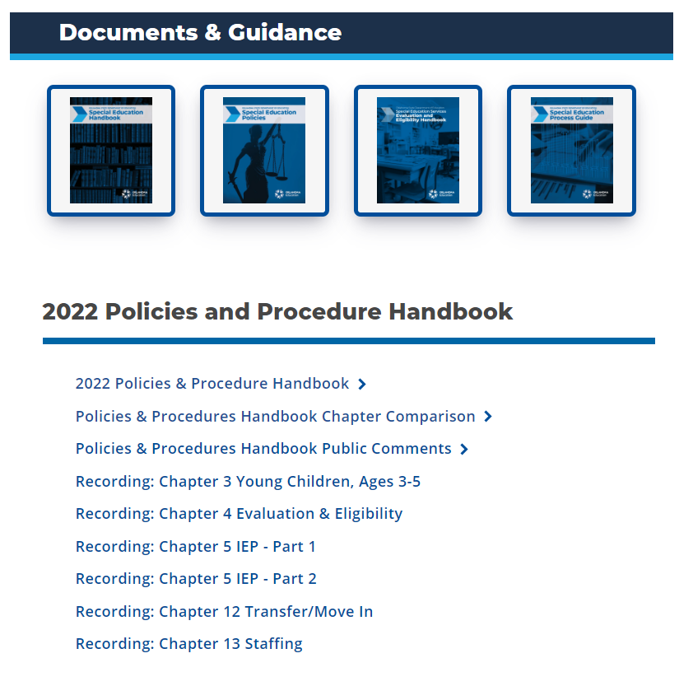

Slide 23
P & P
Chapter 8 Private, Charter, Residential and Other Settings
Section 2
Provides information specific to Charter Schools

Slide 24
Special Education Contact Information
Todd Loftin, Deputy Superintendent for Special Education Services
(405) 522-3237 / (405) 248-8581
Tina Spence, Director of Compliance & Monitoring for Special Education Services
(405) 521-4513

