Slide 2
Special Education: Charter Schools
Tuesday, January 7, 2020

Slide 3
Individuals with Disabilities Education Act (IDEA)
The IDEA is the federal special education law.
The IDEA was originally enacted by Congress in 1975 to ensure that students with disabilities have the equal opportunity to receive a free appropriate public education (FAPE).

Slide 4
Child Find
Students are identified through Child Find activities.
Child Find requires states and districts to
identify,
locate,
and evaluate
Who?
Children with disabilities, ages birth through 21, who are in need of early intervention (SoonerStart) or special education services.

Slide 5
What is required?
All students with disabilities, residing in the State, whether attending public or private schools, must be identified, located, and evaluated.

Slide 6
What happens when a child is eligible for special education services?
An Individualized Education Program (IEP) is written by the IEP team, which required members consist of Special Education Teacher, Regular Education Teacher, Parent, and Administrator.
An IEP is a written statement of the educational program designed to meet a child’s unique needs.
OK EdPlan, Oklahoma’s web-based IEP system must be utilized.

Slide 7
Least Restrictive Environment
To the maximum extent appropriate, all students with disabilities, 3 through 21 years of age, are to be educated with age appropriate peers, both with and without disabilities.
There is a continuum of placement options that must be considered by an IEP team when making a placement decision.
A child on an IEP may have accommodations and modifications in the LRE.

Slide 8
Charter School Responsibilities
Charter Schools are required to comply with State and federal laws relating to the education of students with disabilities.
A Charter School sponsored by an LEA is considered an LEA for purposes of federal funding.

Slide 9
Charter School Responsibilities
Students, who attend public charter schools or virtual charter schools and their parents, retain all the rights given to them in the public school under the IDEA.
Charter schools or virtual charter schools must make available the services needed to provide education for students with IEPs.
The charter that is part of an LEA has, as part of its resources, the full continuum of services and supports within the LEA.

Slide 10
Charter School Responsibilities
A charter school may not unilaterally limit the type or amount of services it will provide to a child with a disability and must ensure a program of FAPE in accordance with that child’s IEP.
The charter school must have in effect policies, procedures, and practices that are consistent with State policies, procedures, and practices in special education. Areas to be addressed include the following:
Nondiscriminatory enrollment procedures.
Provisions to employ special education and related services professionals who are appropriately licensed and/or certificated for the duties they are assigned and highly qualified.

Slide 11
Charter School Responsibilities
Adequate plans, policies, procedures, contractual or other arrangements, and budget to ensure that students with disabilities attending the charter school will receive special education and related services that meet all the requirements of the IDEA. Those requirements include:
Implementation of the IDEA discipline procedures and protections; and
Procedural Safeguards to protect student and parent rights.

Slide 12
Charter School Responsibilities
A professional development plan for the training needs of special education personnel, as well as, general education teachers in order to meet the needs of students with disabilities who are enrolled in the charter school.
A plan that ensures access to charter school programs, as required by the ADA. This plan may include the actual location of the school, classrooms, and settings within the classrooms to permit access by students with disabilities.

Slide 13
Charter School Responsibilities
A transportation plan for students with disabilities, who may, because of the nature of the disabilities, be entitled to specialized transportation, as a related service, even if the charter school does not provide transportation to other students.

Slide 14
Reporting Requirements
Child Count – number of children on IEPs in the district on October 1st of each year.
Data Reports – End of the Year Report includes Annual Performance Report, Personnel, Related Service, Students Exiting, Suspensions.
Assurances and LEA Agreement Finance
IDEA Consolidation Application/Budget
Expenditure Reporting/Claim Reimbursement

Slide 15
Funding
Funds are awarded to the OSDE by the United States Department of Education (USDE), Office of Special Education Programs (OSEP), to "flow-through" to the LEA contingent upon an LEA's application for Part B funds.

Slide 16
Compliance
The OSDE provides monitoring oversight of local education agencies and interlocal cooperatives to ensure adherence to the Federal and State regulations under the IDEA and its amendments.

Slide 17
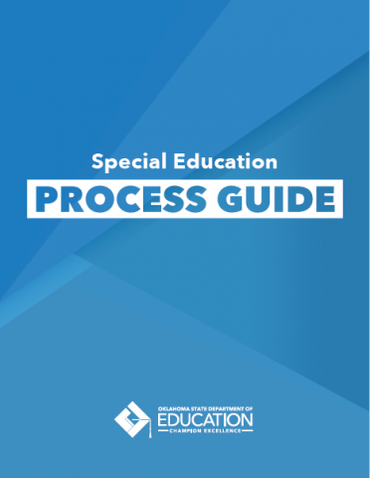
Guidance
Found at: http://sde.ok.gov/sde/special-education

Slide 18
Contacts
Todd Loftin, Executive Director
405-522-3237 Todd.Loftin@sde.ok.gov
405-248-8581 (cell)
Christa Knight, Asst. Executive Director
405-521-4869 Christa.Knight@sde.ok.gov
http://sde.ok.gov/sde/special-education

