Slide 1
1

Slide 2
Oklahoma Charter School State Aid Funding Formula
Renée McWaters
Executive Director
State Aid Section

Slide 3
STATE SOURCES OF REVENUE
STATE - APPROPRIATED REVENUES
$3.16 BILLION FOR 2021-22:
$ 2.4B FINANCIAL SUPPORT OF SCHOOLS
$ 704.4M SCHOOL ACTIVITIES (Including FBA & Txtbks)
$347M CERTIFIED FBA
$188M SUPPORT FBA
$ 60M INSTRUCTIONAL MATERIALS/TEXTBOOKS
$ 12M ALTERNATIVE ED.
$ 12M READING SUFFICIENCY
3

Slide 4
Oklahoma State Department of Education
4

Slide 5
Oklahoma State Department of Education
Pull down to “School Finance”
5

Slide 6
Oklahoma State Department of Education
6

Slide 7
Oklahoma State Department of Education
7

Slide 8
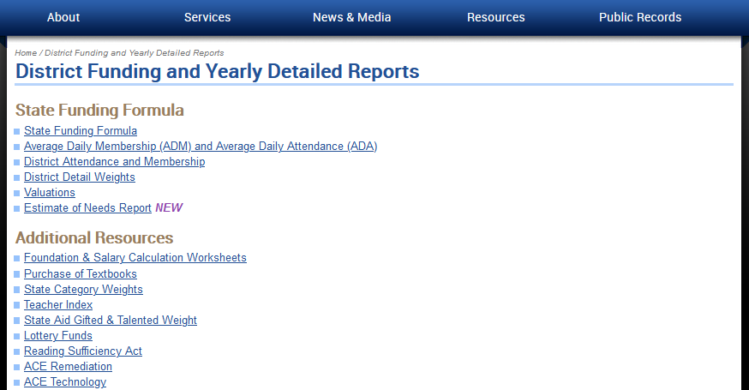
Oklahoma State Department of Education
8

Slide 9
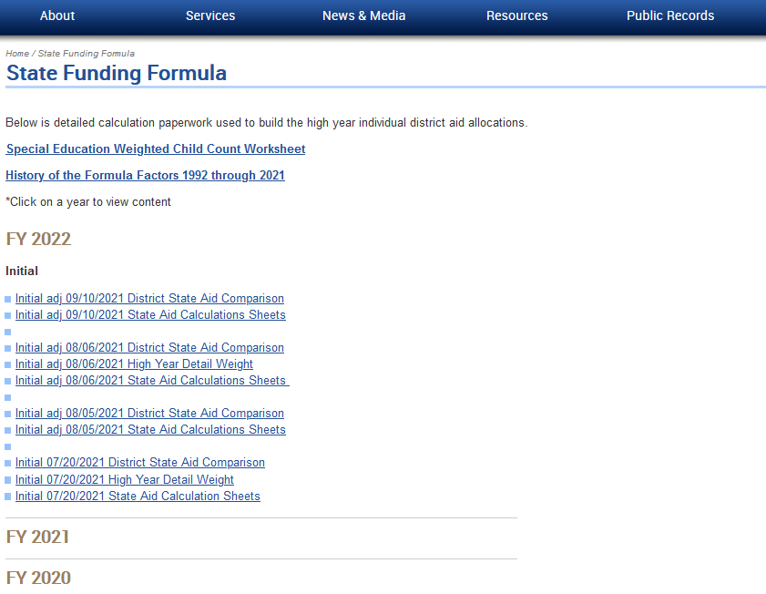
Oklahoma State Department of Education
High Year​
Used in the Formula​
9

Slide 10
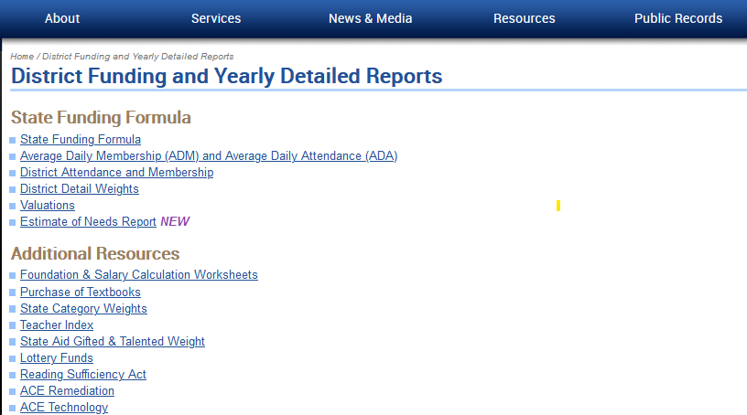
Oklahoma State Department of Education
10

Slide 11
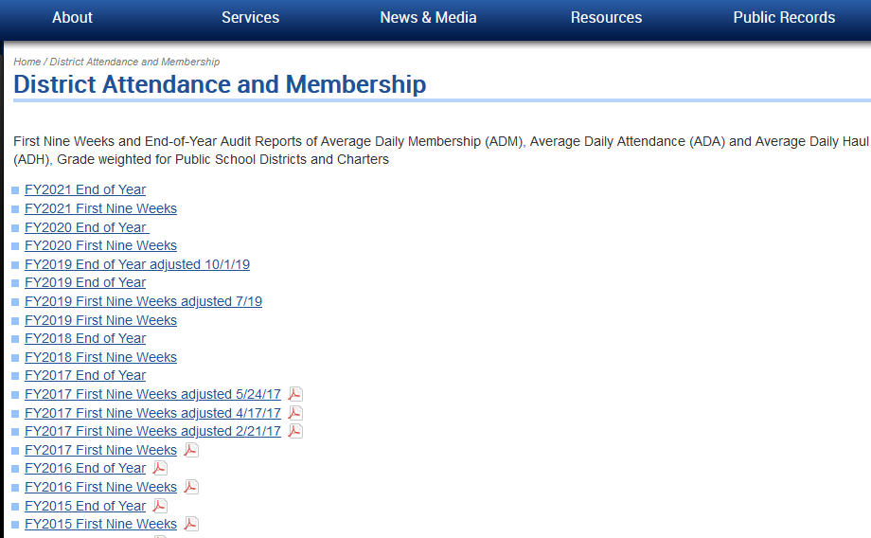
Oklahoma State Department of Education
Year Specific​
11

Slide 12
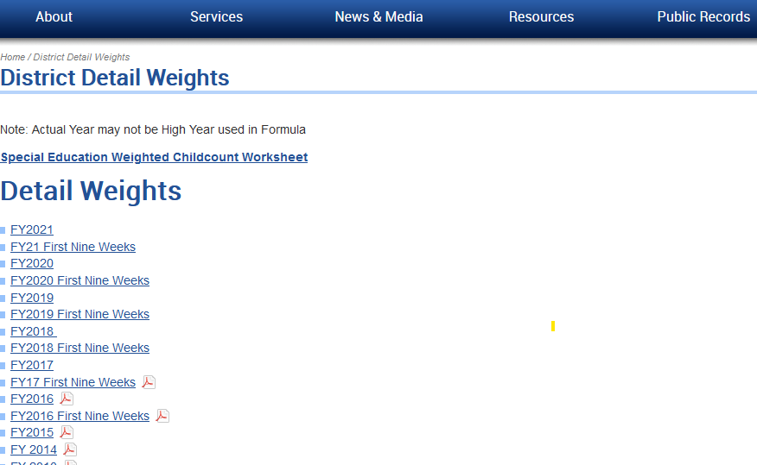
Oklahoma State Department of Education
Year Specific​
12

Slide 13
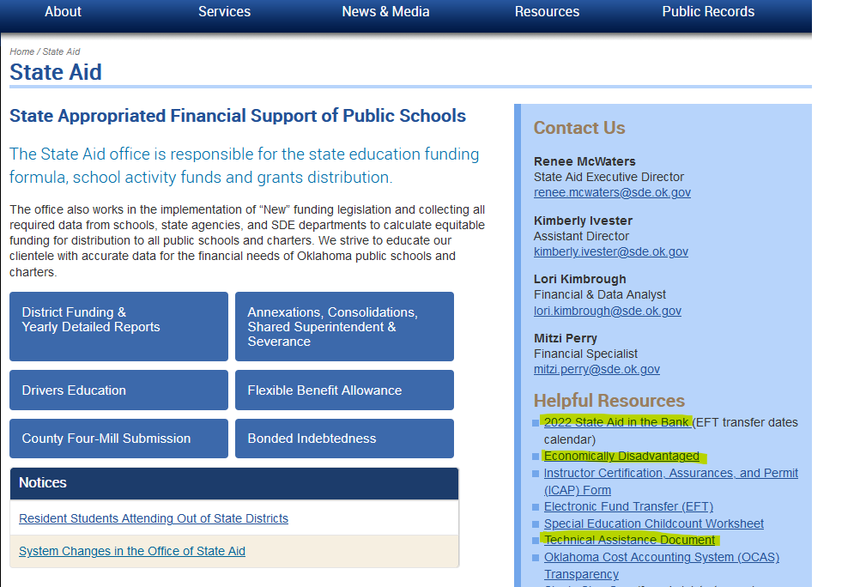
Oklahoma State Department of Education
Helpful Resources​
TAD​
13

Slide 14
SCHOOL FINANCE
TECHNICAL ASSISTANCE DOCUMENT
http://ok.gov/sde/state-aid
• SOURCES OF REVENUE
• STATE AID FORMULA
• PENALTIES / ADJUSTMENTS
• POLICIES / PROCEDURES
Listed Under “Helpful Resources”

Slide 15
Oklahoma State Department of Education
STATE AID FORMULA
FOR OKLAHOMA
SCHOOL DISTRICTS
AND
CHARTER SCHOOLS
15

Slide 16
16

Slide 17
First Year WADM
Title 70 § 3-142 Paragraph B:
1. The weighted average daily membership for the first year of operation of a charter school shall be determined initially by multiplying the actual enrollment of students as of August 1 by 1.333. The charter school shall receive revenue equal to that which would be generated by the estimated weighted average daily membership calculated pursuant to this paragraph. At midyear, the allocation for the charter school shall be adjusted using the first quarter weighted average daily membership for the charter school calculated pursuant to subsection A of this section.

Slide 18
FIVE DATA ELEMENTS
ATTENDANCE AUDITS (FQSR & ASR)
SPECIAL ED. COUNTS (OK EdPlan)
BILINGUAL COUNTS (Oct. 1 Consolidated Rpt.)
ECONOMICALLY DISADVANTAGED
(Oct. 1 Consolidated Rpt.)
GIFTED COUNTS (Oct. 1 Consolidated Rpt.)

Slide 19
GRADE WEIGHTS
PK* 3 (3 yr. old w/ IEP) 1.2
Early Child. / PK (Half Day) 0.7
Early Child. / PK (Full Day) 1.3
Kindergarten (Half Day) 1.3
Kindergarten (Full Day) 1.5
1st - 2nd grade 1.351
3rd grade 1.051
4th - 6th grade 1.0
7th - 12th grade 1.2
Out-of-Home Placement 1.5
*PK = Prekindergarten

Slide 20
WEIGHTED PUPIL CATEGORIES
Deafness or Hearing Impairment (D or HI) 2.90
Speech or Language Impairment (SI) 0.05
Visual Impairment (VI) 3.80
Emotional Disturbance (ED) 2.50
Orthopedic Impairment (OI) 1.20
Other Health Impairment (OHI) 1.20
Specific Learning Disability (SLD) 0.40
Deaf-Blindness (D-B) 3.80
Multiple Disabilities (MD) 2.40
Autism 2.40
Traumatic Brain Injury (TBI) 2.40
Intellectual Disability (ID) 1.30
Spec. Educ. Summer Program 1.20
Gifted 0.34
Bilingual 0.25
Economically Disadvantaged 0.25

Slide 21
GRADE WEIGHT PLUS SPECIAL CATEGORIES
Student:
1st Grade Level 1.351
Autism 2.4
Econ. Disadv. 0.25
Total Student Weight 4.001

Slide 22
GRADE WEIGHT PLUS SPECIAL CATEGORIES
Student:
KG Grade Level 1.5
Autism 2.4
Econ. Disadv. 0.25
Total Student Weight 4.15

Slide 23
TEACHER INDEX
NUMBER OF TEACHERS
LEVEL OF DEGREE
YEARS OF EXPERIENCE
INDEX IS DETERMINED BY COMPARING PRIOR YEAR TOTAL TO THE STATE AVERAGE

Slide 24
WEIGHTED ADMs
2019-20 2020-21
WEIGHTED ADM
AVERAGE DAILY MEMBERSHIP 90.33 101.30
WITH GRADE WEIGHTS 10.56 14.19
SPECIAL ED. WEIGHTS 16.48 20.78
SUMMER PROGRAM 0 0
GIFTED 2.54 2.72
BILINGUAL 25.75 20.25
TEACHER INDEX 6.88 3.08
ECONOMICALLY DISADV. 25.00 20.00
SMALL SCHOOL 0 0
OR
ISOLATION 0 0
TOTAL WEIGHTED ADM: 177.54 182.32

Slide 25
Funding for Midyear
Title 70 § 18-200.1 Paragraph B:
“The State Department of Education shall retain not less than one and one-half percent (1.5%) of the total funds appropriated for financial support of schools, to be used to make midyear adjustments in State Aid which shall be reflected in the final allocations.”

Slide 26
WEIGHTED ADMs
2019-20 2020-21 2021-22
WEIGHTED ADM First Nine Weeks
AVERAGE DAILY MEMBERSHIP 90.33 101.30 111.64
WITH GRADE WEIGHTS 10.56 14.19 18.33
SPECIAL ED. WEIGHTS 16.48 20.78 20.90
SUMMER PROGRAM 0 0 0
GIFTED 2.54 2.72 3.70
BILINGUAL 25.75 20.25 22.25
TEACHER INDEX 6.88 3.08 2.98
ECONOMICALLY DISADV. 25.00 20.00 21.75
SMALL SCHOOL 0 0 0
OR
ISOLATION 0 0 0
TOTAL WEIGHTED ADM: 177.54 182.32 201.55

Slide 27
Charter’s High Year WADM
FY2019-20
177.54
FY2020-21
FY2021-22
TOTAL WADM:
X (TIMES)
FORMULA FACTORS *
TOTAL $$ EQUALS:
182.32
X
$ 3,517.12
$ 641,241
JULY
FUNDING*
201.55
X
$ 3,517.12
$ 708,875
JANUARY
FUNDING*
**
*Chargeables Not Considered
**Assuming no midyear factor change

Slide 28
Charter’s High Year WADM
FY2019-20
FY2020-21
FY2021-22
TOTAL WADM:
X (TIMES)
FORMULA FACTORS *
TOTAL $$ EQUALS:
182.32
X
$ 3,517.12
$ 641,241
JULY
FUNDING*
179.42
175.55
$641,241
JANUARY
FUNDING*
**
*Chargeables Not Considered
**Assuming no midyear factor change

Slide 29
2021-22 FORMULA TIMELINES
By August 31: Notify new schools of their “Initial” Tentative Allocation (Based on Aug. 1 Enrollment).
By August 31: Notify new schools of their “Initial” Tentative Allocation (Based on Aug. 1 Enrollment).
By January 15: Notify schools of their new “Final” Tentative Allocation (Based on First Nine Weeks Weighted ADM).
Adjust. from penalties or data corrections might still change this “Final” Allocation.

Slide 30
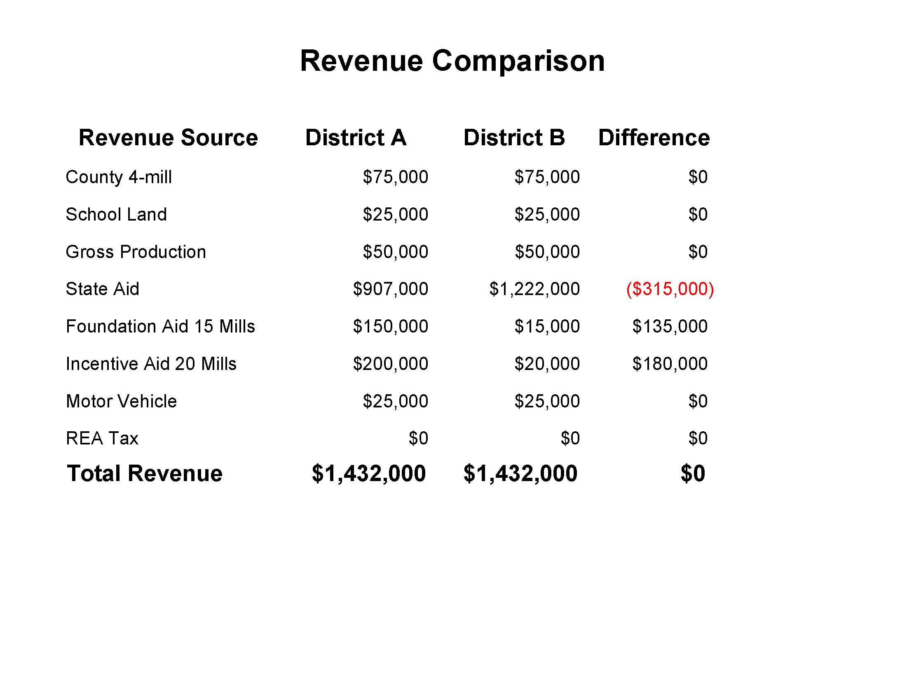
Notes:
Horizontal equity - District A is heavy

Slide 31
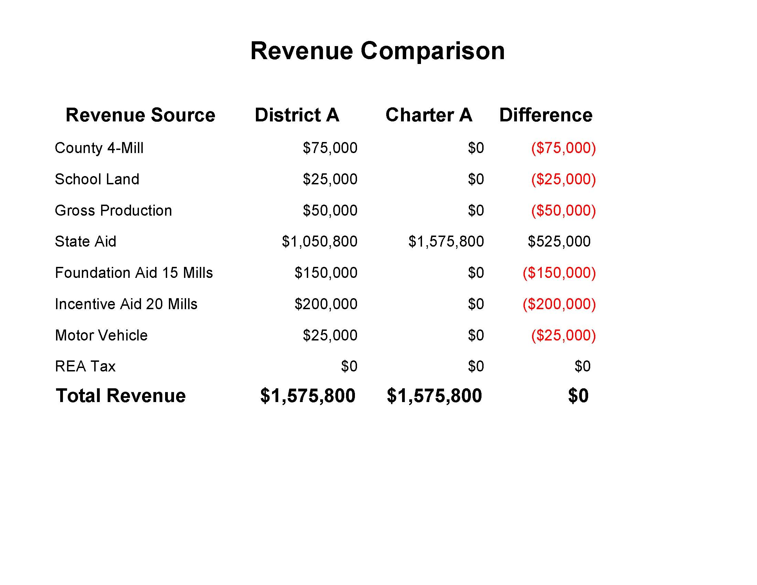
Notes:
Horizontal equity - District A is heavy

Slide 32
PAYMENT SCHEDULE
AUGUST 8% SEPTEMBER 10%
OCTOBER 9% NOVEMBER 9%
DECEMBER 9% JANUARY 9%
FEBRUARY 9% MARCH 9%
APRIL 9% MAY 10%
JUNE 9%

Slide 33
ACCUMULATED PERCENTAGE
AUGUST 9% SEPTEMBER 19%
OCTOBER 28% NOVEMBER 37%
DECEMBER 46% JANUARY 55%
FEBRUARY 64% MARCH 73%
APRIL 82% MAY 91%
JUNE 100%

Slide 34
ACCUMULATED PERCENTAGE
To calculate the state aid payment each month, multiply the accumulated percentage by the most recent allocation, then subtract the amount paid to date. The result is the amount of payment for any given month.

Slide 36
SCHOOL FINANCE
State Aid Section
Web Address
http://ok.gov/sde/state-aid
Email Address
State.Aid@sde.ok.gov
Or
405.521.3460

