Slide 1
Student Data Charter Schools
June Gerred
Program Manager
Data and Information Systems

Slide 2
Student Information Systems (SIS)

Slide 3
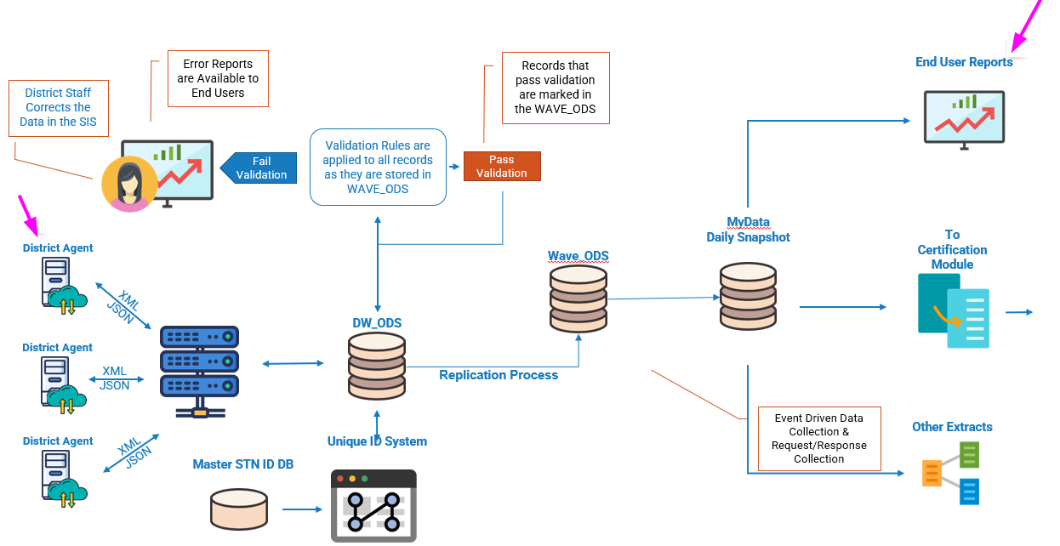
What is WAVE?

Slide 4
Schools Interoperability Framework (SIF)
SIS Communicates in different languages
Translator
Common language
SIF Dictionary
SIF Object Mapping
SIF Code Sets

Slide 5
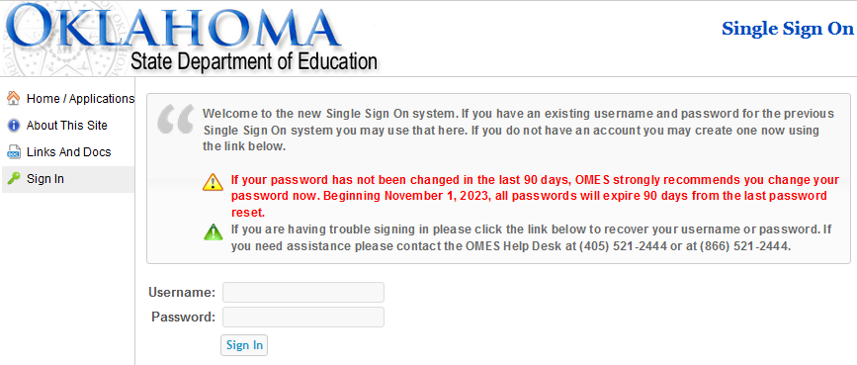
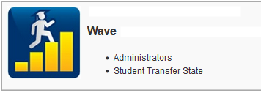
Single Sign On (SSO)
Are you a New User? Click here to create an account.
WAVE Access
Request an Affiliates Account from OMES

Slide 6
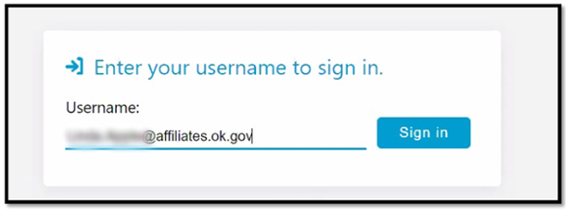
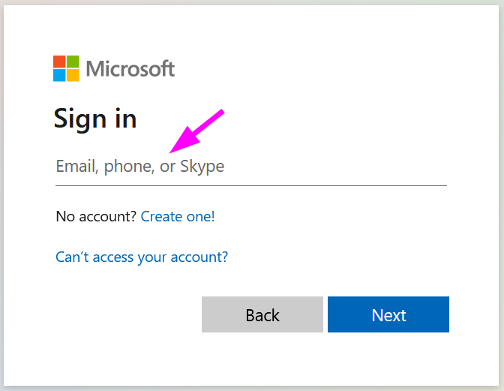
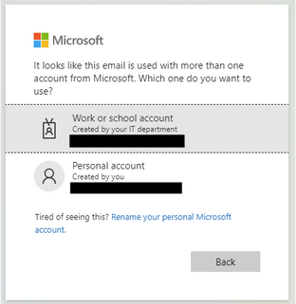
Sign to WAVE
Enter your new affiliate account address.
Sign into Microsoft
Sign into Microsoft

Slide 7
New School
Local Education Agency (LEA)
County Code
District Code
School Name
School Code
NCES Code
School Type
Accreditation
School Sites

Slide 8
Elementary, Middle School
Grades PK – 8
Home membership
High School
Secondary
Grades 9-12
Home membership

Slide 9
Days to Hours
Calendar Name
Start Date
End Date
Instruction Day
School Day
Instructional Minutes
Full Day Minutes
Day Event Type
Day Type Other Code
Calendars

Slide 10
Calendars
Linked to specific schools
Schools may have more than one
Establish a descriptive naming convention
Elementary & secondary must have unique calendars
Students must be associated with home school of record
Notes:
Some vendors map calendar types (instructional, summer…) and some map to calendar name.

Slide 11
Student Enrollment
Entry Date
Entry Code
Exit Date
Exit Code
Grade Level
Basis of Admission
Membership Type
School Year
GT Status
Homeless Status
Alt Ed Status
Virtual Status
504 Status
Neglected Youth
Membership
Funding Source

Slide 12
Enrollment – Entry
Where is the student coming from?
Why can the student enroll?
What are they bringing with them?
When will they start?
Enrollment – Exit
Where is the student going?
What are they taking with them?
When did they leave?

Slide 13
State Testing Number (STN)
Common identifier statewide
Connects student records
New school matching
STN Application
School Ownership
Who officially has the student?
When did that happen?
Resolve Ownership
Ownership Wizard

Slide 14
Accountability
Accreditation
Class Size Audit
October 1 Consolidated
Special Ed Child Count
First Statistical Report (FQSR)
3rd Grade Promotion and Retention
Postsecondary Opportunities
Alternative Education
Graduation
Drop Out
Reporting
Reporting Requirement
Smartsheet

Slide 15
School Meal
Program
Free
Reduced
Eligibility Determination
Economic Disadvantaged
CEP
Provision 2
Provision 3
Parent Refused
Eligibility

Slide 16
Direct Certification - CEP, Provision 2 & 3
Vendor specific process
Global settings
No manual entry
Auditing
Reports
Every student should have an eligibility record

Slide 17
Customer
Support
studentdatainfo@sde.ok.gov
405-521-3020
Help

Slide 18
Connect with Us
Weekly Wave Meetings
Teams Channel
Student Accounting Consortium
Data & Student Information Listserv

Slide 19
WAVE Skills Enhancement Week
WAVE - Data Quality - Target Audience: Novice, intermediate users
Description: This session will address guidance and best practices for access to WAVE, WAVE navigation, student testing Numbers (STN) SSO App, Ownership SSO App, WAVE data validation errors and warnings, data update schedule, and how to get support.
WAVE - Codes, Codes and More Codes - Target Audience: Enrollment staff, registrars, attendance staff, database administrators, schedulers
Description: Discuss requirements of student enrollment, attendance, basis of admission, course codes, alternative diploma, free/reduced records for CEP or Provision schools, and direct certification with Medicaid.
WAVE - State Reporting I - Target Audience: Superintendents, principals, directors
Description: Best practice and guidance for completing the October 1 Consolidated Report and the FQSR/ASR.

Slide 20
WAVE Skills Enhancement Week
WAVE - State Reporting II - Target Audience: Superintendents, principals, directors
Description: Best practice and guidance for completing the Graduation Part-time Report, Alternate Education (Alt Ed) Report, 3rd Grade Retention & Promotion Report, Title 1, School Incident Report.
WAVE - Data Quality Deep Dive -Target Audience: Database administrators, and intermediate users Description: In-depth guidance for understanding and working with the WAVE data validation wizard, understanding errors and warnings, interpreting XML files, and understanding WAVE specification documents and WAVE code sets. Best practices for communicating errors to SDE and the SIS vendor.
Accountability - Postsecondary Coursework - Target Audience: Superintendents, principals, directors, counselors, high school schedulers
Description: Best practices and guidance for setting up coursework for postsecondary for maximum participation credit. Discuss critical factors for ensuring accurate reporting and credit.

Slide 21
SDE Resources
Reporting Requirement Smartsheet
SIF Object Mapping
SIF Code Sets

Slide 22
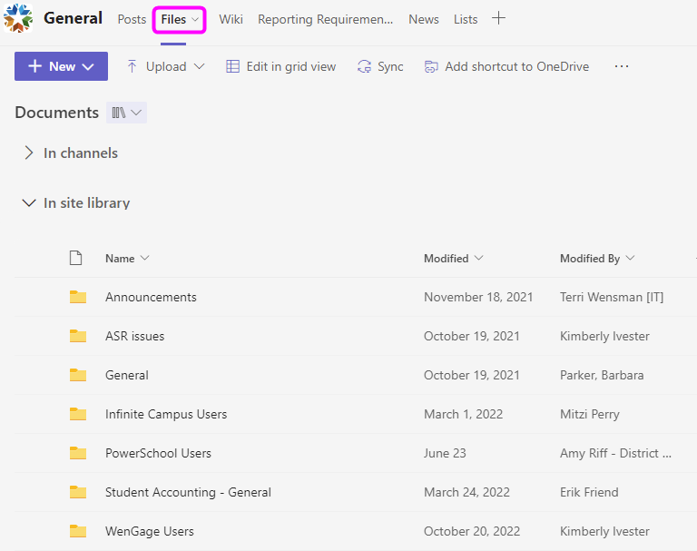
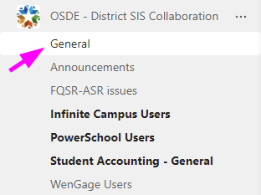
SDE Resources
TEAMs Channel - Files

