Slide 1
Office of Federal Programs
Limited English Proficient (LEP)/Immigrant: Title IIIA
August 27, 2014

Slide 2
Agenda
Subgranting Procedures
Title III-A Application in the Grants Management System (GMS)
Title III-A Allowable Expenditures
Claims Reimbursement Procedures
Annual Reports and Due Dates

Slide 3
Title III-A Subgranting Procedures
Limited English Proficient (LEP)
Immigrant children and youth

Slide 4
State Subgranting Procedures: Immigrant Children and Youth
Any LEA that enrolled one or more English language learners during the previous school year (13-14) qualifies for an LEP subgrant.
Under Title III, Part A (Section 3114 [b]), subgrants less than $10,000 may not be made to individual districts. However, individual districts may join together to form a consortium in order to achieve the Title III, Part A Limited English Proficient (LEP) minimum $10,000 grant award.
The minimum number of students needed to meet the $10,000 benchmark is approximately 110 (number of LEP students multiplied by per student amount).
[Sections 3114 and 3115 of ESEA]

Slide 5
State Subgranting Procedures: Immigrant Children and Youth
Districts must meet the requirements for identification and eligibility (annual LEP Survey), must develop a Language Instruction Program Delivery Plan (LIPDP), and must comply with evaluation and reporting requirements
[Sections 3116, 3121, and 3123 of ESEA]

Slide 6
State Subgranting Procedures: Immigrant Children and Youth
Districts with a “significant increase” of the total immigrant population and at least 20 immigrant students are eligible for an Immigrant grant.
A “significant increase” is based upon a minimum 2% increase of the average of a district’s total immigrant population over the previous two academic years (12-13 & 13-14).

Slide 7
State Subgranting Procedures: Immigrant Children and Youth
Number | Key Term | Definition
1 | Immigrant Children and Youth | The term immigrant means individuals who: are aged 3 through 21; were not born in any State²; and have not been attending one or more schools in any one or more States for more than 3 full academic years³.
2 | State | This includes each of the 50 States, the District of Columbia, and Puerto Rico. This definition is for Title III-A purposes only and is unlike the definition of “State” in Section 9101 of the Elementary and Secondary Education Act (ESEA), which applies generally to ESEA programs. Section 9101 does not include the outlying areas.
3 | Full Academic Year | The Title I definition of Full Academic Year (FAY) does not apply to Title III. Note: Academic years are cumulative and do not start over each time a student re-enrolls in a school in the United States.

Slide 8
Title III-A Applications in the Grants Management System (GMS)

Slide 9
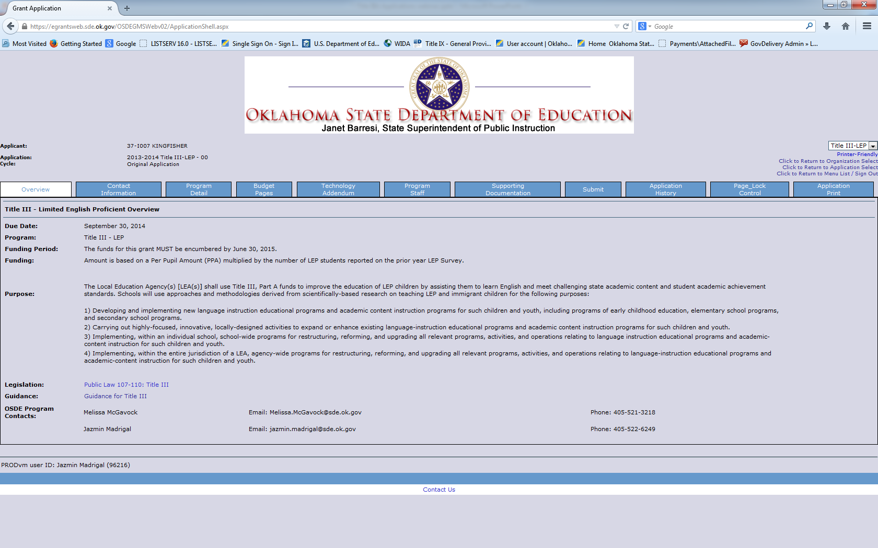

Slide 10
Allowable Expenditures: Title III-A
Limited English Proficient (LEP)
Immigrant children and Youth

Slide 11
General Guidance for Services/Expenditures
Elimination of duplicative programs.
Any service that is paid for with Title III-A must not already be available through another state or federally funded program.
LEP and Immigrant Children and Youth funded educational services must use a different curriculum than what is offered for other Title programs.
Notes:
Title IIIA is supplemental to Title IA

Slide 12
General Guidance for Services/Expenditures
What does this mean for program planning?
Planned purchases/services must be substantially and obviously different in nature than what is offered throughout the district to non-LEP and non-immigrant students.
Examples of planned purchases: Tutoring materials, educational software packages, and subject-specific books.

Slide 13
Supplement, not Supplant: Title III-A
In general, the Title III supplement not supplant requirement is intended to ensure that services provided with Title III funds are in addition to, and do not replace or supplant, services that students would otherwise receive.
Title III funds must be used to supplement the level of federal, state, and local funds that, in the absence of Title III funds, would have been expended for programs for LEP children and immigrant children and youth.
[Section 3115(g) of ESEA]

Slide 14
Examples of Allowable Expenditures: LEP
Requirement #1: programs that are designed to increase English language proficiency and access to academic content
Requirement #2: professional development designed to improve the instruction and assessment of English language learners (ELLs) and enhance curriculum and instruction for ELL students

Slide 15
Examples of Allowable Expenditures: LEP
Upgrade of effective instructional strategies for ELL students
Provision of technology, equipment, and software to improve the instruction of ELL students
Provision of tutorials for ELLs to improve their English fluency and/or access to academic content

Slide 16
Examples of Allowable Expenditures: LEP
Provision of intensified English instruction for ELL children that will help improve their English fluency and/or access to academic content
Provision of community participation programs, family literacy services, parent outreach, and training activities to ELL students and their families
Acquisition of supplemental instructional materials

Slide 17
Examples of Allowable Expenditures: Immigrant
Provision of family literacy, parent outreach, and training activities designed to assist parents to become active participants in the education of their children.
Supplemental support of personnel, which may include teacher assistants, who have been specially trained, or are being trained, to provide services to immigrant children and youth.
Provision of tutorials, mentoring, and academic or career counseling for immigrant children and youth

Slide 18
Examples of Allowable Expenditures: Immigrant
Acquisition of curricular materials, educational software, and technologies for immigrant children and youth
Provision of supplemental services that are designed to assist immigrant children and youth to achieve in elementary and secondary schools in the United States, such as orientation to the educational system or civics education
Capacity building/staff development for educators serving new immigrant children

Slide 19
Claim reimbursement procedures: Title III-A
Limited English Proficient (LEP)
Immigrant children and Youth

Slide 20
Claim reimbursement procedures:
All personnel must be listed and validated on the application.
Professional development agendas must be submitted with travel reimbursement forms.

Slide 21
Time and Effort Documentation
Statewide Time and Effort Sheets.
Sheets must be completed for each person paid in whole or in part with Title III-A funds (LEP and/or Immigrant Children and Youth).
Completed sheets must be submitted with each claim for each individual on the claim.
Per USDE, staff paid 100% with Title III-A funds may not perform any other district duties.

Slide 22
Annual Reports and Due Dates
2014-2015

Slide 23
Annual Reports and Due Dates
1
Home Language Surveys and English Language Proficiency Placement (ELP) Testing for all potential English language learners
First 30 days of school
2
Number of “bilingual” students on Annual Application for State Accreditation Report
October 1, 2014
3
October 2014 (October 1-15)
Annual Limited English Proficient (LEP) Student Survey

Slide 24
Annual Reports and Due Dates
4
Title III, Part A: Language Instruction for Limited English Proficient (LEP) and Immigrant Student Annual Performance Report
5
6
Annual English Language Proficiency Testing – ACCESS for ELL Tests
March – May 2015 (approximately)
Place order for ACCESS for ELLs Tests and Pre-ID Labels
January 2015
November 30, 2014

Slide 25
Questions?
Please direct your questions to the Office of Bilingual and Migrant Education:
Jazmin Madrigal, Program Specialist,
Federal Programs
Phone: 405-522-6249
Fax: 405-521-2361
Email: Jazmin.Madrigal@sde.ok.gov
Melissa McGavock, Director,
Titles I-C & III-A
Phone: 405-522-3218
Fax: 405-521-2361
Email: Melissa.McGavock@sde.ok.gov

