Slide 1
Empowered Schools Act Application
Brad Clark
General Counsel
Notes:
Megan & Shannon

Slide 2
Empowerment Schools Act
Local boards to govern and make decisions based on needs of students
Exemption(s) from statutes and rules
Encourages consideration of innovations
  Services to students, including those at-risk
  Curriculum and academic assessments;
  Reimagining school design

Slide 3
Topic | What Empowered Schools Act flexibility might allow:
Attendance | Students could go to school on Saturdays, breaks and evenings
Flexible graduation requirements | Schools can reorganize content and classes to increase relevance Freedom from “box checking” and pushing students through a regimented course sequence
Limiting definitions of pace, place and proportions | Students can move as fast as they want and as slow as they need Real-world learning can count for academic credit Removal of limits on pace and time spent out-of-the-classroom
Empowered Schools status gives Tulsa Beyond schools the ability to access greater statutory and regulatory freedom, when and if they need it.

Slide 4
Topic | What Empowered Schools Act flexibility will not allow:
Attendance | Students stop coming to school Students attend less than the current minimum number of hours/days Students, schools and the district are no longer accountable for attendance
Flexible graduation requirements | Waiving of state academic standards Waiving of state or district assessment Reducing academic expectations or rigor Eliminating the academic expectations for post-secondary admission
Limiting definitions of pace, place and proportions | Students do whatever they want, wherever they want Students are not taught by certified teachers Students are not under the supervision of schools
Empowered Schools status does not require Tulsa Beyond schools to use the flexibilities provided to them.

Slide 5
Empowerment Schools Act
Process
  Application with stakeholder input
  Local board approval
  OSDE review team
  State Board shall approve unless:
    Not compliant with the Act, and
    Likely to result in decrease in academic achievement; or,
    Not fiscally feasible

Slide 6
Dr. Cindy Koss
Deputy Superintendent for
Student Learning and Achievement

Slide 7
Tulsa Beyond – The Challenge
Create the next generation of schools that will effectively serve Tulsa’s youth and community.

Slide 8
Tulsa Beyond
Tulsa Public School’s Design Lab Conducted a Study to:
Deeply understand the needs and perspectives of Tulsa Public Schools’ stakeholders
Stakeholders included: students, parents, educators and the community

Slide 9
Tulsa Beyond – Five Anchors
Equitable options for youth
Meaningful relationships between students and adults
Opportunities to learn beyond the walls of the school
Rigorous preparation for a very different future
Personalized learning with competency-based progression

Slide 10
Tulsa Beyond Pilot Schools
Daniel Webster High School
Nathan Hale High School
Tulsa Learning Academy

Slide 11
Dr. Aspasia Carlson
Director of High School Design
Tulsa Public Schools Design Lab

Slide 12








Over a year building toward this application and better high schools for Tulsa youth
Craft a Vision
Engagement
Form Teams
Prepare to Launch
Design Models
Submit Application
Prepare Application

Slide 13

Engagement of Tulsans about High School
Five themes common to all stakeholders
Learning needs to be more personalized
Relationships are critical
Future-readiness is on the minds of youth and adults
Tulsa is a city of resources
Equitable opportunities is needed and missing
Craft a Vision
Engagement
Form Teams
Prepare to Launch
Design Models
Prepare Application
Submit Application

Slide 14
Crafting a Vision for the Future of High School
Craft a Vision
Development of a graduate profile for Tulsa Beyond
Selection of five design anchors for Tulsa Beyond
Engagement
Form Teams
Prepare to Launch
Design Models
Submit Application
Prepare Application

Slide 15
Forming Design Teams
Participation was open to all
Four high schools joined:
  Webster High School
  Hale High School
  Tulsa Learning Academy
  McLain High School
Each school cast a design team made of educators, students, parents and community members
Craft a Vision
Form Teams
Engagement
Prepare to Launch
Design Models
Submit Application
Prepare Application

Slide 16
Begin Designing School Models
Begin a year-long design process
Learn from others
Learn from research and experts
Run small prototypes
Visit break-through high schools
Develop an initial design canvas
Craft a Vision
Engagement
Form Teams
Prepare to Launch
Design Models
Submit Application
Prepare Application

Slide 17
Seek Flexibility through the Empowered Schools Act
Design team faculty engagement
Design teams write an overview
Schools hold secret ballot vote
Design Lab begins writing the Empowered Schools Act zone application
TPS School Board approved on March 25, 2019
Craft a Vision
Engagement
Form Teams
Prepare to Launch
Design Models
Submit Application
Prepare Application

Slide 18
3 new pilots…

Slide 19
Webster Beyond
Design Focus
Smaller Student Groups
Expedition Fridays
Personalization
Smart use of technology
Who will be included in the pilot?
All freshmen students
Pilot will scale to include full high school in the future

Slide 20
TLA Beyond
Design Focus
Real-life skills
Deep relationships and life coaching
Career exploration
More peer and teacher interaction
Who will be included in the pilot?
All freshmen students are invited

Slide 21
Hale Beyond
Design Focus
Real-life Skills
Deep Relationships and Mentors
Personalization
Smart use of technology
Who will be included in the pilot?
A quarter of the high school, across grades
Pilot will scale to include full high school in the future

Slide 22
Key Assurances
Models expand equitable access to programs
Special Education services
Language & Cultural Services
NCAA requirements in and out of the pilots
OSSAA requirements in and out of the pilots
Oklahoma’s Promise access
ICAP (Individual Career Academic Planning) is integrated into the models as a key tool for individualization
Sustained professional development

Slide 23
Preparing to Launch a Pilot in August 2019-2020
Moving from vision to operational plans
Expert consultations
Zone-wide development
Beginning staff development
Communicating with stakeholders
Preparing for August 2019
Craft a Vision
Engagement
Form Teams
Prepare to Launch
Design Models
Submit Application
Prepare Application

Slide 24
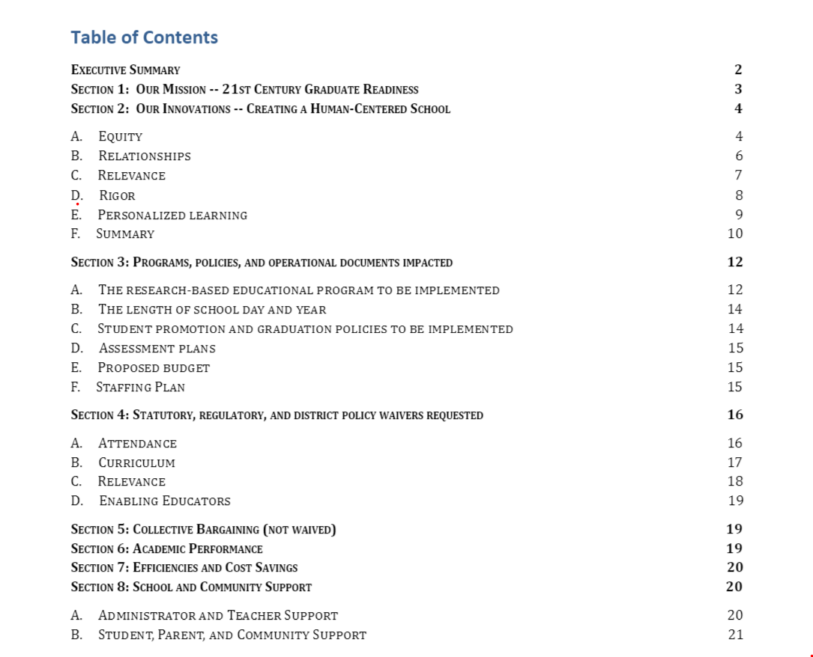
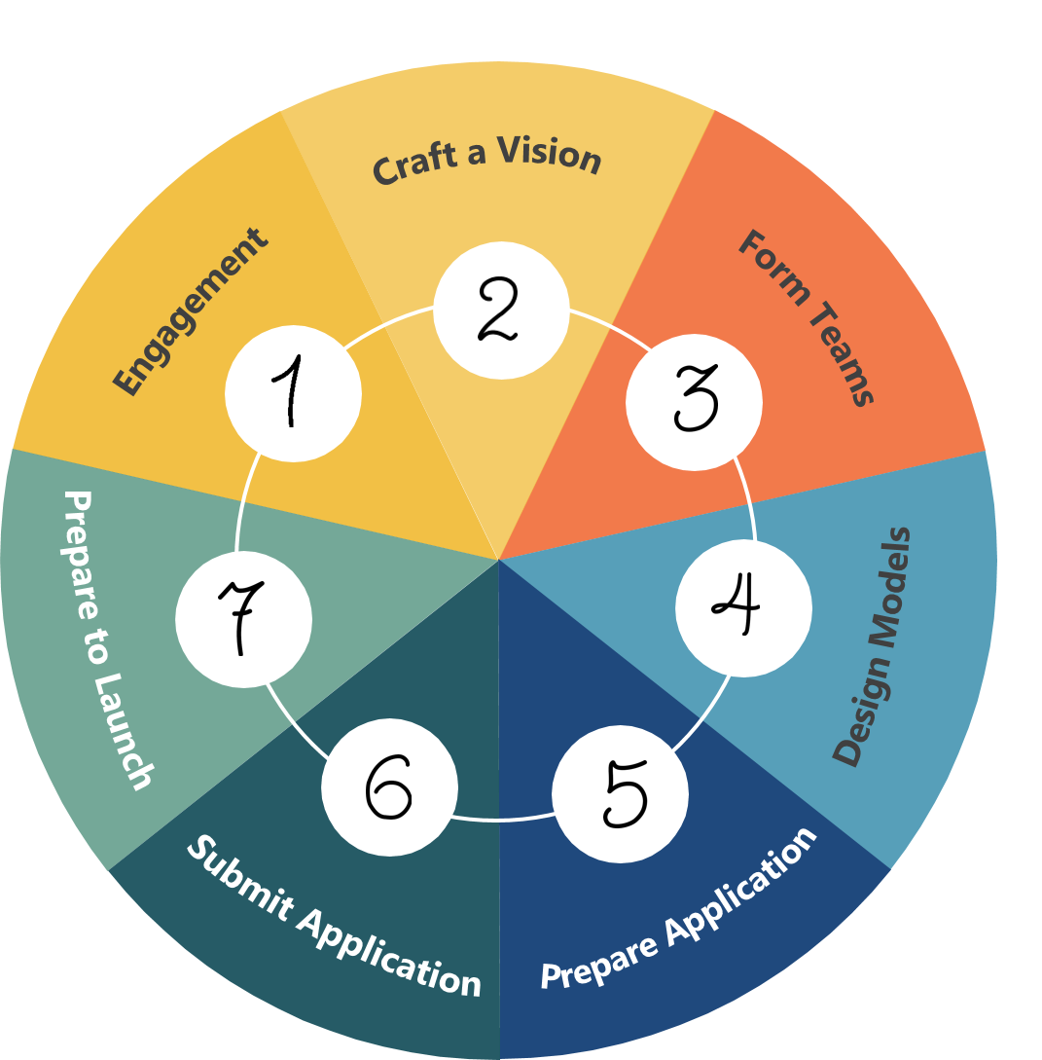
A Tulsa Public Schools Empowered Schools Act Zone Application
Thank you!

