Slide 1
Welcome to the Virtual Annual Diabetes Management Training. We are excited to be offering you this training. Remember this is for the school personnel that have previously attended an in-person diabetes management training only. If you have not completed an in-person training within the last 12 months, then please exit this training now, and contact the Oklahoma State Department of Education's Office of Instruction and Curriculum.
Oklahoma State Department of Education
2500 N Lincoln Blvd.
Oklahoma City, OK 73105

Slide 2
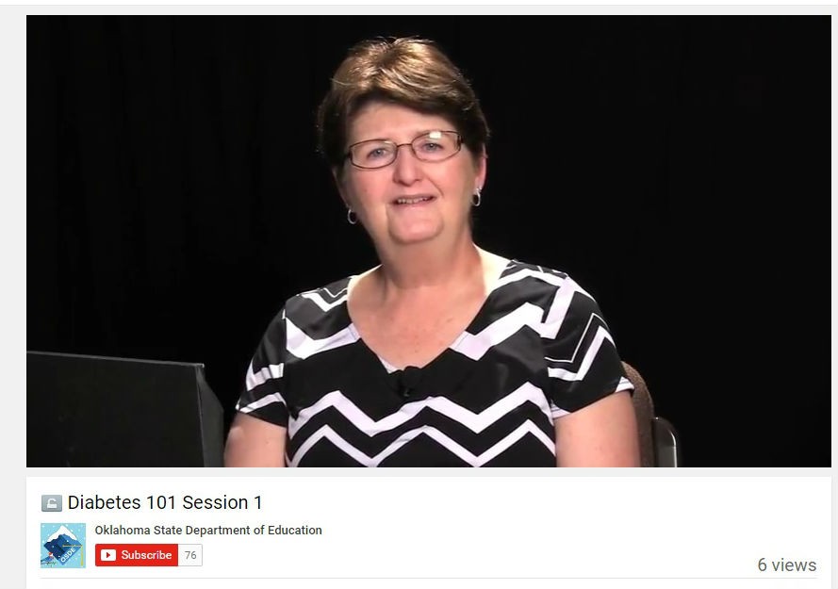
Each session consists of a short training video and a quiz that accompanies it. All enrolled participants must watch the training video before attempting the quiz. In order to successfully complete each session, a passing score of at least 80% is required on each quiz.
Oklahoma State Department of Education
2500 N Lincoln Blvd.
Oklahoma City, OK 73105

Slide 3
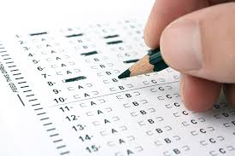
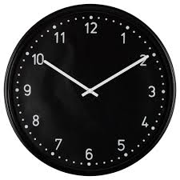
Failure to score at least 80% on a quiz attempt will require a 15-minute timeout before another attempt can be made. During the 15-minute timeout, attendees are highly encouraged to re-watch the training video and review any notes that may be helpful.
Oklahoma State Department of Education
2500 N Lincoln Blvd.
Oklahoma City, OK 73105

Slide 4
BE AWARE that only two quiz attempts can be made per session. The quiz will no longer be accessible after two failed attempts.
Oklahoma State Department of Education
2500 N Lincoln Blvd.
Oklahoma City, OK 73105

Slide 5
To access a quiz, an enrollment key is required.
Oklahoma State Department of Education
2500 N Lincoln Blvd.
Oklahoma City, OK 73105

Slide 6
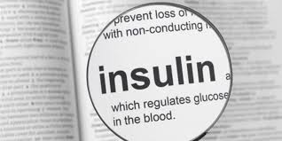
The enrollment key for session one is:
INSULIN
(NOTE: ENROLLMENT KEYS WILL ALWAYS BE IN ALL CAPS)
Oklahoma State Department of Education
2500 N Lincoln Blvd.
Oklahoma City, OK 73105

Slide 7
After successfully passing each quiz a new enrollment key will be provided along with a message confirming that you have passed the section.
(Example Message)
Congrats, You Have Passed Section 1. Please Watch The Next Video And Complete The Quiz For Section 2. The Enrollment Key For Section 2 quiz is: DIABETES.
Oklahoma State Department of Education
2500 N Lincoln Blvd.
Oklahoma City, OK 73105

Slide 8
In addition to the enrollment key, a link to the next training video will be provided as well.
Virtual Annual Diabetes Management Training Video #1
Oklahoma State Department of Education
2500 N Lincoln Blvd.
Oklahoma City, OK 73105

Slide 9
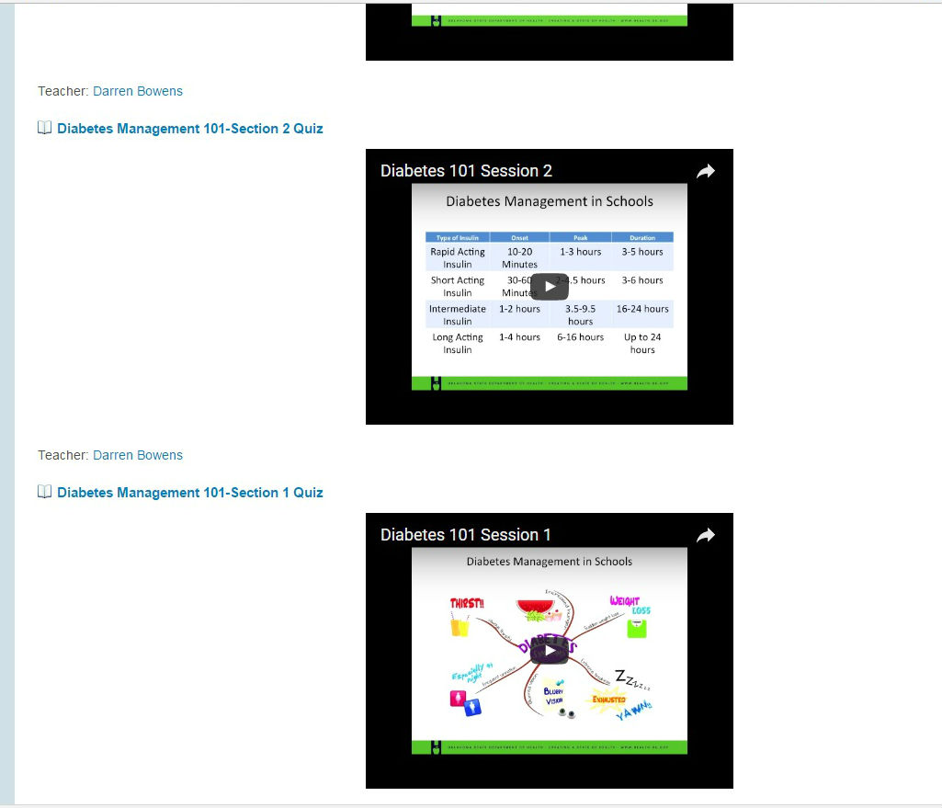
Participants may either access the next video by following that link, or by simply clicking on the next corresponding video that is housed on the course homepage.
Oklahoma State Department of Education
2500 N Lincoln Blvd.
Oklahoma City, OK 73105

Slide 10
After successfully completing all seven sessions, an enrollment key will be provided for session eight.
Oklahoma State Department of Education
2500 N Lincoln Blvd.
Oklahoma City, OK 73105

Slide 11
Session eight is not an actual class, but it will house the course certificate of completion.
Oklahoma State Department of Education
2500 N Lincoln Blvd.
Oklahoma City, OK 73105

Slide 12
After entering the enrollment key for session eight, follow the link to retrieve your course certificate of completion. Session eight will also house a link to access a course evaluation.
Oklahoma State Department of Education
2500 N Lincoln Blvd.
Oklahoma City, OK 73105

Slide 13
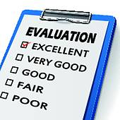
Follow the link to complete the course evaluation. The course evaluation provides valuable feedback that will be used to make this training even more successful and user friendly in the future.
Oklahoma State Department of Education
2500 N Lincoln Blvd.
Oklahoma City, OK 73105

Slide 14
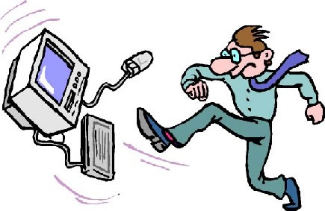
If at any moment during the Virtual Annual Diabetes Management Training you experience technical issues or require assistance navigating the training, please contact Savannah Owen, Director of Health and Physical Education, Oklahoma State Department of Education by emailing savannah.owen@sde.ok.gov
Oklahoma State Department of Education
2500 N Lincoln Blvd.
Oklahoma City, OK 73105

Slide 15
Every effort will be made to respond to your request for help within one business day.
Oklahoma State Department of Education
2500 N Lincoln Blvd.
Oklahoma City, OK 73105

Slide 16
You are now ready to begin the Virtual Annual Diabetes Management Training. Remember that the enrollment key for the session one quiz is “INSULIN.” Good luck and enjoy the training. To view the first training video click here
Oklahoma State Department of Education
2500 N Lincoln Blvd.
Oklahoma City, OK 73105

