Slide 1
Oklahoma Academic Standards
Steering Committee Meeting
May 19, 2015
Stakeholder Input
May 2015

Slide 2
Stakeholder Groups
Feedback
PTA and other Parent Organizations
Teacher Organizations
Administrator Organizations
State Board of Career Technology
State Regents for Higher Education
State Board of Education
Tribal Councils
State Chamber
OBEC
Legislators
Governor’s Office

Slide 3
English Language Arts Survey
614 Responses

Slide 4
Mathematics Survey
1172 Responses
Thank you for taking the time to give us your input as we start the process of creating Oklahoma's new Math Standards. Each survey is about 25 questions. There is a space to comment after each group of standards and there is also be a place for general comments at the end of the survey. At the beginning of each survey there is a link to the PASS Objectives written in a vertical progression so that you can see how the skills build across the grade levels. The PASS objectives are a blend of content skills (a list of topics to teach) and Process Skills (ways of using and applying the mathematics). Responses
Choose the survey you would like to take. At the end of the survey, you will have the option to take additional grade level surveys or end the survey. Primary (PK-2) Math Standards Intermediate (3-5) Math Standards Middle Level (5-8) Math Standards HS Algebra I and II HS Geometry

Slide 5
Stakeholder Feedback
First Draft Review
June 3, 2015 – First Draft Survey
Available to Stakeholder Groups
Provided to the following for review:
State Regents for Higher Education,
State Board of Education,
State Board of Career and Technology Education
Oklahoma Department of Commerce

Slide 6
Stakeholder Feedback
Second Draft Review
Cox Convention Center
Tuesday, July 7, 2015
Computers Set –Up for
Survey Feedback on
Second Draft
Town Hall - 4- 5 p.m.
Wednesday, July 8, 2015
Overview and Question and Answer Sessions
8 a.m. & 10:45 a.m. Math Standards
2 p.m. & 3 p.m. English Language Arts

Slide 7
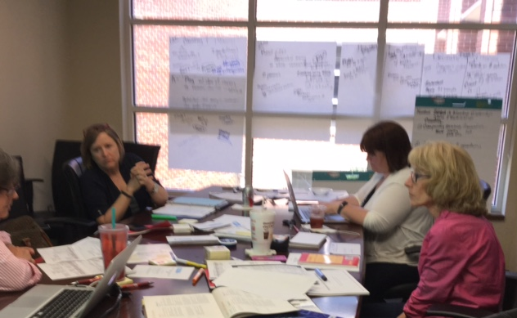
Standards Writing Math

Slide 8
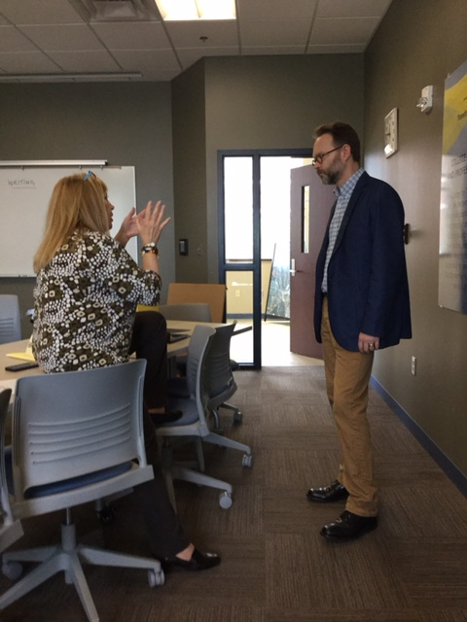
English Language Arts

