Slide 1
Creating a new Accountability System
Marianne Perie, University of Kansas
December 15, 2016

Slide 2
Task Force Meetings
Four between August and November
Involved ~95 stakeholders from around Oklahoma
Tasked with developing a system to meet both ESSA and Oklahoma statutes
Agreed on an approach, but many numbers are hypothetical
Need to see scale and cut scores for new grade 3–8 assessment
Waiting on contract award for nationally-recognized college readiness assessment
Accountability and assessment are quite intertwined.

Slide 3
Goals for Oklahoma Schools
We started the process articulating the goals for Oklahoma schools.
Focus on college and career readiness:
College and career ready means that students graduate from high school prepared to enter and succeed in postsecondary opportunities whether college or career.
Students should graduate high school ready for postsecondary success and need to demonstrate they are on-track towards that goal in grades 3–8.

Slide 4
Next Step: Indicators
What are the variables that should go into the accountability system?
Annual assessments
Graduation rates for high schools
Another statewide “academic” indicator for elementary and middle schools (e.g., growth or achievement gap)
English language proficiency for English learners
At least one additional statewide indicator of school quality or student success (e.g. school climate/safety, student engagement, educator engagement, postsecondary readiness)

Slide 5
Indicators
Elementary and Middle Schools
High Schools
ELA status
Math status
Science status
ELA growth
Math growth
ELPA progress
Chronic absenteeism
ELA status
Math status
Science status
Graduation rate
Postsecondary opportunities
ELPA progress
Chronic absenteeism

Slide 6
Student groups
ESSA does not require the 24 hurdles that NCLB did, but we do need to incorporate the performance of students in the various demographic groups.
New approach:
Assign students to only one demographic category for purposes of accountability.
Order categories by statistical relationship with achievement: economically disadvantaged, students with disabilities, English learners, black, Hispanic, Native American, other.
Each student only counts once per school for accountability purposes (unlike under NCLB), but their scores will be reported in every category they represent.
Minimum N (sample size) remains at 10 students per school

Slide 7
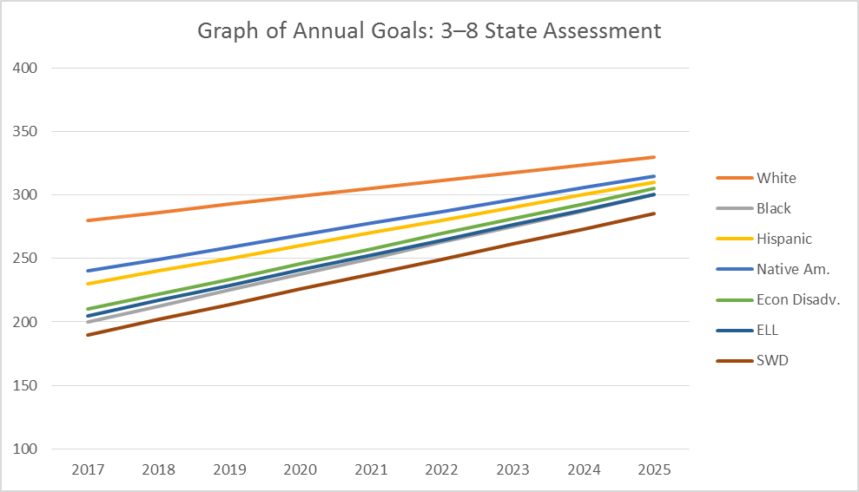
Sample Status measure for Grades 3–8
Proficiency Cut = 300
Combines status with gap closure
Assumed a scale of 100 – 400 with the “target” cut score set at 300.
Goals are set based on where the 60th percentile school scored on average (40% of schools at or above this point).
Goals increase by 6-13 points each year (depending on group), increasing more for lower performing groups to narrow achievement gap.

Slide 8
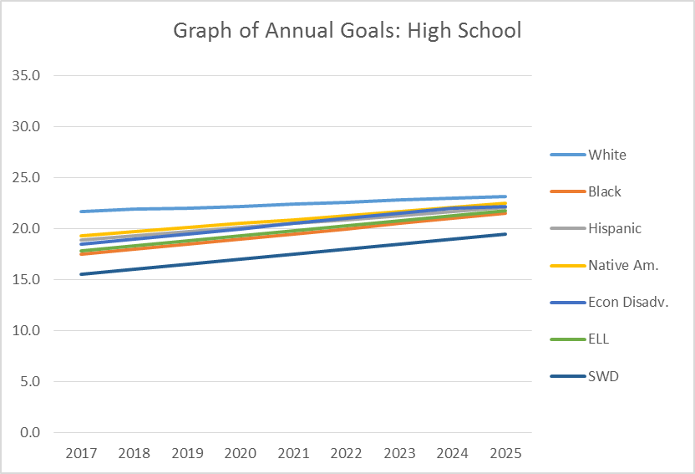
Sample Status measure for High School with Nationally recognized HS test
Same process combining status with gap reduction
Started with state averages from 2014.
22 is the college-ready goal for reading and math.
Goals increase by 2–5 points each year.
Goals must increase more for lower performing groups.

Slide 9
Implications of this approach
Questions
Answers
Doesn’t this reflect lower expectations for some groups?
Are we hiding the performance of black students by first separating out performance of economically-disadvantaged groups?
We start with meeting students where they are. Student groups who start at a lower level have to improve faster.
Socioeconomic status has a much higher correlation with achievement than race, so we want our focus there. The percent proficient statistic will be reported for all students in every category.

Slide 10
Growth: Value tables
One type of growth measure is value tables:
Based solely on performance categories, but performance categories can be split.
Each student earns a different amount of points depending on how their performance category changed from one year to the next.
Points are averaged across all students to give a score for the school or district.
Point values should reflect system goals.
Oklahoma values growth across the scale, not simply growth to proficiency

Slide 11
Sample Value Table (Actual points may change)
 |  | 2018
 |  | 1L | 1H | 2L | 2H | 3L | 3H | 4L | 4H
2017 | Level 1—Low | 0 | 120 | 160 | 185 | 200 | 200 | 200 | 200
 | Level 1—High | 0 | 90 | 130 | 150 | 195 | 200 | 200 | 200
 | Level 2—Low | 0 | 50 | 95 | 130 | 165 | 175 | 195 | 195
 | Level 2—High | 0 | 30 | 55 | 95 | 130 | 160 | 185 | 195
 | Level 3--Low | 0 | 0 | 30 | 80 | 100 | 130 | 150 | 175
 | Level 3—High | 0 | 0 | 0 | 30 | 70 | 105 | 135 | 160
 | Level 4—Low | 0 | 0 | 0 | 0 | 40 | 75 | 115 | 145
 | Level 4—High | 0 | 0 | 0 | 0 | 25 | 50 | 95 | 125
Level 1 = Unsatisfactory
Level 2 = Limited Knowledge
Level 3 = Proficient
Level 4 = Advanced
More emphasis is placed on the movement: Greater reward for positive growth, fewer points for negative growth.
The goal is 100 points, as that is the value for staying at a low Level 3.

Slide 12
Sample Value Table (Actual points may change)
 |  | 2018
 |  | 1L | 1H | 2L | 2H | 3L | 3H | 4L | 4H
2017 | Level 1—Low | 0 | 120 | 160 | 185 | 200 | 200 | 200 | 200
 | Level 1—High | 0 | 90 | 130 | 150 | 195 | 200 | 200 | 200
 | Level 2—Low | 0 | 50 | 95 | 130 | 165 | 175 | 195 | 195
 | Level 2—High | 0 | 30 | 55 | 95 | 130 | 160 | 185 | 195
 | Level 3--Low | 0 | 0 | 30 | 80 | 100 | 130 | 150 | 175
 | Level 3—High | 0 | 0 | 0 | 30 | 70 | 105 | 135 | 160
 | Level 4—Low | 0 | 0 | 0 | 0 | 40 | 75 | 115 | 145
 | Level 4—High | 0 | 0 | 0 | 0 | 25 | 50 | 95 | 125
Green numbers need to be re-examined. Criticized as too high.
More emphasis is placed on the movement: Greater reward for positive growth, fewer points for negative growth.
The goal is 100 points, as that is the value for staying at a low Level 3.

Slide 13
Implications about this Growth Model
Questions
Answers
How were these numbers determined?
Why should students get any credit for falling back?
Modeled from anther state and will be tailored to Oklahoma.
The goal is 100. A student moving from a high level 3 to a low level 3 receiving zero points seems harsh. Particularly when it may mean moving from a 320 in one grade to a 318 in the next.

Slide 14
ELPA Progress
Make long-term goal that all students should achieve English proficiency within 5 years of entering school. For students currently in system:
Level 1 student has 5 years to exit.
Level 2 student has 4 years to exit
Level 3 student has 3 years to exit
Level 4 student has 2 years to exit
Determine current proficiency levels and set goals for each student to be proficient in five years
Use interim benchmarks to measure progress. Students will enter accountability system when they have two years of data.

Slide 15
Growth to Target 5-years
TIMELINE
Level 1.0 – 5 years
Level 2.0 – 4 years
Level 3.0 – 3 years
Level 4.0 – 2 years
Exit Level 5.0

Slide 16
Implications for Schools with ELLs
Questions
Answers
Does this mean that English language learners have to test their first year in school?
Does this include all students in grades K–12?
ELLs will test the first year only to provide a baseline. Their scores will not be used for accountability. Second year, their ELPA scores will count, and their ELA and math growth scores will count. Third year, growth and proficiency will count.
This indicator will be for all ELLs. A K–5 school will include grades

Slide 17
Other Indicators
Elementary/Middle
High School
Chronic absenteeism
Typically defined as missing 15+ days a year or 10% or more of school days.
OSDE has chosen to use the metric of 10% of school days, which is 18 days per year.
(No growth measure until a cohort of students has taken the new 8th grade test in 2017 and the HS test in 2020.)
Chronic absenteeism
Graduation rate (4 yr/5 yr/6 yr)
Participation in AP/IB/dual (concurrent) enrollment/internship/apprenticeship/ industry certification

Slide 18
Chronic Absenteeism
Indicator focuses on issue of a single student missing multiple days rather than multiple students missing a single day.
Follows research:
Students who are chronically absent in sixth grade are much less likely to graduate high school on time, if at all
Chronic absence in kindergarten is associated with lower academic performance in first grade.
In California, only 17 percent of the students who were chronically absent in both kindergarten and 1st grade were reading proficiently by 3rd grade, compared with 64 percent of those with good attendance in the early years

Slide 19
High School Graduation Rate
The graduation rate will focus on 4-year graduation using the current formula.
Then, the percentage of students who graduated in 5 years will be calculated, multiplied by 0.85 and added to the 4-year percentage.
We do not want schools to give up on students who do not graduate in 4-years
The percentage of students who graduated in 6 years will be calculated, multiplied by 0.50 and added in.
OSDE will monitor the 6-year graduation rate to ensure it is not creating perverse incentives.
Later graduation is often associated with an IEP, and we do not want to penalize schools for providing students with disabilities the extra instructional time needed and allowed.

Slide 20
Postsecondary Participation
For the first year, the focus on post-secondary activities will be on participation. Schools will receive credit for the percentage of their students enrolling and completing the following activities:
AP courses
IB program
Dual enrollment
Career-based internship or apprenticeship
Industry certification
As programs become more available to students, the goal will shift from participation to successful outcomes. (E.g., move from rewarding enrollment in an AP course to rewarding the receipt of a 3 or higher on the AP test.)

Slide 21
Bringing it all together into a summative judgment
The indicators were given weights by the Task Force. The weights summed to 90 points for schools with at least 30 English learners and to 75 points for schools with fewer than 30.
A rubric was created to spread most schools in the B, C, and D grades, with fewer schools in A or F. Assuming strong rigor in assessments and proficient cut score.
The approach is similar to what a teacher does with a grade book, as assignments are worth different points, and rubrics are created to ensure an appropriate spread of grades.
As a majority of schools improve to As and Bs, the rubric will be adjusted to highlight the greatest success.

Slide 22
Sample Elementary or Secondary Table
No. | Indicator | Points possible | Points earned | Percentage | Weight | Total
1a. | ELA status (with progress targets) | # students with ELA score | # students meeting goal | 0.65 | 15 | 9.75
1b. | Math status (with progress targets) | # students with math score | # students meeting goal | 0.59 | 15 | 8.85
1c. | Science status (with progress targets) | # students with science score | # students meeting goal | 0.62 | 5 | 3.10
2a. | ELA growth | Highest value on table | Value table average | 0.67 | 15 | 10.05
2b. | Math growth | Highest value on table | Value table average | 0.71 | 15 | 10.65
3. | ELPA progress | # of ELLs in US for more than one year | # of ELLs meeting goal | 0.68 | 15 | 10.20
4. | Chronic Absenteeism | #students enrolled | #students NOT missing 18+ days of school | 0.96 | 10 | 9.60
With ELL Without ELL
A > 70 > 60
B 57–70.00 47–60.00
C 43–56.99 38–46.99
D 30–42.99 25–37.99
F < 30 < 25
or lowest 5% in achievement
Sum = 62.20 B

Slide 23
Sample High School Table
No. | Indicator | Points possible | Points earned | Percentage | Weight | Total
1a. | ELA status (with progress targets) | # students with ELA score | # students meeting goal | .55 | 15 | 8.25
1b. | Math status(with progress targets) | # students with math score | # students meeting goal | .42 | 15 | 6.30
1c. | Science status(with progress targets) | # students with science score | # students meeting goal | .52 | 15 | 7.80
2. | ELPA progress | # of ELLs in US for more than one year | # of ELLs meeting goal | .75 | 15 | 11.25
3. | Graduation rate | Use state graduation formula to determine percentage |  | .92 | 10 | 9.20
4. | Chronic Absenteeism | #students enrolled | #students NOT missing 18+ days of school | .96 | 10 | 9.60
5. | Postsecondary opportunity | 10% of enrollment | # enrolled in one program | .35 | 10 | 3.50
With ELL Without ELL
A > 70 > 60
B 57–70.00 47–60.00
C 43–56.99 38–46.99
D 30–42.99 25–37.99
F < 30 < 25
or lowest 5% in achievement or graduation rate <67%
Sum = 55.90 C

Slide 24
Implications of A–F System
Questions
Answers
Why 90 points?
With 20 points in the “A” category, is Oklahoma watering down the grading system?
After weighting all indicators, that’s what the total was. We could turn it into “percent of available points” but that adds another layer and reduces transparency.
The new assessments are expected to be much more rigorous, making the status and growth targets harder to reach. Rubric may be more lenient, but indicators are tougher.

Slide 25
Design Decisions
Base comprehensive support schools on those who are in the lowest category, lowest 5% on overall points, and/or graduation rate below 67%
Base targeted support schools on those with large achievement gaps (first year) and little change or increases in gaps (subsequent years)
Identify reward schools
Highest category schools
Top 5% in points
Must show some growth (accounting for ceiling affect)
No large achievement gaps/progress for all student groups
Graduation rate above 80%, no student group below 70%
Participation rate of 95% or higher

Slide 26
Exiting Targeted and Comprehensive Support Categories
More than just no longer in bottom 5%
Must show continued progress on multiple indicators
Must have plan for continued success

Slide 27
Reporting results: Dashboard approach
It is important for the public to see how schools did on all indicators in the accountability system and overall.
Grades will be given for each indicator and overall.
Schools could receive a “B” for multiple reasons. Public can distinguish between schools that are high achieving but not growing, or lower achieving but improving rapidly.
Additional indicators will be included such as per-student expenditures, performance on NAEP, professional qualification of educators, and participation rates in assessments.

Slide 28
Sample Report—Dashboard + Index

Slide 29
Changes to Sample report
Present number lines to show where on the continuum the school falls on each of the indicators
Include district and state comparison
Or possibly a peer school/group of schools
Online, reports should be dynamic, allowing users to dive deeper to see student group comparisons, data tables, graphs, and contextual information.

Slide 30
Example Alternate Graphic
Target = 85%
B+

Slide 31
Validation of A–F System
Once we have real data, the system will need to be validated. Analyses will include:
How often do schools with different rates of proficiency receive different grades? Why does this happen?
How close in performance are schools among the various grades? How influential is measurement error?
Do external stakeholders agree that schools in the A category are truly excelling and schools in the F category need additional supports?

Slide 32
Ongoing work
We need to wait until students have take new assessments in 2017 to determine baselines and create targets.
At that point, the calculations and weights will be reviewed to ensure the schools identified validly reflect the intention of the system.
Schools and districts are calculating growth using the value table and older data to examine whether the results match the intention.
Continuing to examine the influence of including a “percent proficient” indicator.
Work is ongoing to determine a parallel system for non-traditional schools.

