Slide 1
Oklahoma English Language Arts Standards Writing Team Progress Report
Dr. Matt Hollrah and Dr. Jennifer Watson
Co-Chairs, Oklahoma ELA Standards Writing Team
Oklahoma Standards Setting Steering Committee
May 19, 2015

Slide 2
Writing Team Timeline
Task | Tentative Dates
Goal: First Draft Process | Mid-April to June 12, 2015
Teams receive invitations, tentative schedule, preliminary resources | April 20-30, 2015
Full team face-to-face purpose-setting/planning meeting | May 4, 2015
First draft face-to-face writing sessions | May 14-15, 2015
Final first draft due | June 1, 2015
Review of First Draft First draft out to review entities and feedback to writing team | June 2-12, 2015
Goal: Second Draft Process
Writing teams incorporate reviews of first draft | June 12-June 19, 2015
Writing/Review team considers vertical alignment | June 22-July 1, 2015
Second draft review days @ Engage Oklahoma | July 7-9, 2015
Close window for comments | July 14, 2015
Goal: Third Draft Process
Teams work to finalize the draft incorporating vertical alignment and second draft review comments in preparation for town halls | July 15 – August 1, 2015
Goal: Final Draft
Incorporate additional feedback into final draft | Completed by October 1, 2015

Slide 3
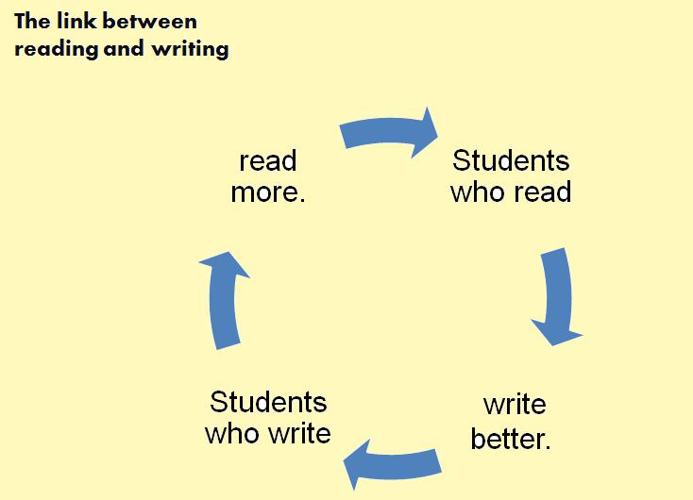
New Standards: Focus and Organization
Each standard addresses both reading and writing.
8 Overarching Standards
These 8 standards appear from PreK – 12.
Individual grade progressions are being developed.

Slide 4
1. Speaking and Listening
Reading
(Consuming Discourse & Texts)
Writing
(Producing Discourse & Texts)
DRAFT
Students will engage in discourse in pairs, small groups, and class discussion to acquire and refine knowledge.
Students will engage in discourse and collaborate in pairs, small groups, and class discussion to create individual and group projects and presentations.

Slide 5
2. Reading Process/Writing Process
Reading
Writing
Students will read and comprehend increasingly complex literary and informational texts—both classic and modern—from a variety of historical and cultural perspectives.
Students will develop and strengthen writing, using the writing process--prewriting, drafting, revising, editing, and publishing.
DRAFT

Slide 6
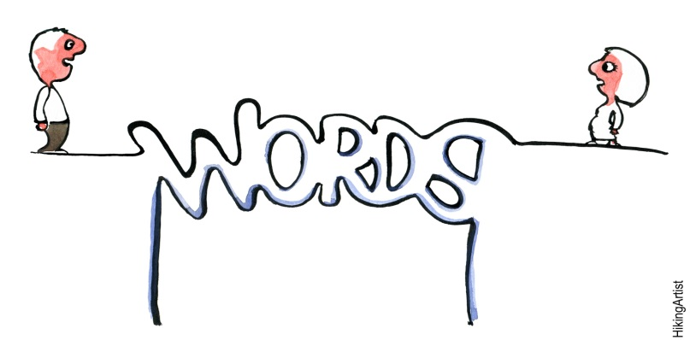
3. Vocabulary
Reading
Writing
Students will expand vocabulary through word study, reading, and class discussion.
Students will apply knowledge of word origins and communicate through domain appropriate abstract and concrete words.
DRAFT

Slide 7
4. Critical Reading/Critical Writing
Reading
Writing
Students will comprehend, interpret, evaluate, appreciate, and respond to a variety of complex fiction and nonfiction texts from a variety of historical, cultural, and global perspectives, including texts from the traditional canon and modern works of all genres.
Students will write for varied purposes and audiences in all modes, using fully developed ideas, strong organization, well-chosen words, fluent sentences, and insightful voice.
DRAFT

Slide 8
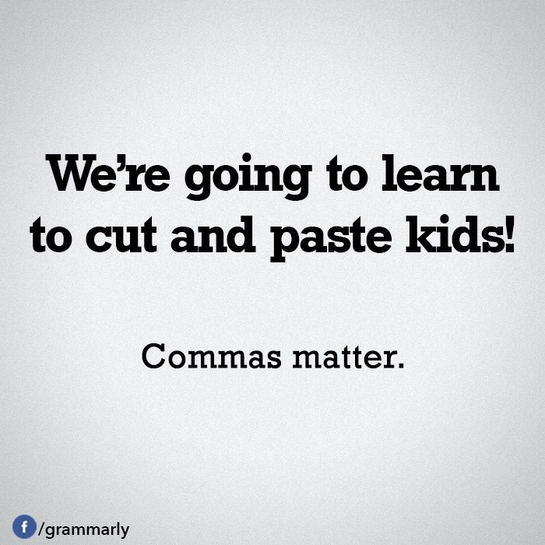
5. Language
Reading
Writing
Students will apply knowledge of grammar and rhetorical style to analyze and evaluate a variety of texts.
Students will demonstrate command of Standard English, grammar, mechanics, and usage through writing and other modes of communication.
DRAFT

Slide 9
6. Research
Reading
Writing
DRAFT
Students will comprehend, evaluate, and synthesize resources to acquire and refine knowledge.
Students will integrate evidence, summarize and paraphrase, and cite sources to create projects and presentations for multiple purposes.

Slide 10
7. Multiple Literacies
Reading
Writing
DRAFT
Students will evaluate and analyze written, oral, visual, digital, and non-verbal texts in order to draw conclusions and defend arguments.
Students will create multimedia texts (including non-print and digital) to communicate knowledge and defend arguments.

Slide 11
8. Independent Reading/ Independent Writing
Reading
Writing
DRAFT
Students will read independently for pleasure and information for extended periods of time. Students will select appropriate texts for specific purposes.
Students will write independently for pleasure and information for extended periods of time. Students will vary their modes of expression to suit audience and task.

Slide 12
Questions and Comments

