Slide 1
Oklahoma Mathematics Writing Team 2015
Notes:
SR

Slide 2
Imagine a classroom, a school, or a school district where all students have access to high-quality, engaging mathematics instruction.
- NCTM, 2000
Notes:
SR

Slide 3
Goal
Develop exemplary mathematics standards for Oklahoma students that prepare them to be college and career ready.

Slide 4
Oklahoma Mathematics Standards Writing Team
University of Oklahoma
Norman Public School
Stillwater Public Schools
Union Public Schools
University of Central Oklahoma
Retired Educator
Jenks Public Schools
Moore Public Schools
K20 Center
Oklahoma State University
Union Public Schools
Tuttle Public Schools
Retired Educator
University of Central Oklahoma
Collinsville Public Schools
El Reno Public Schools
Piedmont Public Schools
University of Central Oklahoma
Oklahoma SDE
Oklahoma SDE
Dr. Stacy Reeder
Stacey Weinand
Dee Atkins
Paige Bergin
Dr. Darlinda Cassel
Sara Snodgrass
George Abshire
Andrea Brock
Nicole Shobert
Dr. Juliana Utley
Shannon Bittle
Shari Gierhart
Linda Hall
Dr. Carol Lucas
Toni Slagle
Julie Owens
Dr. Courtney Lockridge
Dr. Alana McAnally
Jennifer Lamb
Levi Patrick
Notes:
Represents 5 faculty from higher education, 7 classroom teachers, 2 retired educators, 1 K20 Center, 3 district curriculum coordinators, and 2 Oklahoma State Department of Education

Slide 5
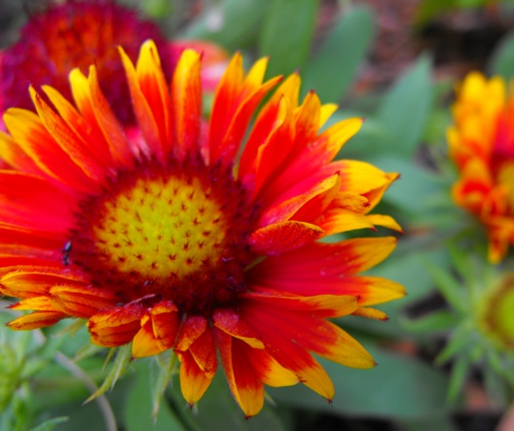
Tentative Timeline
Mathematics Writing Team
Notes:
SR

Slide 6
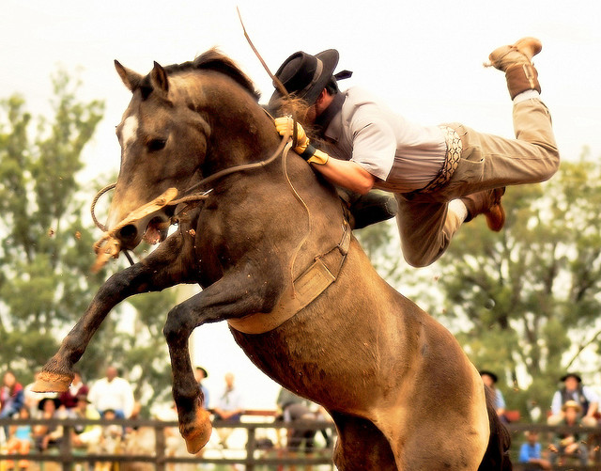
Hang on! This is going to be a wild Ride!
Task | Tentative Dates
Goal: First Draft Process | Mid-April to May 31, 2015
Teams receive resources and initial directions to begin work | April 27, 2015
Face-to-face meeting | May 1-2, 2015
Final first draft due | May 29, 2015
Review of First Draft First draft out to review entities and feedback to writing team | June 1-21, 2015
Goal: Second Draft Process
Writing teams incorporate reviews of first draft | June 22-July 1, 2015
Sub-team of writers will be formed to consider vertical alignment | June 22-July 1, 2015
Second draft review day @ Engage Oklahoma | July 7, 2015
Close window for comments | July 14, 2015
Goal: Third Draft Process
Teams work to finalize the draft incorporating vertical alignment and second draft review comments | July 20 – August 1, 2015
Goal: Final Draft
Final draft from writing team submitted to OSRHE and SDE | August 1, 2015
Notes:
Our goal is to have the content and process skills ready to submit to the steering committee (?) in a 1st draft by June 1st.
In June, we will get feedback from the Review Committees and work on the PK-12 progressions to ensure vertical alignment.
The 2nd draft will be ready for public viewing on July 7th.

Slide 7
Writing team was selected and approved in late April.
May 1st & 2nd – Team meeting to share goals and set guidelines for the revision process held at OU.
There was a need to add an additional person to the 9-12 team to address Geometry expertise.
May 11th – Rough draft of the revised process skills completed and shared with the entire writing team for feedback.
May 16th – Grade band 9-12 met at UCO. Developed rough draft of Algebra I, Geometry, and Algebra II standards
Grade band 5-8 has been meeting virtually using GoToMeetings and has rough draft of strands for Number and Operations, Geometry and Measurement, and Algebra.
May 26th & 27th – Grade band pk- 4 plans to meet at UCO to finalize their rough draft.
Deadline for 1st draft is due to co Chairs by May 28th.
Mathematics Standards Writing Team
Where are we now?

Slide 8
Rough Draft – Process skills
PASS Process Skills (NCTM, 1989)
Mathematical Actions and Processes: Oklahoma’s MAP to College and Career Readiness in Mathematics
Problem Solving
Communication
Reasoning
Connections
Representation
Develop a Deep and Flexible Understanding
Develop Accurate and Appropriate Procedural Fluency
Develop Strategies for Solving Diverse Problems
Develop Mathematical Reasoning
Develop a Productive Mathematical Disposition
Develop the Ability to Make Conjectures and Generalize
Develop the Ability to Communicate Mathematically
Notes:
The MAPs were developed based on the converstation

Slide 9
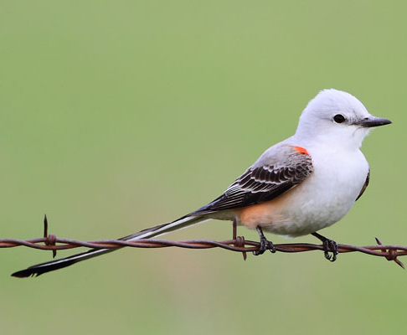
Sample - Rough Draft Of Content Skills
5th Grade Number and Operations
5.N.1 Read, write, represent and compare fractions and decimals; recognize and write equivalent fractions; convert between fractions and decimals; use fractions and decimals in real-world and mathematical situations.
5.N.1.1 Represent decimal fractions (e.g. 1/10, 1/100) using a variety of models and make connections between fractions and decimals.
5.N.1.2 Model, read and write decimals using place value to describe decimal numbers from at least millions to thousandths.
5.N.1.3 Find 0.1 more than a number and 0.1 less than a number. Find 0.01 more than a number and 0.01 less than a number. Find 0.001 more than a number and 0.001 less than a number.
5.N.1.4 Compare and order fractions and decimals, including mixed numbers and improper fractions, and locate on a
number line.
5.N.1.5 Recognize and generate equivalent decimals, fractions, mixed numbers and improper fractions in various contexts.

Slide 10
Discussion and Questions

